Slide 1

DSP Training and Competencies Webinar
Presented by the Office of Provider Development
Notes:
Welcome to the DSP Training and Competencies Webinar Presented by the DBHDS Office of Provider Development.
The purpose of this training is share widely the expectations for DSP Orientation Training and Competencies with affected stakeholders.
This webinar will be recorded to be posted on the DBHDS Provider Development webpage.

Slide 2

What is the biggest hurdle to meeting competency requirements?
Notes:
This is going to be a little more interactive of a webinar than what some of you may be used to, so we ask that you participate as much as you feel comfortable. We’ll be launching a poll here in a moment, then have some elements where we’re going to ask for responses in chat with a chance for Q and A at the end, so we appreciate your participation.
Let’s start with a poll question:
(Launch poll question in Zoom)
What is the biggest hurdle to meeting competency requirements?
Options:
Not understanding why it is necessary.
The time to observe staff.
Completing the requirements in the 180 day window.
Not sure of the difference between competent and proficient.
Staff turnover.
Other.
(Review poll results)

Slide 3



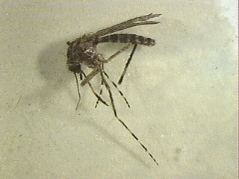
Friends and Family Picnic
Imagine you have contracted a new disease from a mosquito bite.
The bite causes a rash and then 2 weeks of paralysis.
During the paralysis you will need personal care for everything.
You have contacted my organization to provide your care, we are on the phone reviewing what is important for you…
Notes:
Those of you who have taken Person Centered Thinking in the past, may recognize this scenario. For those of you who have not yet taken Person Centered Thinking, you can find a schedule of classes and registration information at personcenteredpractices.org.
Take a minute and imagine that you have just been to the “Friends & Family Picnic” and have been bitten by a mosquito”. The bite causes a rash and then 2 weeks of paralysis.
During the paralysis you will need personal care for everything.
Paralysis has set in, and the person who will provide your care arrives.
They seem nice, but have never supported a person who needed the type of support you do before.
They don’t understand the amount of support you need so they try to do everything for you.
They don’t seem concerned with the things that are important to you to be happy.
They pick out your clothes for you without asking what you want to wear.
They don’t like to cook, so they get fast food every day, which is contrary to your low sodium diet for your blood pressure, not to mention you don’t like fast food.
They only record your BP when they remember to, not every day like your doctor ordered.
When it is time to support you to reposition, they just lift you up without telling you what’s happening. When you pushed them away when they just grabbed you because you were startled, and they start complaining that you’re “violent.” They don’t understand that was your way of communicating to them you need them to explain what they are doing when they are supporting you.
They have never administered medication before, so you’ve missed some doses and some you’ve not been able to take at the right time.
They keep the door open when they are supporting you in the bathroom and when you are getting dressed in your bedroom.
They don’t get your wheelchair fixed when a brake stops working on one wheel.
When they take you places, they talk for you and about you like you aren’t there.
They’ve referred to you as “crippled” on several occasions.
You want to see your friends, but you only go to places where there are other people have become paralyzed as well from a mosquito bite.
How do you feel about the supports you’re receiving?
Respond in chat. (Read a few responses out loud.)
What if the paralysis lasted indefinitely?

Slide 4

Would you want this person to support you?
Did they?
Demonstrate person-centered skills, values, and attitudes?
Understand and follow service requirements?
Demonstrate abilities that improve or maintain the health
and wellness of those they support?
If we have competent staff, we can better assure the people we support have quality support to live good lives.
Notes:
Would you want this person to support you? You can respond in chat. (read a few responses)
Do you feel like you deserve better?
Do you feel like your partner, parent, or child would deserve better? (read a few responses)
Of course! Because you would want someone who is competent to support you or your loved one!
(animated) Did this person:
Demonstrate person-centered skills, values, and attitudes?
Understand and follow service requirements?
Demonstrate abilities that improve or maintain the health and wellness of those they support?
(We should see mostly “no” responses in chat.)
These are the 3 basic competencies. Everything this person did to support you in this scenario was contrary to these three basic expectations of DSPs.
(animated)
If we have competent staff, we can better assure the people we support have quality support to live good lives.
Yes, this is an extreme scenario, and hopefully no one person embodies the opposite of everything in the competencies, as the fictitious DSP in this example; however, these things do happen. Even well-meaning DSPs make these mistakes, solely because they were never trained otherwise.
Story:
Gentleman I used to support who was in rehab facility after a hospitalization, and the nurses came in while I was visiting, proceeding to pull his covers off him, lifting him, and attempting to change his depends while I was in the room. Not even saying a word to him– they didn’t even greet him by name. I had to speak up to stop them because my friend didn’t speak up (I assume because this wasn’t the first time they did this to him). I ended up filing a complaint with VDH.
If DSPs are trained from the beginning that this is unacceptable, we can better assure people will be treated with dignity and respect.

Slide 5

Why is it important to have competent DSPs?
The people we support deserve it.
It is the right thing to do.
Competent staff is the minimal standard.
Reduces risk and liability.
Required by DD Waiver regulations.
Required by Virginia’s Settlement Agreement.
Notes:
Why is it important to have competent DSPs?
(animated)
The people we support deserve it.
It is the right thing to do.
Competent staff is the minimal standard.
Reduces risk and liability.
Required by DD Waiver regulations.
Required by Virginia’s Settlement Agreement.

Slide 6
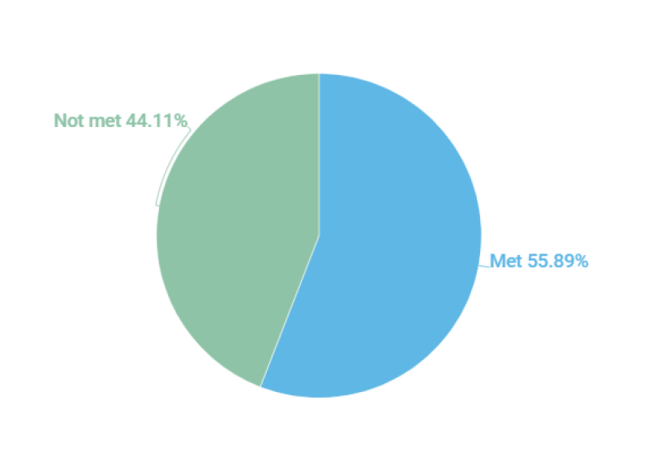
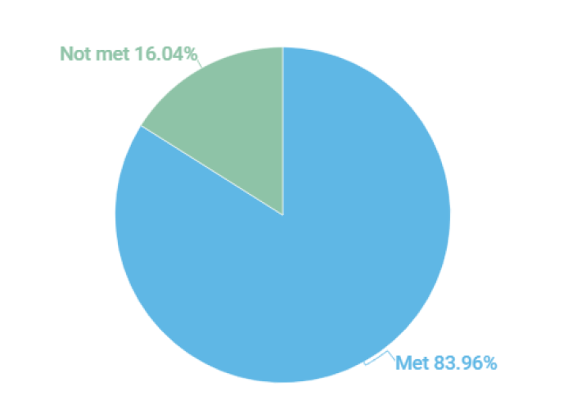
Progress with meeting expectations
At least 95% of DSPs and their supervisors receive training and competency testing per DMAS regulation 12VAC30-122-180. V.H.1.4
83.6% for FY19 - provider agency staff meeting provider orientation training requirements
55.89% for FY19 - provider agency DSPs meeting competency training requirements
Notes:
Virginia’s Settlement Agreement requires that at least 95% of DSPs and their supervisors receive training and competency testing per DMAS regulations. This training is part of a Quality Improvement Initiative to improve these results. As seen here, as a system we only achieved a success at 83.6% with provider training and 55.89% with DSP competencies in FY19. We need to reach 95% in order to be compliant with Settlement Agreement requirements.
We hope this webinar will better help you to understand the requirements and timeframes in order to help you to stay compliant with DSP Orientation training and competencies.

Slide 7
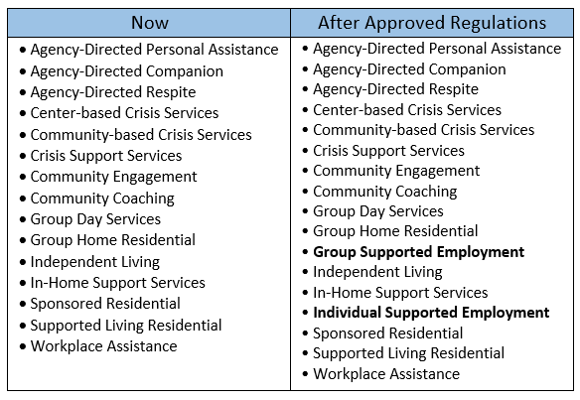
Who needs to meet DSP Orientation Testing Requirements?
Notes:
Agencies providing direct support to individuals on the Developmental Disabilities' waivers are required to complete the DSP Orientation training. Upon the approval of final DD Waiver Regulations, this will include both non-DBHDS licensed providers (such as Home Care Organizations licensed by the Virginia Department of Health and Employment Services Organizations under the Department of Aging and Rehabilitative Services) in addition to DBHDS-licensed providers.
Any agency employee, regardless of credentials, who provides Medicaid Waiver reimbursable support, must complete the DBHDS DSP Orientation process. This process also applies to supervisors who oversee the work of DSPs. Providers may elect to employ agency trainers in delivering training content to DSPs and their supervisors, which is acceptable, but the use of a trainer does not supplant conversations between DSPs and supervisors about the content of the training or the application of that content within the provider setting.
This process does not apply to professional staff who provide consultative or specialized medical and behavioral support, such as Therapeutic Consultation, Skilled Nursing, and Private Duty Nursing. Providers of Individual and Group Supported Employment services were previously excluded due to operating within organizations that met Commission on Accreditation of Rehabilitation Facilities (CARF) standards. Upon approval Employment Service Organizations are now required to complete orientation training, testing, and to observe and document basic competencies. In addition, DMAS enrolled Home Care Organizations licensed by the Virginia Department of Health who are providing Personal Assistance, Respite, and Companion under any DD Waiver must implement the process of observing and documenting competencies as described in this protocol in addition to completing the training and testing requirements.
This chart delineates which services currently must meet DSP Orientation Testing requirements and those that will have to meet these requirements once final DD Waiver regulations are approved. Note that Group and Individual Supported Employment must meet these requirements after the regulations are approved.

Slide 8
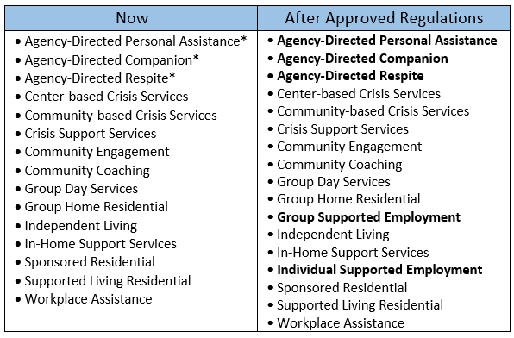
Who needs to meet Basic Competencies Requirements?
*Until the approval of new regulations, only Agency-Directed Services licensed by DBHDS must currently meet competency requirements.
Notes:
This chart delineates which services currently must meet Basic Competency requirements and those that will have to meet these requirements once final DD Waiver regulations are approved. Note the addition that all Agency Directed Personal Assistance, Companion, and Respite providers, as well as Group and Individual Supported Employment must meet these requirements after the regulations are approved.

Slide 9
Who is considered a DSP?
Direct Support Professional (DSP) is defined under the DD waivers as:
"Direct support professional," "direct care staff," or "DSP" means staff members identified by the provider as having the primary role of assisting an individual on a day-to-day basis with routine personal care needs, social support, and physical assistance in a wide range of daily living activities so that the individual can lead a self-directed life in his own community. This term shall exclude consumer-directed staff and services facilitation providers.
Notes:
Direct Support Professional (DSP) is defined under the DD waivers as:
"Direct support professional," "direct care staff," or "DSP" means staff members identified by the provider as having the primary role of assisting an individual on a day-to-day basis with routine personal care needs, social support, and physical assistance in a wide range of daily living activities so that the individual can lead a self-directed life in his own community. This term shall exclude consumer-directed staff and services facilitation providers.

Slide 10

Why is DSP Orientation training required for DSPs and Supervisors?*
So people get quality services
To build skills and confidence
To enhance the supervisor-DSP relationship
Required before providing reimbursable services in the BI, FIS, and CL Waivers
Notes:
Why must DSPs and Supervisors participate in training?
So people get quality services
To build skills and confidence in providing supports to individuals with DD
To enhance the supervisor-DSP relationship
This is REQUIRED before providing reimbursable services in the Building Independence, Family and Individual Supports, and Community Living Waivers.
Any agency employee, regardless of credentials, who provides Medicaid Waiver reimbursable support as described in the DSP definition, must complete the DBHDS DSP Orientation process. This process also applies to supervisors who oversee the work of DSPs. Providers may elect to employ agency trainers in delivering training content to DSPs and their supervisors, which is acceptable, but the use of a trainer does not supplant conversations between DSPs and supervisors about the content of the training or the application of that content within the provider setting.

Slide 11

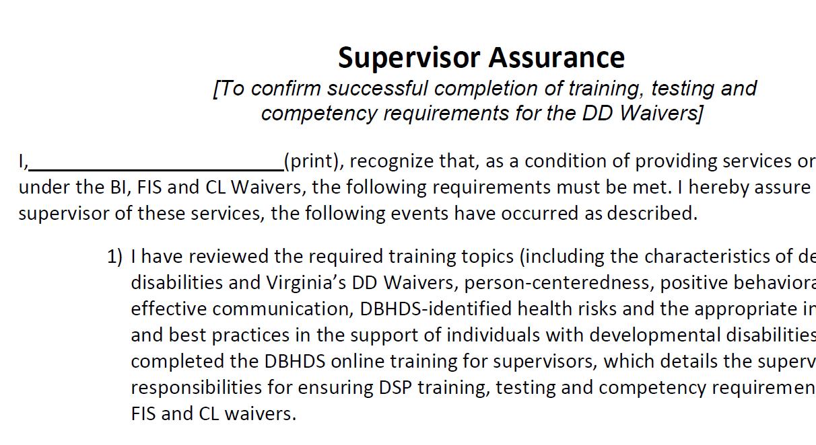
What are expectations of a supervisor?
• To obtain a certificate through the DBHDS Knowledge Center and pass the Orientation Manual test online (with a total score of 80% or better)
• To complete a Supervisor Assurance that verifies the completion of the supervisor’s training and confirms understanding of the requirements for training and ensuring the competencies of DSPs and themselves
Notes:
What are the supervisor’s responsibilities?
• To obtain a certificate through the DBHDS Knowledge Center and pass the Orientation Manual test online (with a total score of 80% or better)
• To complete a Supervisor Assurance that verifies the completion of the supervisor’s training and confirms understanding of the requirements for training and ensuring the competencies of DSPs

Slide 12
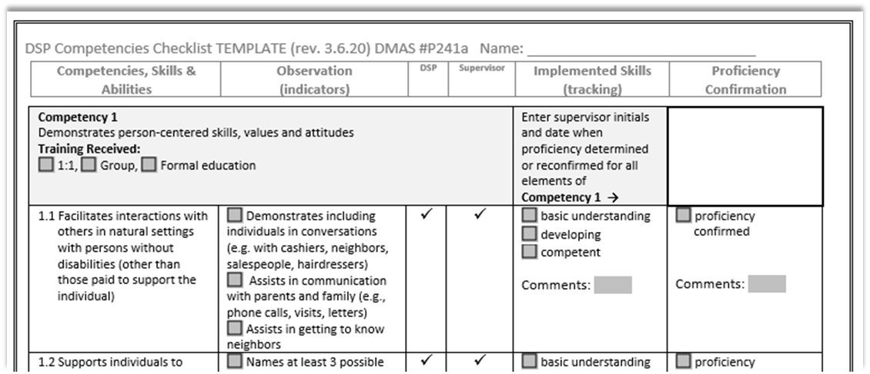
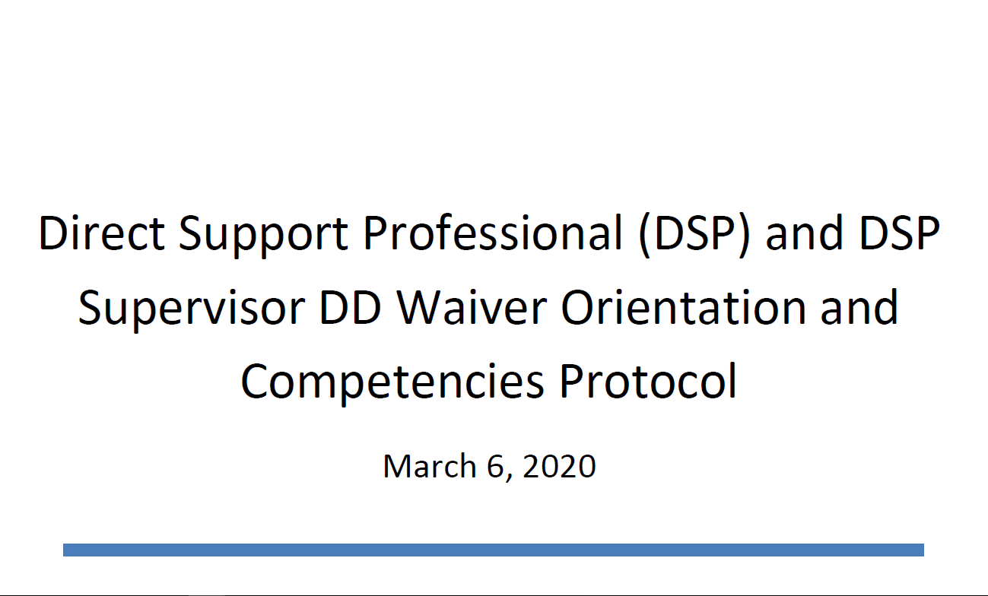
What are expectations of a supervisor?
• To have the agency Director or designee observe and document competence according to the instructions in the Direct Support Professional (DSP) and DSP Supervisor DD Waiver Orientation and Competencies Protocol dated March 6, 2020. http://www.dbhds.virginia.gov/developmental-services/provider-development
Notes:
And
• To have the agency Director or designee observe and document competence according to the instructions in the Direct Support Professional (DSP) and DSP Supervisor DD Waiver Orientation and Competencies Protocol dated March 6, 2020
Which you can find on the Provider Development webpage.

Slide 13
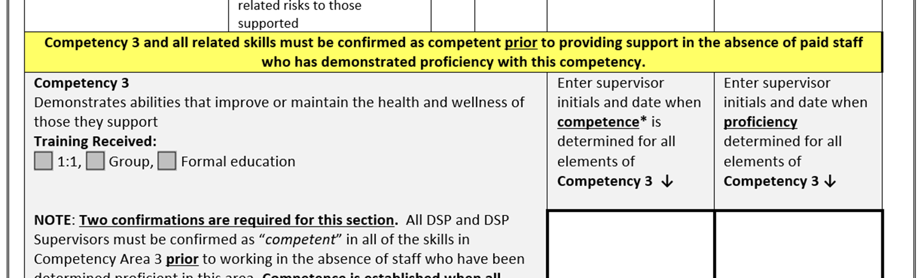
What are expectations of a supervisor?
• To ensure that each direct support professional providing services has:
Completed DSP Orientation training
Successfully passed the Orientation Manual test with at least 80% success.
Competence with health and safety related supports (Competency 3) observed and documented in the DSP and Supervisors Competencies Checklist for DSPs prior to providing these supports in the absence of paid staff who has demonstrated proficiency.
Notes:
Supervisors are also responsible: (animated)
• To ensure that each direct support professional providing services has completed training and successfully passed the Orientation Manual test. Training must be completed, the test passed, and competence with health and safety related supports observed and documented in the DSP and Supervisors Competencies Checklist for DSPs prior to providing these supports in the absence of paid staff who has demonstrated proficiency.
• To ensure that all DSPs pass the test before providing services, each DSP must achieve at least a total of 80% of the test items correct. The DSP may take and pass the chapter tests all at once or one at a time as the chapter content is presented
• To meet competencies as required by DBHDS and observe and document DSP demonstration of competence with health and safety supports before providing reimbursable supports and then proficiency with all competencies within 180 days of hire and reconfirmed at least annually

Slide 14
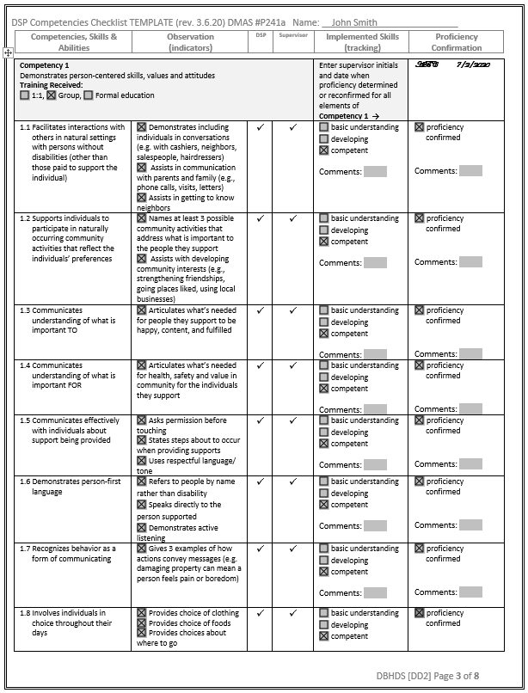

What are expectations of a supervisor?
• To ensure that each direct support professional, providing services is proficient with competencies within 180 day of hire
Notes:
What are the supervisor’s responsibilities?
• To ensure that each direct support professional, providing services is proficient with competencies as described in the March 6, 2020 Direct Support Professional (DSP) and DSP Supervisor DD Waiver Orientation and Competencies Protocol within 180 day of hire

Slide 15

Pending Regulation 12VAC30-122-180:
Pending regulation for Sponsored Residential Services:
“The date of hire can be the date that the sponsor begins providing service in the sponsored home setting.”
Notes:
Pending regulations for the 180 day requirement have been expanded to include a caveat for sponsored residential services:
12VAC30-122-180 B.4. Providers shall ensure that supervisors of DSPs complete the competencies checklist (DMAS Form P241a) for each DSP they supervise within 180 days of the DSP hire date and complete annual updates thereafter. For sponsored residential services, the date of hire can be the date that the sponsor begins providing service in the sponsored home setting.

Slide 16

Observation and Feedback
How to observe for competency:
Before observing, make a list of the actions you expect from the DSP.
Try not to be disruptive.
If needed, watch their work several times before making a judgement about the level of proficiency.
https://www.shrm.org/resourcesandtools/hr-topics/behavioral-competencies/pages/3-direct-ways-to-determine-competency-proficiency-in-hr-staff-candidates-yourself-.aspx
Notes:
As you observe your employees working, note behaviors and identify competencies that are exhibited. Using the indicators observed in the Competency Checklists, think about those displayed by the employees and record your thoughts.
Before observing, make a list of the actions you expect from the DSP. Try not to be disruptive. If you are commonly in the work area, observation without disruption will be easier. If not, you may want to watch their work several times before making a judgment about the level of proficiency.

Slide 17

Observation and Feedback
Effective Feedback Discussions can:
Strengthen communication between you and the employee
Help the employee attain performance objectives
Increase employee motivation and commitment
Maintain and increase the employee's self-esteem
Provide support
Adapted from https://hr.ucdavis.edu/performance-appraisals/supervisor-resources/observation
Notes:
You have a responsibility to recognize and reinforce strong performance by an employee, and identify and encourage improvement where it is needed.
Effective Feedback Discussions can:
Strengthen communication between you and the employee
Help the employee attain performance objectives
Increase employee motivation and commitment
Maintain and increase the employee's self-esteem
Provide support

Slide 18
Observation and Feedback
Key Elements of Feedback Discussions:
Coach when you want to focus attention on any specific aspect of the employee's performance
Observe the employee's work and solicit feedback from others
When performance is successful, take the time to understand why
Advise the employee ahead of time on issues to be discussed
Discuss alternative solutions
Agree on action to be taken
Schedule follow-up meeting(s) to measure results
Recognize successes and improvements
Document key elements of Feedback Discussions session
Adapted from https://hr.ucdavis.edu/performance-appraisals/supervisor-resources/observation
Notes:
Key Elements of Feedback Discussions:
Coach when you want to focus attention on any specific aspect of the employee's performance.
Observe the employee's work and solicit feedback from others.
When performance is successful, take the time to understand why.
Advise the employee ahead of time on issues to be discussed.
Discuss alternative solutions.
Agree on action to be taken.
Schedule follow-up meeting(s) to measure results.
Recognize successes and improvements.
Document key elements of Feedback Discussions session.

Slide 19
Observation and Feedback
Follow-Up Discussion:
Review the previous discussion(s)
Discuss insufficient improvement and ask for reasons why
Indicate consequence of continued lack of improvement
Agree on action to be taken and set a follow-up date, if appropriate
Convey your confidence in the employee
Document your discussion
Adapted from https://hr.ucdavis.edu/performance-appraisals/supervisor-resources/observation
Notes:
To conduct a follow-up discussion, consider the following steps:
Review the previous discussion(s).
Discuss insufficient improvement and ask for reasons why.
Indicate consequence of continued lack of improvement. (No threats! This isn't an oral warning.)
Agree on action to be taken and set a follow-up date, if appropriate.
Convey your confidence in the employee.
Document your discussion.

Slide 20

What are expectations of a supervisor?
• To schedule a time to meet with DSPs once they have received training, to talk about the specific topics
• To be prepared to answer questions and explain how principles and values are supported by your agency and the work they will be doing
Notes:
What are the supervisor’s responsibilities?
• To schedule a time to meet with DSPs once they have received training, to talk about the specific topics
• To be prepared to answer questions and explain how principles and values are supported by your agency and the work they will be doing

Slide 21

What are expectations of a supervisor?
• In DBHDS Licensed Services only:
-Complete and maintain a copy of the required Advanced Competencies documents signed by the agency director or designee for individuals assigned a tier 4 based on their Supports Intensity Scale SIS©
Notes:
• In DBHDS Licensed Services only:
-Complete and maintain a copy of the required Advanced Competencies documents signed by the agency director or designee.

Slide 22
Orientation Manual and Training Slides
The Orientation Manual was designed:
To outline the current values and best practices associated with providing Developmental Disability Waiver services and supports
To provide DSPs and supervisors with practical tips on how to apply these values and better support individuals with intellectual and other disabilities
To prepare DSPs and supervisors who come with varying degrees of experience, for the work ahead of them
To promote person-centered service delivery
https://partnership.vcu.edu/DSP_orientation/index.html
Notes:
Direct Support Professionals follow a different process from supervisors in completing orientation training and competency testing. DSPs receive training from their agency supervisor or designated agency trainer. They may also access the training materials through a public facing website, which includes a manual, training slides for agency use, and the various forms and checklists related to these requirements. Use of the materials is encouraged as they contain content that is freely available to providers and align with Virginia’s principles, values, and expectations for providing support under the DD waivers. The Orientation Manual and training slides that may be used in equipping DSPs with necessary knowledge, skills and abilities are available online at:
https://partnership.vcu.edu/DSP_orientation/index.html
The Orientation Manual was designed:
To outline the current values and best practices associated with providing Developmental Disability Waiver services and supports
To provide DSPs and supervisors with practical tips on how to apply these values and better support individuals with intellectual and other disabilities
To prepare DSPs and supervisors who come with varying degrees of experience, for the work ahead of them
To promote person-centered service delivery

Slide 23
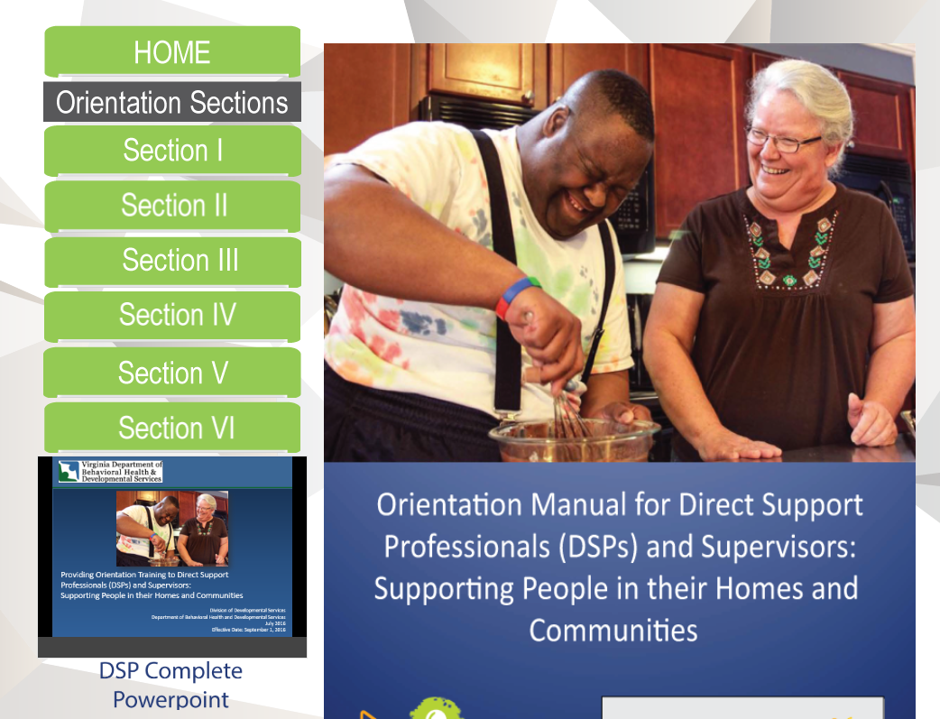
Orientation Manual and Training Slides
The Orientation Manual Test is divided across the six areas contained in the DSP Orientation Manual:
Section I: The Values that Support Life in the Community
Section II: Introduction to Developmental Disabilities
Section III: Waivers for People with Developmental Disabilities
Section IV: Communication
Section V: Positive Behavioral Support
Section VI: Health and Safety
https://partnership.vcu.edu/DSP_orientation/index.html
Notes:
The Orientation Manual Test is divided across the six areas contained in the DSP Orientation Manual:
Section I: The Values that Support Life in the Community
Section II: Introduction to Developmental Disabilities
Section III: Waivers for People with Developmental Disabilities
Section IV: Communication
Section V: Positive Behavioral Support
Section VI: Health and Safety

Slide 24
Assurances
Confirms that DSP and DSP Supervisor have met the competency-based requirements and passed the Orientation Manual Test with at least 80% success prior to providing reimbursable supports in the absence of other staff who have met requirements.
Confirms the receipt of instruction in the characteristics of developmental disabilities and Virginia’s DD Waivers, person-centeredness, positive behavioral supports, effective communication, DBHDS-identified health risks and the appropriate interventions, and best practices in the support of individuals with developmental disabilities.
https://partnership.vcu.edu/DSP_orientation/Competencies-Assurances-Tests.html
Notes:
DSPs (and DSP supervisors) must also confirm through a signed assurance that they have met the competency-based training requirements and passed the “Orientation Manual Test” with at least 80% success prior to providing reimbursable supports in the absence of other staff who have successfully completed requirements.
The signed assurance confirms the receipt of instruction in the characteristics of developmental disabilities and Virginia’s DD Waivers, person-centeredness, positive behavioral supports, effective communication, DBHDS-identified health risks and the appropriate interventions, and best practices in the support of individuals with developmental disabilities.
The assurances include confirmation of the use of observational competency checklists, which will be covered in the next sections.

Slide 25
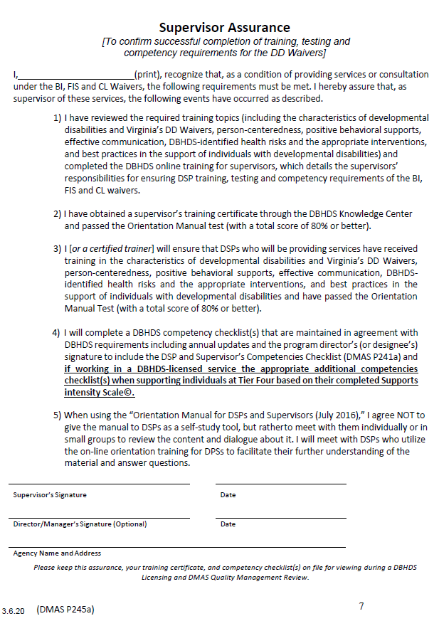
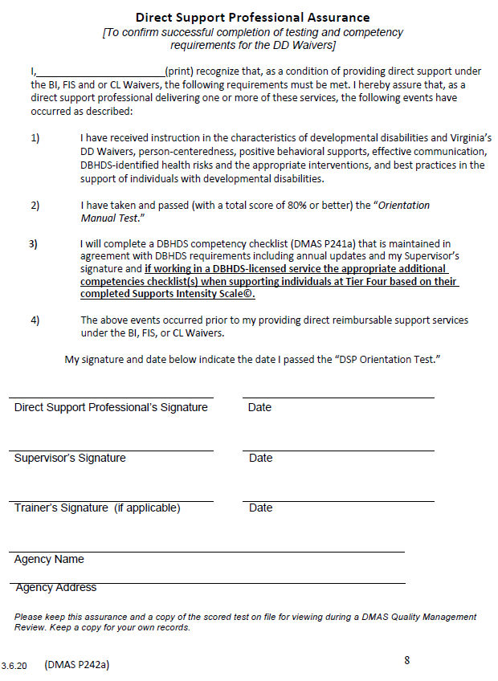

Assurances
Assurance documents are specific to agency role. There are two versions and DSPs and DSP supervisors complete the version that matches their role within the organization.
https://partnership.vcu.edu/DSP_orientation/Competencies-Assurances-Tests.html
Notes:
Assurance documents are specific to agency role. There are two versions and DSPs and DSP supervisors complete the version that matches their role within the organization. A copy of the Orientation Manual test and these assurance documents are available online at:
https://partnership.vcu.edu/DSP_orientation/Competencies-Assurances-Tests.html

Slide 26
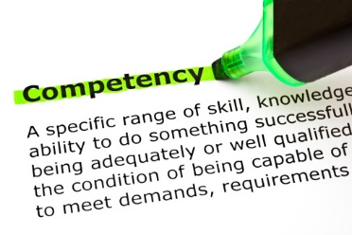
Basic Competency Checklist
All DSPs and DSP Supervisors providing the services described previously must:
  Complete an observed competency checklist
  Be observed and documented within 180 days of hire
  Be confirmed annually
  Have a new checklist every 5th year
  *Pending regulations: DSP Orientation must be completed and staff must be confirmed “competent” with Competency 3 prior to providing these supports in absence of “proficient” staff
1. Demonstrates person-centered skills, values and attitudes;
2. Understands and follows service requirements; and
3. Demonstrates abilities that improve or maintain the health and wellness of those they support
Notes:
All DSPs and DSP Supervisors providing the services described must complete an observed competency checklist that records DSP and DSP supervisors’ ability to be proficient in three established competencies. Each competency has a set of skills that are observed and documented during the 180 day orientation period for new DSPs and DSP Supervisors. The skills under the third competency, must be confirmed at a “competent” level of ability prior to providing these supports in the absence of staff who have been deemed proficient with these skills once established in DMAS Waiver Regulations. The three competencies are:
1. Demonstrates person-centered skills, values and attitudes,
2. Understands and follows service requirements, and
3. Demonstrates abilities that improve or maintain the health and wellness of those they support.

Slide 27
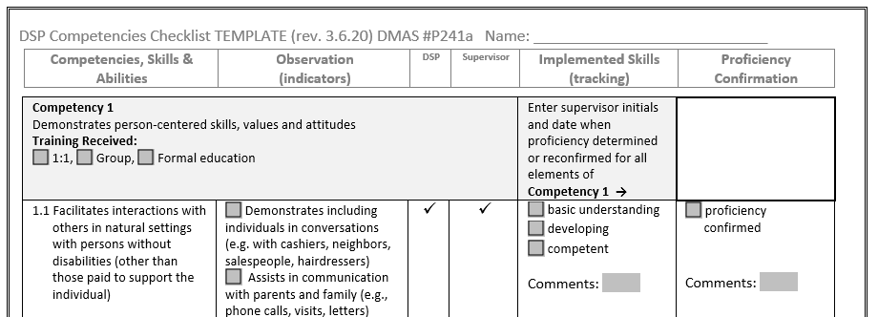
Basic Competency Checklist
These competencies and the type of related training are documented on the standard checklist (DMAS #P241a).
DSPs are observed by DSP Supervisors
DSP Supervisors are observed by the Agency Director or designee.
The current forms (2016) are available on the DMAS website. The March 2020 checklist is optional for use until regulations are finalized.
Notes:
These competencies and the type (for example, 1:1, group, and/or formal education) of any related training (such as reviewing the DBHDS provider DSP training manual and slides) are documented on a standard checklist (DMAS #P241a). Observation of DSPs applying their knowledge and skills is documented by DSP Supervisors. DSP supervisors’ observation and documentation is completed by the agency Director or designee. This checklist is introduced with two pages of instruction to assist in consistent application across DSPs and DSP Supervisors.
The current forms, dated 2016, are available through a DMAS provider portal forms search. The March 2020 checklist is optional for use until regulations are finalized.

Slide 28
Basic Competency Checklist
Levels of ability recorded on the checklist are defined as follows:
• Basic understanding: The individual is able to communicate a fundamental knowledge of the skill or action; high level of supervision needed.
• Developing: The individual is in the process of establishing the ability or is showing some, but not all, aspects of the skill or action in practice; moderate level of supervision needed.
• Competent: The individual demonstrates all applicable skills or actions in column two, but not on a routine basis as appropriate to the skill or action; low level of supervision needed. Competency refers to the minimum required for acceptability.
• Proficiency: The individual demonstrates all aspects of the skill or action on a routine basis in practice as appropriate to the skill or action; minimal supervision needed. Proficiency establishes an ongoing level of ability that is above the minimum.
Notes:
Levels of ability recorded on the checklist are defined as follows:
• Basic understanding: The individual is able to communicate a fundamental knowledge of the skill or action; high level of supervision needed.
• Developing: The individual is in the process of establishing the ability or is showing some, but not all, aspects of the skill or action in practice; moderate level of supervision needed.
• Competent: The individual demonstrates all applicable skills or actions in column two, but not on a routine basis as appropriate to the skill or action; low level of supervision needed. Competency refers to the minimum required for acceptability.
• Proficiency: The individual demonstrates all aspects of the skill or action on a routine basis in practice as appropriate to the skill or action; minimal supervision needed. Proficiency establishes an ongoing level of ability that is above the minimum.

Slide 29
Basic Competency Checklist
Other important information found in the checklist instructions:
Proficiency is established when the skills are observed over time and each area must be confirmed as proficient within 180 days of hire.
Competency refers to the minimum required for acceptability
Proficiency establishes an ongoing level of ability that is above the minimum.
If at any time a DSP or DSP Supervisor is found to be deficient* in any competency area, certain actions must be taken to permit the continuation of billing related to those areas.
The initial checklist and annual updates, as well as confirmation of training, must be maintained and available for review by DBHDS, DMAS, and other reviewers as required.
* “Deficient” is defined as an established pattern of inability to demonstrate one or more competency skills.
Notes:
Pay attention to the checklist instructions as they contain critical information about the process, including this additional information not already addressed:
(animated)
Proficiency is established when the skills are observed over time and each area must be confirmed as proficient within 180 days of hire.
Competency refers to the minimum required for acceptability where proficiency establishes an ongoing level of ability that is above the minimum.
If at any time a DSP or DSP Supervisor is found to be deficient in any competency area, certain actions must be taken to permit the continuation of billing related to those areas.
The initial completion of the checklist and annual updates, as well as confirmation of training, must be maintained and available for review by the Department of Behavioral Health and Developmental Services, the Department of Medical Assistance Services, and other reviewers as required.
It’s important to note that “Deficient” is defined as an established pattern of inability to demonstrate one or more competency skills.

Slide 30
Pending Regulation 12VAC30-122-180:
Actions to permit continued billing when a DSP or DSP Supervisor is deemed “deficient:”
7 days from discovery to begin remediation of identified skills and document actions taken to confirm proficiency (1st episode).
If proficiency not reconfirmed within 7 days of discovering a 2nd episode occurring within 3 months, the skills shall only be performed under direct supervision, observation, and guidance of qualified staff who document these supports.
Once proficiency is demonstrated, provider must maintain signed confirmation describing actions taken and is completed by the DSP Supervisor for DSPs and the Agency Director or designee for DSP Supervisors.
Billing may resume from that date forward.
Pending Regulations
Notes:
Pending regulations will expand on the actions an agency must take when a DSP or Supervisor is deemed “deficient”
12VAC30-122-180
B.5. If at any time after the initial 180 days, a DSP or DSP Supervisor is found to be deficient in any competency area, the following actions must be taken to permit the continuation of billing by the agency related to the areas of the person’s identified deficiencies. “Deficient” is defined as an established pattern of inability to demonstrate one or more competency skills.
a. Upon discovery of a staff person's inability to demonstrate proficiency, the provider has seven calendar days to begin remediation of the identified skills and document the issue and the actions taken by the agency to confirm proficiency. This initial seven day process is considered a first episode of one or more identified deficiencies
b. If proficiency is not reconfirmed within seven days following discovery of a second episode, occurring within three months of the staff person’s inability to demonstrate proficiency, the skills being remediated shall only be performed under direct supervision, observation and guidance of qualified staff who document the provision of these supports in the person’s record.
c. Once proficiency with these skills have been demonstrated, the provider shall maintain a signed confirmation which describes the actions taken and is completed by the DSP Supervisor for DSPs and the Agency Director or designee for DSP Supervisors and may resume billing for these related supports provided by the DSP or DSP Supervisor from that date forward.

Slide 31
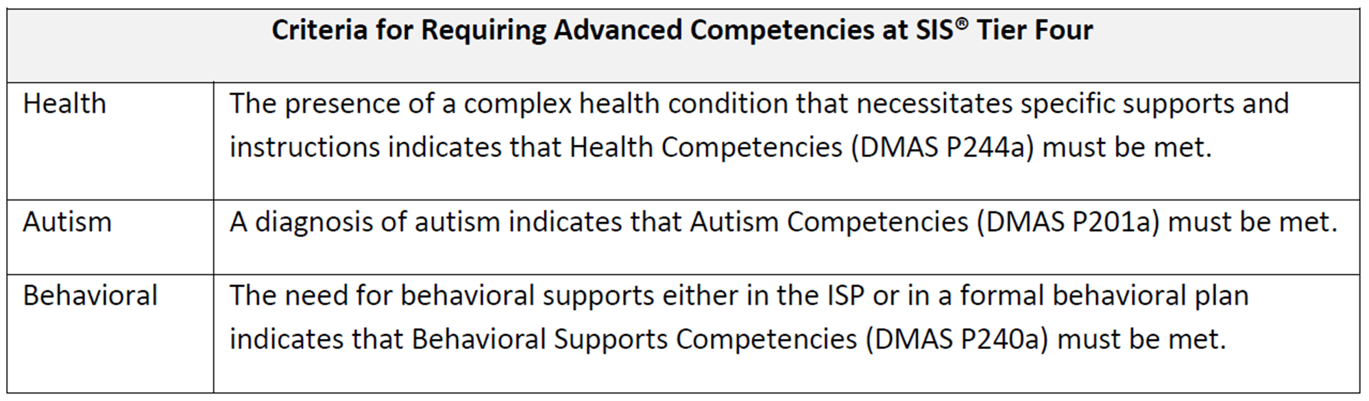
Advanced Competency Checklists
DBHDS-Licensed Agencies Only
DD Waiver regulations (12VAC30-122-180) and the Medicaid Memo dated 9.1.16 require DBHDS-licensed providers supporting individuals at SIS© tier 4 to complete training in the areas of autism, complex health supports, and complex behavioral supports.
Notes:
While Virginia’s Competencies for Direct Support Professionals and Supervisors who support individuals with Developmental Disabilities checklist applies to DBDHS-licensed agencies supporting people from Supports Intensity Scale SIS© tiers one through four, there are additional training requirements and competency checklists when providers support people most at risk and identified as having support needs defined through the SIS© at tier four.
DBHDS established training and competency requirements as described in the 2016 DMAS Medicaid Memo to include a higher level of skill when providers offer services and supports to people with tier four support needs. Included in DD Waiver regulations (12VAC30-122-180) and the Medicaid Memo 9.1.16, are the requirements that providers supporting individuals at SIS© tier four complete training in the areas of autism, complex health supports, and complex behavioral supports.

Slide 32

Advanced Competency Checklists
DBHDS-Licensed Agencies Only
Training may be accessed through a variety of means as long as it is nationally recognized or developed or approved by a qualified professional in each competency area.* This means your organization may develop and perform training as long as it is approved by a qualified professional.
*Refer to the March 6, 2020 Protocol for a full list of qualified professionals and training topics.
https://partnership.vcu.edu/DSP_orientation/Competencies-Assurances-Tests.html
Notes:
Training in these areas can be developed or reviewed and approved by a qualified professional in each area as described in the DBHDS Advanced Competencies Training Topics 9.25.17 document available online here: https://partnership.vcu.edu/DSP_orientation/Competencies-Assurances-Tests.html
Training may be accessed through a variety of means as long as it is nationally recognized or developed or approved by a qualified professional in each competency area. This means your organization may develop and perform training as long as it is approved by a qualified professional.
For a full list of qualified professionals and training topics, please refer to the Direct Support Professional (DSP) and DSP Supervisor DD Waiver Orientation and Competencies Protocol dated March 6, 2020.

Slide 33
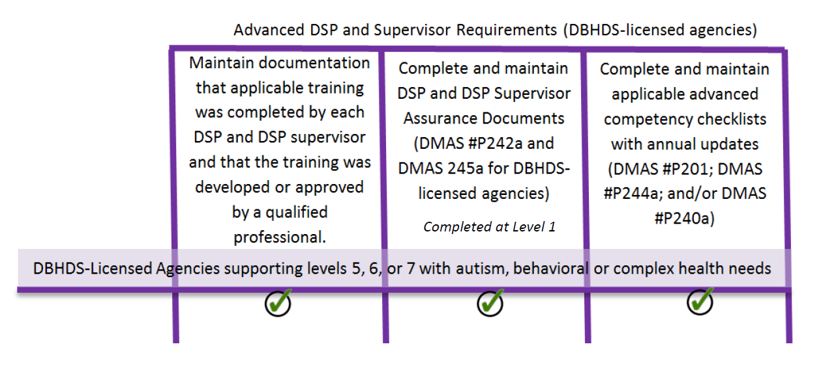
Advanced Competency Checklists
DBHDS-Licensed Agencies Only
Must be initiated by DBHDS-licensed providers and DSPs and DSP supervisors confirmed as proficient:
within 180 days of hire or
within 180 days of assisting a person with related SIS© tier 4 support needs (levels 5, 6, 7)--whether new to the program or receives a new SIS© confirming tier 4.
Notes:
These checklists must be initiated by DBHDS-licensed providers and DSPs and DSP supervisors confirmed as proficient within 180 days of hire or within 180 days of assisting a person with related SIS© tier four support needs whether that person is new to the program or receives an updated SIS© confirming Tier Four, which corresponds with SIS© levels 5, 6, and 7.

Slide 34
Supervisory Requirements Timeline
1
2
3
4
5
Take online DSP Supervisor Training
Begin providing support and training/observing DSPs
Receive annual updates to confirm competencies are still met
Take online DSP Test
Obtain and file certificate from training/testing
Sign and file Supervisor’s Assurance
Demonstrate competence with Competency 3*
Be confirmed as proficient w/ basic competencies
by Director with 180 days; if providing services in a licensed service setting, also demonstrate proficiency with advanced competencies based on people supported with 180 days
*required once DD Waiver Regulations are approved
Notes:
This slide provides an overview of the steps that supervisors follow in completing requirements for Orientation training, testing, and competencies.

Slide 35
DSP Requirements Timeline
1
2
3
4
5
Review Orientation Manual
Receive annual updates to confirm competencies are still met
Begin providing support
Receive Orientation training from
Supervisor
Take DSP Test
Pass with at least 80% correct.
Sign DSP Assurance
Demonstrate competence with Competency 3*
Be confirmed as proficient w/ basic competencies
by Supervisor within 180 days; if providing services in a licensed service setting, also demonstrate proficiency with advanced competencies based on people supported within 180 days
*required once DD Waiver Regulations are approved
Notes:
This slide provides an overview of the steps for DSPs in completing requirements for Orientation training, testing, and competencies.

Slide 36

Compliance
Not meeting these requirements may result in:
Citation by DMAS Quality Management Review.
Revocation or suspension of DMAS Participation Agreement.
Revocation or suspension of DBHDS license.
Payback for supports provided by DSPs who did not meet training and competency requirements.
Notes:
(animated)
Provider agencies are reviewed by DMAS Quality Management Review (QMR) for compliance with DSP and DSP Supervisor competency training requirements. If upon review a provider does not have documentation to demonstrate that DSPs and DSP Supervisors have met the requirements set forth in this protocol per DD Waiver regulations, the provider will be cited for a lack of compliance with waiver requirements. Providers must respond through a corrective action plan when deficiencies are identified by DMAS that details the methods that will be employed to ensure ongoing, sustained implementation of these requirements. A provider’s inability to demonstrate compliance can result in a provider having its DMAS participation agreement or DBHDS license suspended or revoked. A provider may even be subject to payback for supports provided by DSPs who did not meet training and competency requirements.

Slide 37
Portability
DSPs who move employment from one agency to another and have documentation of having completed training and passed the 2016 Orientation Manual Test there do not have to be retrained, but:
Supervisors must still discuss the values and concepts as they pertain to their agency’s policies with the new employee,
ensure that receipt of a copy of the DSP’s scored test or supervisor’s VLC certificate and assurance, and
keep it on file.
Competencies must be confirmed at the new agency within 180 days of hire and reconfirmed at least annually.
Notes:
DSPs who move employment from one agency to another and have documentation of having completed training and passed the 2016 Orientation Manual Test there do not have to be retrained, although the new agency would still discuss the values and concepts as they pertain to their agency’s policies with the new employee. The new provider would ensure that receipt of a copy of the DSP’s scored test or supervisor’s VLC certificate and assurance and keep it on file.
Competencies, where required, must be confirmed at each agency within 180 days of hire and reconfirmed at least annually.

Slide 38

Q&A
Please post any questions you may have in chat.
Notes:
Please post any questions you may have in chat.
We will respond to as many as we’re able within the timeframe of our meeting.
After we’ve concluded all of the scheduled webinars, we will compile an FAQ page to post with the webinar video on the DBHDS Website.

Slide 39
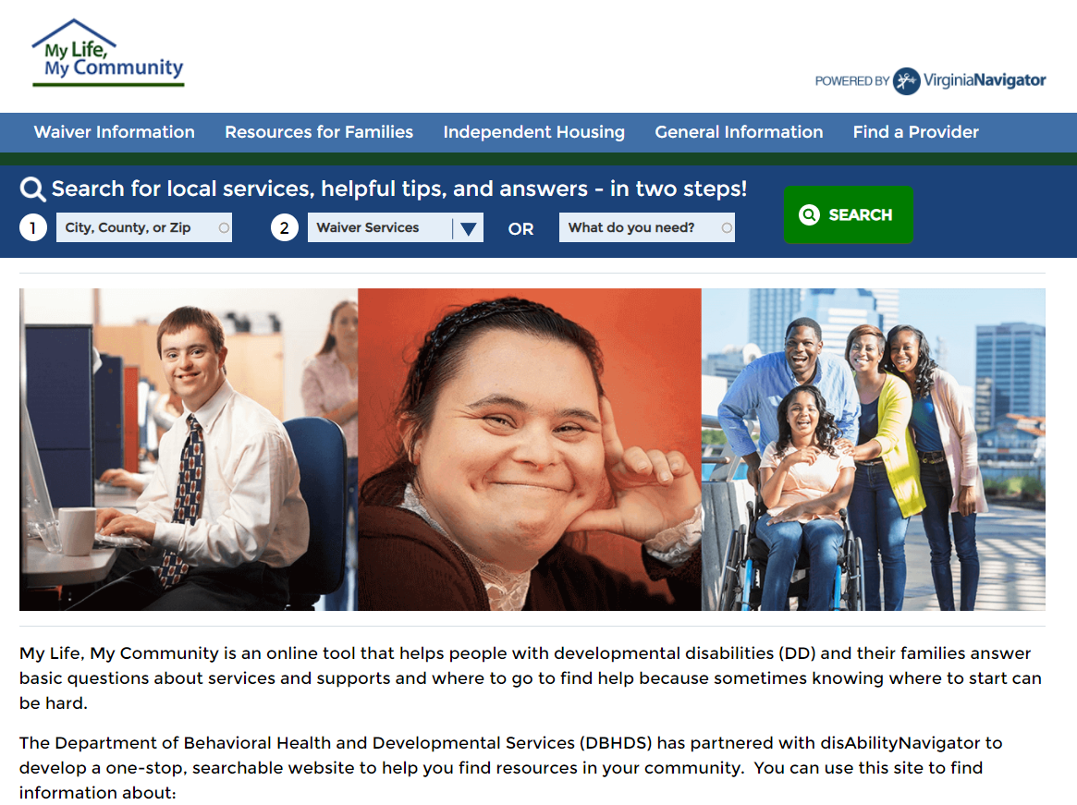
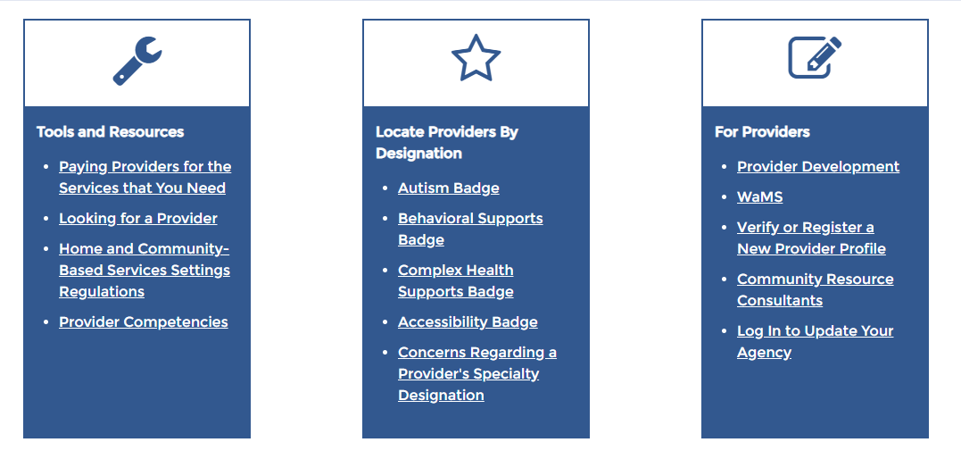
REMINDER!!
Please don’t forget to register your organization for the provider search on the My Life, My Community Website so Individuals, Families, and Support Coordinators can find you!
http://mylifemycommunityvirginia.org/
Notes:
Please don’t forget to register your organization for the provider search on the My Life, My Community Website so Individuals, Families, and Support Coordinators can find you!
You can get there by going to mylifemycommunityvirginia.org, clicking on “Find a Provider” in the top right hand corner, then “Verify or Register a New Provider Profile” under “For Providers.”

Slide 40

Additional Questions?
Questions about these requirements can be directed to your assigned Provider Team Community Resource Consultant. A contact list and linked documents are available online at the DBHDS Provider Development Webpage:
http://www.dbhds.virginia.gov/developmental-services/provider-development
Notes:
Questions about these requirements can be directed to your assigned Provider Team Community Resource Consultant. You can access a CRC listing on the provider development webpage.

