Slide 1

DSP Supplemental Training: Choking Risk
Adapted from the Office of Integrated Health Choking: Identification and Prevention Training
Presented by the Office of Provider Development
Notes:
Welcome to the DSP supplemental training on identifying and responding to choking events. This training supplements the content available at https://web.partnership.vcu.edu/DSP_orientation/index.html.

Slide 2
Choking Risk
Learning Objectives for this training:
Define choking
Review signs and symptoms of choking
Identify chronic conditions which increase risk
Identify foods known to increase risk of choking
Identify types of medications known to increase risk of choking
Identify signs and symptoms of someone who may be choking
Identify health care professional who is able to assess swallowing
Identify behaviors that may increase risk of choking
Identify steps which can be taken to prepare for a choking emergency
9/15/21
Virginia Department of Behavioral Health & Developmental Services
2

Slide 3
Choking Risk
Choking can be defined most simply as “an obstructed airway” and may be caused when:
  A foreign body obstructs the airway.
  Food and/or a combination of food and drink obstructs the airway.
  Choking can be:
  Due to an intentional or unintentional act.
  Partial or complete.
  Related to age or other chronic neurological and neuromuscular conditions.
9/15/21
Virginia Department of Behavioral Health & Developmental Services
2
Notes:
Airway Obstruction/Choking Introduction (Page 1, OIH Choking Health & Safety Alert 2020)
Choking (object in the airway) can be a partial or complete obstruction of the airway due to a foreign body (e.g. a bead, toy, etc.), whether intentional (pica) or unintentional (typically in childhood). Choking can also be a partial or complete obstruction of the airway due to food. Age or other chronic conditions can affect neurological and neuromuscular functioning, and put individuals at increased risk. An increased risk of choking has also been attributed to the consumption of alcohol, certain medications, dysphagia, tardive dyskinesia, poor dentition (loose, missing, or decaying teeth) and poor positioning. Some behaviors can also increase the risk of choking. The risk of choking is multiplied with each additional risk factor the individual has (Berzlanovich et al., 2005).

Slide 4
Choking Risk
Increased risk of choking may also be related to:
Alcohol consumption
Certain medications
Dysphagia
Tardive Dyskinesia
Loose, missing, or decaying teeth
Poor positioning
Behavioral concerns
The risk of choking is multiplied with each additional risk factor (Berzlanovich et al., 2005).
9/15/21
Virginia Department of Behavioral Health & Developmental Services
2
Notes:
Dysphagia refers to difficulty swallowing foods or liquids, arising from the throat or esophagus, ranging from mild difficulty to complete and painful blockage.
Tardive dyskinesia (TD) involves involuntary movements of the tongue, lips, face, trunk, and extremities that occur in patients treated with long-term psychiatric medications.

Slide 5

Choking Risk
Choking typically occurs when eating
9/15/21
Virginia Department of Behavioral Health & Developmental Services
2

Slide 6
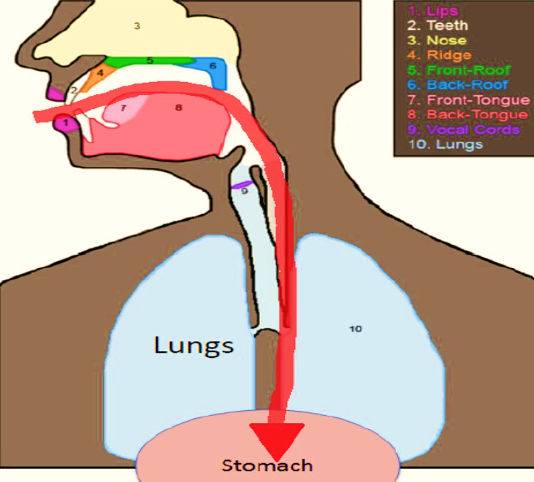
Choking Risk
The correct food path…
leads to the stomach, where food is digested.
9/15/21
Virginia Department of Behavioral Health & Developmental Services
2

Slide 7
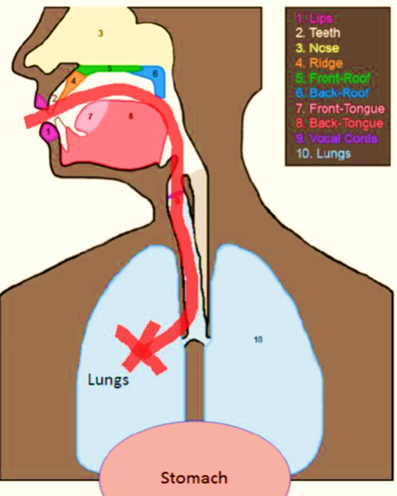
Choking Risk
The incorrect food path…
leads to the lungs, resulting in:
Choking if the airway is blocked by food, drink, or foreign objects or
Aspiration if food, drink, or foreign objects are breathed into the lungs.
9/15/21
Virginia Department of Behavioral Health & Developmental Services
2
Notes:
-Choking occurs when the airway is blocked by
food, drink, or foreign objects.
- Aspiration occurs when food, drink, or foreign
objects are breathed into the lungs (going down the
wrong tube). It might happen during choking, but
aspiration can also be silent, meaning that there is
no outward sign
https://dbhdd.georgia.gov/sites/dbhdd.georgia.gov/files/related_files/site_page/Choking%20and%20Aspiration%20Fact%20Sheet.pdf

Slide 8
Choking Risk
Symptoms of difficulty eating and swallowing…
difficulty with creating a lip seal around the fork or spoon
difficulty with solid foods
coughing before, during or shortly after swallowing
a choking sensation
shortness of breath, watery eyes
changes in voice quality after swallowing
repeated pneumonia
weight loss
heartburn
vomiting, burping
abdominal pain
For more examples, see the OIH Choking Health & Safety Alert 2020 provided with this training
9/15/21
Virginia Department of Behavioral Health & Developmental Services
2

Slide 9
Choking Risk
Some other conditions that increase the risk…
A history of aspiration pneumonia.
Gastroesophageal Reflux Disease (GERD) and or a history of GERD
Parkinson’s
Seizures
Alzheimer’s
Cerebral Palsy
Multiple Sclerosis
Prader Willi Syndrome
Dysphagia (difficulty swallowing)
Down Syndrome
For more examples, see the OIH Choking Health & Safety Alert 2020 provided with this training
9/15/21
Virginia Department of Behavioral Health & Developmental Services
2
Notes:
Factors/Conditions Which Increase Choking Risk (Page 3-4, OIH Choking Health & Safety Alert 2020)

Slide 10
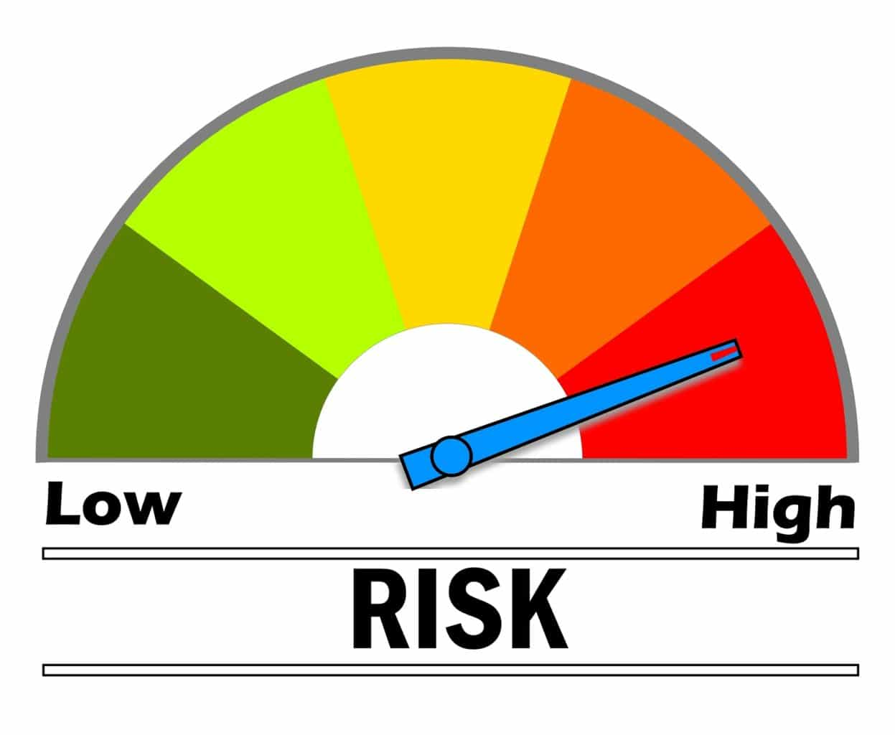
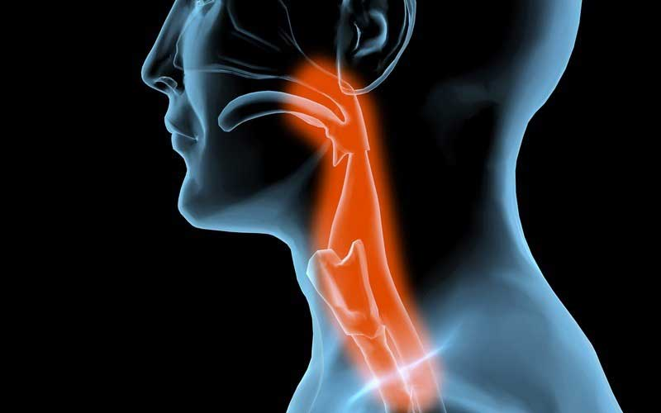
Choking Risk
Dysphagia
a condition in which a person has difficult or abnormal swallowing. It can also mean that it hurts to swallow, and/or the swallowing process is unsafe for an individual and can pose a choking and/or an aspiration risk
9/15/21
Virginia Department of Behavioral Health & Developmental Services
2
Notes:
A Diagnosis of Dysphagia Can Increase Choking Risk (Page 2, OIH Choking Health & Safety Alert 2020)
What is dysphagia? If an individual is diagnosed with dysphagia it means they have difficult or abnormal swallowing. It can also mean that it hurts to swallow, and/or the swallowing process is unsafe for an individual and can pose a choking and/or an aspiration risk. Watch for the following signs and symptoms of dysphagia in individuals:
Frequent episodes of gagging, coughing or choking during or after eating/drinking.
Difficulty managing saliva (drooling).
Difficulty closing lips.
Wet vocal quality during or after eating/drinking.
Runny nose during or after eating/drinking.
Watery eyes during or after eating/drinking.
Frequent bouts with pneumonia.
Frequent upper respiratory infections.
Swallowing food whole in order to “get it down” fast without anyone noticing a problem.
Eating/drinking quickly.
Extra effort or time to chew and/or swallow.
Pain with swallowing.
Pocketing food or liquid in cheeks.
Loss of food or liquid.
Frequent vomiting.
Weight loss or dehydration from inadequate intake.
Weak facial muscles.
Difficulty chewing (Bryant-Waugh, et al., 2019; Lindvall, et al., 2017; Thomas & Eddy, 2018).
If an individual you care for has any of the symptoms listed above, they may have dysphagia and may be at an increased risk for choking and aspiration. Please contact the individual’s PCP at your earliest convenience to explain your concern. A referral to a speech language pathologist (SLP) for further assessment may be needed. Please be sure to take a list of all of the individual’s medications to their appointment. Certain medications can increase choking risk.

Slide 11
Choking Risk
Down Syndrome (DS)
Prader Willi Syndrome (PWS)
a complex genetic condition that affects many parts of the body. In infancy, this condition is characterized by weak muscle tone (hypotonia), feeding difficulties, poor growth, and delayed development. Beginning in childhood, affected individuals develop an insatiable appetite, which leads to chronic overeating (hyperphagia) and obesity.
a condition in which a child is born with an extra copy of their 21st chromosome — hence its other name, trisomy 21. This causes physical and mental developmental delays and disabilities.
9/15/21
Virginia Department of Behavioral Health & Developmental Services
2

Slide 12
Choking Risk
Individuals with Down Syndrome (DS)
  Lack tongue control and frequently have an underdeveloped jaw, leading to impaired chewing, and poor ability to use their tongue thrust to assist during swallowing
  Are at exceptionally higher risk for choking when compared to other genetic disorders
Individuals with Prader Willi Syndrome (PWS)
  poor oral/motor coordination, poor gag reflex, abnormally strong sensation of hunger or desire to eat, decreased chewing and voracious eating habits
  Heimlich maneuver training, eyes-on, supervised meals, and food preparation and diet modification recommendations via an assessment with an Speech Pathologist, to avoid high risk choking textures and foods recommended
9/15/21
Virginia Department of Behavioral Health & Developmental Services
2
Notes:
Any DD Diagnosis Can Increase Choking Risk (Page 5, OIH Choking Health & Safety Alert 2020)
Down Syndrome
Among individuals with DD, research suggests that individuals with Down syndrome (Thacker et al., 2008) and those with Prader Willi Syndrome are at exceptionally high risk for choking, when compared to other genetic disorders (Stevenson et al., 2007). Individuals with Down Syndrome lack tongue control and frequently have an underdeveloped jaw, which can lead to impaired chewing, and poor ability to use their tongue thrust to assist during swallowing (Thacker et al., 2008).
Prader Willi Syndrome
Individuals with Prader Willi Syndrome (PWS) are at an increased risk for choking (Stevenson et al., 2007) due to poor oral/motor coordination, poor gag reflex, hypotonia, polyphagia or hyperphagia (abnormally strong sensation of hunger or desire to eat), decreased mastication and voracious eating habits ((Stevenson et al., 2007; Thacker et al., 2008). Researchers recommend implementation of preventive measures and education for family caregivers and group home care providers for all individuals diagnosed with PWS including the Heimlich maneuver, eyes-on, supervised meals, and food preparation and diet modification recommendations via an assessment with an SLP, to avoid high risk choking textures and foods (Stevenson et al., 2007).

Slide 13
Choking Risk
Medications that increase the risk…
antipsychotic drugs
medications that affect throat muscles (e.g. Cogentin)
antihistamines and other medications that cause dry mouth
medications affecting the central nervous system (e.g. Tegretol)
medications that linger in the throat (e.g. Tetracycline)
anti-cancer drugs or high dose steroids
Talk with the physician, pharmacist, and/or read side effect information to evaluate each medication for associated risk.
For more examples, see the OIH Choking Health & Safety Alert 2020 provided with this training
9/15/21
Virginia Department of Behavioral Health & Developmental Services
2

Slide 14
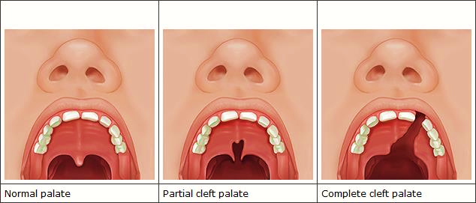
Choking Risk
Structural Abnormalities can be Congenital or Acquired and may increase risk of choking.
Cleft lip and palate are examples of congenital structural abnormality.
9/15/21
Virginia Department of Behavioral Health & Developmental Services
2

Slide 15
Choking Risk
Structural Abnormalities can be Congenital or Acquired and may increase risk of choking.
Tongue dysfunction
High palate
Structural, functional and neuromuscular abnormalities,
including high palate occur in numerous congenital syndromes associated with intellectual disability and would place the individual at a higher risk of choking.
Such as:
Fragile X
Marfan syndrome (MFS)
Van der Woude syndrome
For more examples, see the OIH Choking Health & Safety Alert 2020 provided with this training
9/15/21
Virginia Department of Behavioral Health & Developmental Services
2
Notes:
Tongue dysfunction results in:
Impaired chewing
Impaired formation of a mass of chewed food ready to swallow
Impaired transport of the chewed food
Excessive retention of food in oral cavity
Tongue dysfunction increases choking risk because food can become dislodged when the individual reclines and can cause an airway obstruction.
Tongue dysfunction occurs in numerous congenital syndromes.
A high (but closed) palate can also result in an increased choking risk. Why?
Because food can be trapped in a high palate while eating, but fall down into the mouth when the individual reclines.
A high arched palate is a symptom of numerous congenital syndromes.

Slide 16
Choking Risk
Poor oral health and chewing difficulty increases risk
Loss of any teeth reduces chewing performance resulting in a mass of chewed food which may be too large to safely swallow.
Loose, decayed or missing teeth all increase the risk for choking and or airway obstruction.
Less Teeth = Lessened Ability to Grind, Chop, and Process Food
9/15/21
Virginia Department of Behavioral Health & Developmental Services
2
Notes:
Missing Teeth (Poor Dentition), No Teeth (Edentulous), Loose Teeth, or Decaying Teeth Can Increase the Risk of Choking (Page 8, OIH Choking Health & Safety Alert 2020)
Loss of any teeth reduces masticatory performance. This can result in a mass of chewed food that may be too large to safely swallow. If an individual you care for has any loose, decayed or missing teeth, they are at an increased risk for choking (airway obstruction). Please contact the individual’s PCP at your earliest convenience, to explain your concern. A referral to a speech language pathologist (SLP) for further assessment may be needed. Please be sure to take a list of all of the individual’s medications to their appointment. As mentioned previously, certain medications can increase choking risk.
Chewing (mastication) falls under the SLP assessment area of “oral preparatory stage of swallowing”. A speech language pathologist can assess someone with a chewing (mastication) disorder. The mouth and teeth begin the digestion process by breaking food into small pieces that can be formed into a bolus, which can then be swallowed. Saliva softens food, teeth grind food and the tongue manipulates food into a bolus. If an individual has difficulty with any part of this process, they may be at higher risk of choking and need to have an assessment completed by a Speech Language Pathologist or SLP.

Slide 17
Choking Risk
Eating disorders that increase the risk…
Avoidant Restrictive Food Intake Disorder (ARFID)
ARFID is similar to anorexia in that both disorders involve limitations in the amount and/or types of food consumed, but unlike anorexia, ARFID does not involve any distress about body shape or size, or fears of fatness.
Pica
Pica is an eating disorder that involves eating items that are not typically thought of as food and that do not contain significant nutritional value, such as hair, dirt, and paint chips.
Rumination Disorder (RD)
Rumination disorder involves the regular regurgitation of food that occurs for at least one month. Regurgitated food may be re-chewed, re-swallowed, or spit out. Typically, when someone regurgitates their food, they do not appear to be making an effort, nor do they appear to be stressed, upset, or disgusted.
9/15/21
Virginia Department of Behavioral Health & Developmental Services
2
Notes:
Diagnosed Feeding or Eating Disorders Can Increase Choking Risk (Page 6, OIH Choking Health & Safety Alert 2020)
Some individuals may have sensory issues relating to food. This difficulty can be due to any of the reasons listed in this document or it may be due to a diagnosed feeding or eating disorder. Avoidant Restrictive Food Intake Disorder (ARFID), Pica, and Rumination Disorder (RD) are all characterized by avoidant and restrictive eating, which can lead to: a failure to meet nutritional and/or energy requirements; significant weight loss; or failure to gain expected weight; dependence on oral nutritional supplements or enteral feeding; nutritional deficiencies; and/or difficulties with psychosocial functioning. Individuals with ARFID may also restrict or avoid food intake for reasons that relate to the sensory aspects of food or eating (e.g., taste, smell, texture); lack of interest in food or eating; or because of the feared negative consequences (e.g. choking, vomiting) associated with eating (APA, 2013; Bryant-Waugh, et al., 2019; Lindvall, et al., 2017; Thomas & Eddy, 2018).

Slide 18
Choking Risk
Behaviors which increase the risk of choking
Placing too much food or medication in one's mouth.
Not chewing food well enough prior to swallowing.
Putting large portions of food in one's mouth.
Eating too fast.
Drinking too fast.
Inattention while eating.
Swallowing food whole.
Isolating behaviors.
Food stealing - resulting in obtaining non-prescribed/inappropriate diet, etc.
9/15/21
Virginia Department of Behavioral Health & Developmental Services
2
Notes:
Certain Behaviors can Increase Risk of Choking (Page 8, OIH Choking Health & Safety Alert 2020)
Behaviors which increase the risk of choking:
Placing too much food or medication in one's mouth.
Not chewing food well enough prior to swallowing.
Putting large portions of food in one's mouth.
Eating too fast.
Drinking too fast.
Inattention while eating.
Food stealing - resulting in obtaining non-prescribed/inappropriate diet, etc.
Swallowing food whole.
Isolating behaviors.
If an individual has any of the behaviors mentioned in this document, they are at an increased risk for choking (airway obstruction). Please contact the individual’s PCP at your earliest convenience, to explain your concern. A referral to a speech language pathologist (SLP) and/or a Board Certified Behavior Analyst (BCBA) may be needed. Please be sure to take a list of all of the individual’s medications to their appointment. As mentioned previously, certain medications can increase choking risk.

Slide 19

Choking Risk
Some individuals feel embarrassment related to their eating. They may move away from others and/or want to eat meals alone or in bed. Isolation increases risk for choking. Be alert to those individuals who may choose to leave the dining area, and check on them regularly to ensure they are not in need of assistance.
9/15/21
Virginia Department of Behavioral Health & Developmental Services
2
Notes:
Some individuals may feel embarrassment when they have difficulty eating, and may move away from others or may want to eat their meals in their bedrooms. This type of behavior places those individuals at an increased risk because they are less likely to be near people who can help. When food is served, be alert to those who may choose to leave, and check on them to ensure they are not in need of assistance.

Slide 20
Choking Risk
Eating Behaviors May Increase Choking Risk
Learn about high risk eating habits (stuffing food, isolation, etc.) and make sure all staff members are aware of what to watch for.
If high risk eating behaviors are observed, instruct staff to notify their direct supervisor immediately and document the incident.
The individual’s PCP should be notified as soon as possible, if any high risk eating behaviors are observed.
9/15/21
Virginia Department of Behavioral Health & Developmental Services
2
Notes:
Certain Behaviors can Increase Risk of Choking (Page 7, OIH Choking Health & Safety Alert 2020)
Strategies for choking prevention should include caregiver education on eating habits of individuals (stuffing food, etc.) that can increase their risk of choking. Caregivers who observe any of the behaviors in the aforementioned list, should notify their direct supervisor immediately and/or follow their agency’s policy for notification. The individual’s PCP should be notified that a particular risky behavior has been observed, and a protocol for observation (at a minimum), should be developed with the help of a nurse, and/or an SLP, and/or a physician.

Slide 21

Choking Risk
If a choking incident is related to the individual’s high risk eating behaviors, a referral to a behavior specialist, such as a Board Certified Behavior Analyst (BCBA) or Positive Behavioral Supports Facilitator (PBSF) may be needed.
9/15/21
Virginia Department of Behavioral Health & Developmental Services
2
Notes:
If the choking incident is related to the individual’s behavior’s (in any way), a referral to a specialist in behaviors, such as a Board Certified Behavior Analyst (BCBA) or a Positive Behavioral Supports Facilitator (PBSF) may be needed. A BCBA is a licensed healthcare professional who studies the behavior of children and adults and has experience and training in the development and execution of plans to improve or change a particular behavior, or behaviors. “Positive behavior support is an applied science that uses educational methods to expand an individual’s behavior repertoire and systems change methods to redesign an individual’s living environment to first enhance the individual’s quality of life and, second, to minimize his or her problem behavior” (Carr, et al., 2002, p. 4) http://personcenteredpractices.org/launch_vpbs.html

Slide 22
Choking Risk
Where to get help
All those at an increased risk for choking and/or aspiration for any condition mentioned on the previous slides (or any other which puts them at higher risk), should be evaluated by a healthcare professional as soon as possible.
Schedule an appointment with the individual’s primary care physician (PCP) at your earliest convenience for a referral to the appropriate specialist for an assessment. (Be sure to get a script for the assessment from the individual’s PCP.)
The individual’s PCP will know which specialist to best assess the individual’s particular condition and or their choking risk.
9/15/21
Virginia Department of Behavioral Health & Developmental Services
2
Notes:
(Page 3, 6, & 7, OIH Choking Health & Safety Alert 2020)
Health Conditions which Increase Risk of Choking (not all-inclusive):
If an individual you care for has any of the health conditions mentioned, they may be at an increased risk for choking (airway obstruction). Please contact the individual’s PCP at your earliest convenience to explain your concern. A referral to a speech language pathologist (SLP) for further assessment may be needed. Please be sure to take a list of all of the individual’s medications to the appointment. Certain medications can increase choking risk.

Slide 23
Choking Risk
Where to get help
Healthcare professionals who can assess issues with choking and or swallowing are:
  Speech Language Pathologists (SLPs).
  Otolaryngologists (aka Ear, Nose & Throat Doctor or ENT).
  Gastroenterologists (they specialize in conditions affecting the entire digestive system).
9/15/21
Virginia Department of Behavioral Health & Developmental Services
2
Notes:
A meal time and or eating protocol including observations (at a minimum), should be developed with the assistance of a healthcare professional. Please follow all physician-ordered protocols.
If you need additional guidance on eating protocols, please ask the individual’s PCP for a referral for assessment with a Speech and Language Pathologist, commonly known as an SLP.

Slide 24
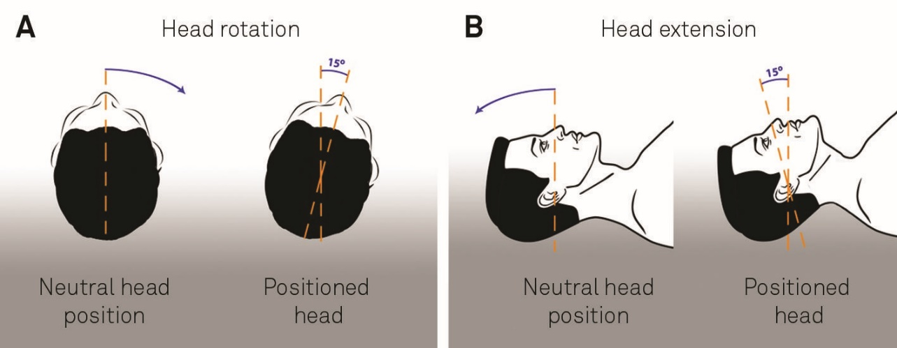
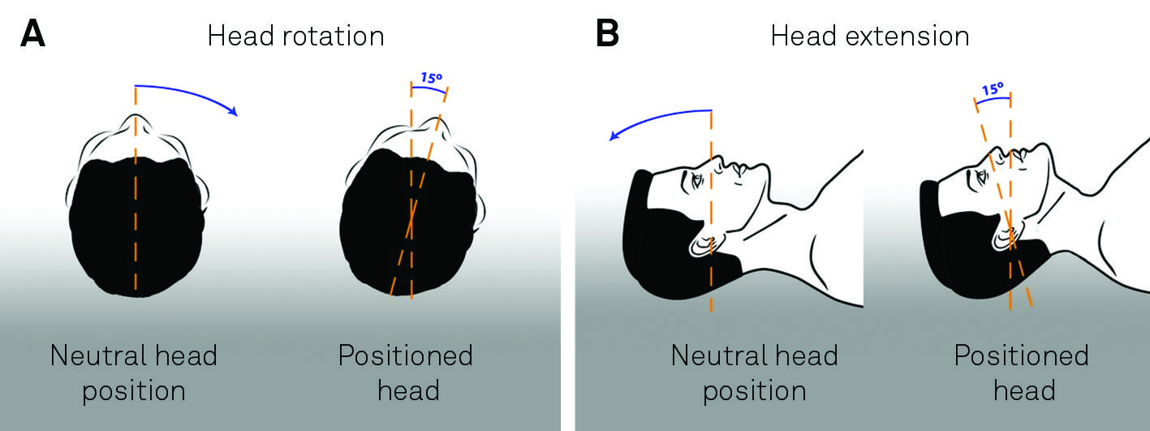


Choking Risk
Healthcare professionals may advise
Maintaining a neutral head position allows the airway to remain closed while swallowing. While assisting an individual to drink or eat, hold cups and utensils level with the individual’s mouth.
Holding a cup too high will cause flexion of the neck, which opens the airway putting an individual at greater risk of choking and aspiration.
Neutral head position
Extended head position (15 degrees of extension)
9/15/21
Virginia Department of Behavioral Health & Developmental Services
2
Notes:
Speech Language Pathology (SLP) Assessments (Page 11, OIH Choking Health & Safety Alert 2020)
When holding a cup for an individual to take a drink from, be sure to hold the cup level with their mouth. Holding a cup too high can cause flexion which opens the airway, and can put individuals at greater risk of choking and aspiration.

Slide 25
Choking Risk
Healthcare professionals may advise
Avoiding certain foods and beverages.
The addition of special thickeners to foods and drinks.
The avoidance of hot or cold foods/beverages which may trigger choking/aspiration incidents.
Protocols and precautions needed to prevent aspiration, if dysphagia is diagnosed.
A referral to a dietician or nutritionist.
PCP orders for diet modification.
9/15/21
Virginia Department of Behavioral Health & Developmental Services
2
Notes:
Speech Language Pathology (SLP) Assessments (Page 11 & 12, OIH Choking Health & Safety Alert 2020)
For some people, treatment may involve avoiding certain foods. Others may not be able to drink thin liquids and may need to have special thickeners added to them prior to consumption. Other people may have to avoid hot or cold foods or drinks, which can trigger choking incidents in some people. If the individual is diagnosed with dysphagia, caregivers will be instructed on the protocols and precautions needed to prevent aspiration. This might include diet modification or thickening of liquids, positioning, protocols for eating and drinking, etc. A referral to a dietician or nutritionist may be recommended. PCP orders for diet modification may also be needed.
The individual’s PCP, a nurse, a dietician and/or a nutritionist can help you develop a well-thought out protocol for eating and drinking for someone who has a high choking risk. Do not attempt to formulate protocols without a healthcare professional’s input and written order affirming approval. (The SLP may write the protocols, and the PCP will sign them, in some situations.) Please make sure all caregivers in all settings the individual visits on a regular basis are aware of these changes and protocols. Make sure all changes, protocols, etc. are included in the individual’s ISP (or IEP, if the individual is still in school), and update them as needed.

Slide 26
Choking Risk
Emergency Preparedness
Everyone is at risk for choking.
Individuals with DD are at higher risk for choking.
Caregivers should be certificated annually in CPR and the process of administering back blows and abdominal thrusts for choking emergencies.
Caregiver should do practice drills and or mock emergencies to reinforce emergency protocols.
Practicing emergency protocols, and allowing direct caregivers the chance to ask questions, builds confidence and improves response technique.
Repetition of any activity increases muscle memory and gives participants a chance to improve reaction response times (Popov & Reder, 2017).
Well-placed posters with clear instructions on the steps for caregivers to follow during an emergency can serve as a visual reminders and can help calm caregivers when/if, they begin to panic when an individual is choking.
9/15/21
Virginia Department of Behavioral Health & Developmental Services
2
Notes:
Caregiver Tips (Page 12, OIH Choking Health & Safety Alert 2020)
Emergency Preparedness to Lower the Risk of Choking Fatalities
Everyone is at risk for choking. Individuals with DD are at higher risk for choking. Caregivers should learn the Heimlich maneuver and CPR in a certified first-aid training course and practice putting both into action during your emergency preparedness training drills. The use of caregiver drills or mock emergencies in order to reinforce emergency protocols for choking is a good idea. Practicing an emergency protocol, and allowing direct caregivers to have a chance to ask questions, can build confidence and improve technique. Repetition of any activity increases memory of any skill (Popov & Reder, 2017) and gives participants a chance to build their skills. Having all staff trained in the Heimlich maneuver, CPR and First Aid represents best practice. It is also important to keep skill requirements current with refresher courses.
In addition, the use of well-displayed posters with clear instructions on the steps a caregiver should follow (for both the Heimlich maneuver and CPR) is a good idea. A poster can serve as a visual reminder of the steps needed, (e.g. the placement of hands, the sequence, the number of repetitions, etc.), and can help calm caregivers’ nerves when, or if, they begin to panic and cannot remember what to do, when an individual is choking.

Slide 27
Choking Risk
What not to do
DO NOT rush mealtimes
DO NOT plan other activities during mealtimes
DO NOT permit eating or drinking while the individual is lying down
DO NOT give foods or liquids that a particular individual has difficulty swallowing
DO NOT assist individuals to bed, for at least 30 minutes after eating or drinking
DO NOT give foods or liquids restricted by an individual’s health care provider
DO NOT start mealtime if the individual is too lethargic, angry, anxious, or if they cannot sit still
DO NOT let an individual finish eating a particular food item, if that food item has just caused the individual to choke
9/15/21
Virginia Department of Behavioral Health & Developmental Services
2
Notes:
What Not to Do (Page 13, OIH Choking Health & Safety Alert 2020)
Be sure to include what to do, as well, in a person’s individualized protocol.

Slide 28
Choking Risk
Foods considered high risk
Corn
Grapes
Bananas
Hard nuts
Marshmallows
Peanut butter (any kind)
Chicken on the bone
Candy with large nuts
Hotdogs served whole
Whole, hard fruits like apples or pears
Peanut butter sandwiches on soft bread
Thick chewy bread, e.g. white bread, bagels, pizza, etc.
Whole, raw vegetables served in large bite-sized pieces
Dry meats such as ground beef served without sauce, gravy
Dry, crumbly foods such as cornbread or rice served without butter, jelly, sauce, etc.
Incorrect diet texture - liquids or food items not prepared in accordance with a prescribed diet
Eating something with two or more diet textures, especially anything with a thin liquid in addition to a solid component, such as cereal and milk (Sidell, et al., 2013)
9/15/21
Virginia Department of Behavioral Health & Developmental Services
2
Notes:
Make Sure Staff Are Aware of Foods Identified as "High Risk" for Choking (Page 13, OIH Choking Health & Safety Alert 2020)
Be sure to include high risk foods that are specific to the person in their individualized protocols.

Slide 29
Choking Risk
Individual protocols
It is essential to consult the individual’s PCP and SLP to ensure a person centered support plan and or choking protocol meets their specific needs. All person centered support plans and/or protocols must meet human rights guidelines and require approval with signature from a healthcare professional (12VAC35-115-100).
Possible protocols:
  Protocols for Pica precautions.
  Protocols for hands-on, staff-assisted eating.
  Protocols for direct visual supervision when the individual is consuming food.
  Protocols for assisted eating or drinking techniques, using adaptive equipment.
  Protocols for implementing physician orders for prescribed diets and or for thickening foods.
  Protocols limiting access to food impact an individual’s human rights which requires approval from the local human rights counsel (LHRC) prior to implementation.
9/15/21
Virginia Department of Behavioral Health & Developmental Services
2
Notes:
Protocols for Lowering the Risk of Choking (not all inclusive) (Page 16, OIH Choking Health & Safety Alert 2020)

Slide 30
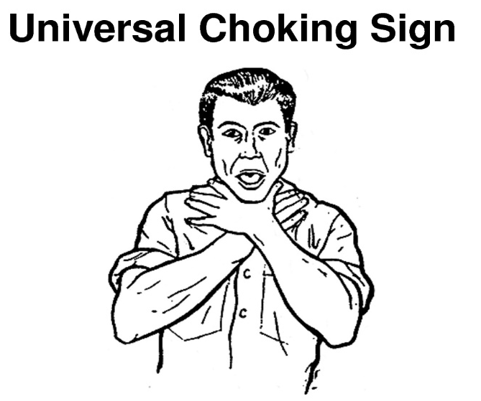
Choking Risk
Ways to support
The universal sign for choking is both hands clutched to the throat.
Demonstrate the Universal Choking Sign to individuals and teach individuals (who are cognitively and physically able) how to do it themselves.
Have them demonstrate it to you at routine intervals to make sure they remember how to do it, and when they should use it (i.e. when they are choking).
9/15/21
Virginia Department of Behavioral Health & Developmental Services
2
Notes:
Protocols for Lowering the Risk of Choking (not all inclusive) (Page 16, OIH Choking Health & Safety Alert 2020)

Slide 31
Choking Risk
Did you know?
Some people who choke can still breathe.
Symptoms:
Look of fear or panic
Reddish face
Grabbing throat
Drooling
Forceful coughing
Some people who choke can NOT breathe.
Symptoms:
Can not speak
Grayish or pale face
Bluish lips
Grabbing throat
High-pitched noise or no noise
9/15/21
Virginia Department of Behavioral Health & Developmental Services
2

Slide 32
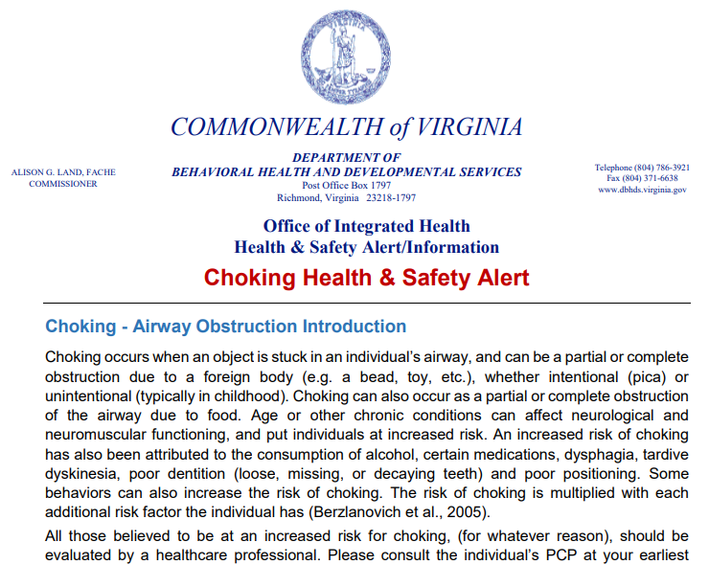
Resources
The companion document for use with this training is available online at the link below. Be certain to review and keep in a location for easy reference:
https://dbhds.virginia.gov/assets/doc/OIH/choking-health-safety-alert.pdf
9/15/21
Virginia Department of Behavioral Health & Developmental Services
2

Slide 33
Resources
Office of Integrated Health (OIH) at DBHDS: http://www.dbhds.virginia.gov/office-of-integrated-health
Newsletters & Safety Alerts Archive: http://www.dbhds.virginia.gov/office-of-integrated-health/safety-alerts-archive
If you have a technical assistance question, please email the Registered Nurse Care Consultant (RNCC) Team at: communitynursing@dbhds.virginia.gov
Office of Provider Development https://dbhds.virginia.gov/developmental-services/provider-development
9/15/21
Virginia Department of Behavioral Health & Developmental Services
2

Slide 34
Resources
American Red Cross (2011). First aid conscious choking poster. file:///C:/Users/dha92624/Downloads/first-aid-consciouschokingposter-en.pdf
American Red Cross (n.d.). How do you care for a conscious choking victim? https://www.youtube.com/watch?v=UVNxP7K2ATE
American College of Emergency Physicians. Choking (Heimlich maneuver). https://www.emergencyphysicians.org/article/know-when-to-go/choking--heimlich-manuever
American Academy of Pediatrics. (2011). Choking Prevention and First Aid for Infants and Children https://www.laborposters.org/first-aid/1805-choking-cpr-for-children-or-infants-poster.htm
American Red Cross (2010). CPR/AED for professional rescuers and health care providers. https://www.redcross.org/content/dam/redcross/atg/PHSS_UX_Content/CPRO_Handbook.pdf
Resuscitate! CPR AED & Choking App Stone Meadow Development LLC https://apps.apple.com/us/app/resuscitate-cpr-aed-choking/id363393502
National Safety Council’s Emergency Response App It provides a list of abbreviations and memory aids, as well as an illustrated summary of treatment steps for various illnesses and injuries. https://play.google.com/store/apps/details?id=com.nsc.hybrid&hl=en_US
If you have any questions about the information contained in this Health & Safety Alert, please email your question to the Office of Integrated Health’s nursing team at: communitynursing@dbhds.virginia.gov
What to do when a Wheelchair User is choking: https://www.aid-training.co.uk/news/what-to-do-when-a-wheelchair-user-is-choking
The ARC handout on Choking an Obesity, Choking in a Wheelchair: https://hrstonline.com/demo/elearning/live/choking/choking-part-2/Choking%20with%20Morbid%20Obesity%20Protocol.pdf
How to deal with a choking wheelchair user YouTube video: https://www.youtube.com/watch?v=1L1dR9qUN0E
9/15/21
Virginia Department of Behavioral Health & Developmental Services
2

Slide 35
Resources
A.I.D Training & Operations Ltd (2015). What to do when a wheelchair user is choking. https://www.aid-training.co.uk/news/what-to-do-when-a-wheelchair-user-is-choking
American Academy of Pediatrics. (2011). Choking Prevention and First Aid for Infants and Children https://www.laborposters.org/first-aid/1805-choking-cpr-for-children-or-infants-poster.htm
American College of Emergency Physicians. Choking (Heimlich maneuver). https://www.emergencyphysicians.org/article/know-when-to-go/choking--heimlich-manuever
American Red Cross (2010). CPR/AED for professional rescuers and health care providers. https://www.redcross.org/content/dam/redcross/atg/PHSS_UX_Content/CPRO_Handbook.pdf
American Red Cross (2011). Adult first aid/CPR/AED: Ready reference. Retrieved from https://www.redcross.org/content/dam/redcross/atg/PDF_s/Health___Safety_Services/Trainin g/Adult_ready_reference.pdf
American Speech, Language, Hearing Association (n.d.). Adult dysphagia. https://www.asha.org/PRPSpecificTopic.aspx?folderid=8589942550&section=References
Balzer, K. M. (2000). Drug-induced dysphagia. International Journal of MS Care, 2(1), 40-50. Retrieved from http://ijmsc.org/doi/abs/10.7224/1537-2073-2.1.40?code=cmsc-site
Berzlanovich, A. M., Fazeny-Dörner, B., Waldhoer, T., Fasching, P., & Keil, W. (2005). Foreign body asphyxia: a preventable cause of death in the elderly. American journal of preventive medicine, 28(1), 65-69. https://www.sciencedirect.com/science/article/abs/pii/S0749379704000777?via%3Dihub
Bryant-Waugh, R., Micali, N., Cooke, L., Lawson, E. A., Eddy, K. T., & Thomas, J. J. (2019). Development of the Pica, ARFID, and Rumination Disorder Interview, a multi-informant, semi-structured interview of feeding disorders across the lifespan: A pilot study for ages 10-22. The International journal of eating disorders, 52(4), 378–387. https://doi.org/10.1002/eat.22958
Carl, L. L., & Johnson, P. R. (2006). Drugs and dysphagia: How medications can affect eating and swallowing. Austin, Tex: Pro-Ed.
Lindvall Dahlgren, C., Wisting, L., & Rø, Ø. (2017). Feeding and eating disorders in the DSM-5 era: a systematic review of prevalence rates in non-clinical male and female samples. Journal of eating disorders, 5, 56. https://doi.org/10.1186/s40337-017-0186-7
Lu, Q. F., Ma, Q., Rithwan, S. M. S., Ng, H. C., Lee, S. L., Lee, K. M., ... & Xie, H. (2017). Risk factors and nursing strategies to manage choking in adults with mental illness: a systematic review protocol. JBI Database of Systematic Reviews and Implementation Reports, 15(8), 1998-2003. https://journals.lww.com/jbisrir/Fulltext/2017/08000/Risk_factors_and_nursing_strategies_to_manage.5.aspx
Lumsden, A. J. & Cooper, J. G. (2017). The choking hazard of grapes: a plea for awareness. Archives of Disease in Childhood, 102, p. 473-474. Retrieved from https://adc.bmj.com/content/archdischild/102/5/473.full.pdf
Manduchi, B., Walshe, M., Burke, É., Carroll, R., McCallion, P., & McCarron, M. (2020). Prevalence and risk factors of choking in older adults with intellectual disability: Results from a national cross-sectional study. Journal of Intellectual & Developmental Disability, 1-12. https://doi.org/10.3109/13668250.2020.1763278
Martin-Harris, B., Brodsky, M. B., Michel, Y., Ford, C. L., Walters, B., & Heffner, J. (2005). Breathing and swallowing dynamics across the adult lifespan. Archives of Otolaryngology–Head & Neck Surgery, 131, 762–770.
9/15/21
Virginia Department of Behavioral Health & Developmental Services
2

Slide 36
Resources
M. B., Michel, Y., Ford, C. L., Walters, B., & Heffner, J. (2005). Breathing and swallowing dynamics across the adult lifespan. Archives of Otolaryngology–Head & Neck Surgery, 131, 762–770.
Mayo Clinic (2017). Choking: First aid. https://www.mayoclinic.org/first-aid/first-aid-choking/basics/art- 20056637#:~:text=Deliver%20five%20separate%20back%20blows,until%20the%20blockage%20is%20dislodged.
National Institute of Deafness and other Communication Disorders (NIDCD), National Institutes of Health (NIH) (2017). Dysphagia. https://www.nidcd.nih.gov/health/dysphagia#2
National Safety Council (2017). National Safety Council: Injury facts, 2017 edition. Retrieved from http://viewer.zmags.com/publication/20020222#/20020222/1
National Safety Council (2018). Choking prevention and rescue tips: Thousands of people die from choking every year. https://www.nsc.org/home-safety/safetytopics/choking-suffocation
National Safety Council (2020). EMR Guide. https://play.google.com/store/apps/details?id=com.nsc.hybrid&hl=en_US
Popov, V., & Reder, L. M. (2017). Repetition improves memory by strengthening existing traces: Evidence from paired-associate learning under midazolam. In CogSci. http://venpopov.com/papers/popov-reder-midazolam-cogsci2017.pdf
Sheppard, J. J., Malandraki, G. A., Pifer, P., Cuff, J., Troche, M., Hemsley, B., ... & Hochman, R. (2017). Validation of the choking risk assessment and pneumonia risk assessment for adults with intellectual and developmental disability (IDD). Research in developmental disabilities, 69, 61-76. https://doi.org/10.1016/j.ridd.2017.07.016
Sidell, D. R., Kim, I. A., Coker, T. R., Moreno, C., & Shapiro, N. L. (2013). Food choking hazards in children. International journal of pediatric otorhinolaryngology, 77(12), 1940-1946. https://doi.org/10.1016/j.ijporl.2013.09.005
Stevenson, D. A., Heinemann, J., Angulo, M., Butler, M. G., Loker, J., Rupe, N., Kendell, P., Clericuzio, C. L., & Scheimann, A. O. (2007). Deaths due to choking in Prader-Willi syndrome. American journal of medical genetics. Part A, 143A(5), 484–487. https://doi.org/10.1002/ajmg.a.31502
Thacker, A., Abdelnoor, A., Anderson, C., White, S., & Hollins, S. (2008). Indicators of choking risk in adults with learning disabilities: a questionnaire survey and interview study. Disability and rehabilitation, 30(15), 1131-1138. http://ergotherapeutedordogne.fr/wp-content/uploads/2018/01/5-indicators-of-choking-risk-in-adults-with-learning-disabilities.pdf
Tippett, D. (2020). Treatments tests and therapies: Dysphagia: What happens during a bedside swallow exam. https://www.hopkinsmedicine.org/health/treatment-tests-and-therapies/dysphagia- what-happens-during-a-bedside-swallow-exam
U.S. National Library of Medicine, Medline Plus (2018, Aug). Choking - adult or child over 1 year. Retrieved from https://medlineplus.gov/ency/article/000049.htm
9/15/21
Virginia Department of Behavioral Health & Developmental Services
2

Slide 37

Questions & Suggestions
For more information, visit Provider Development online at
http://www.dbhds.virginia.gov/developmental-services/provider-development
9/15/21
Virginia Department of Behavioral Health & Developmental Services
75

