Slide 1
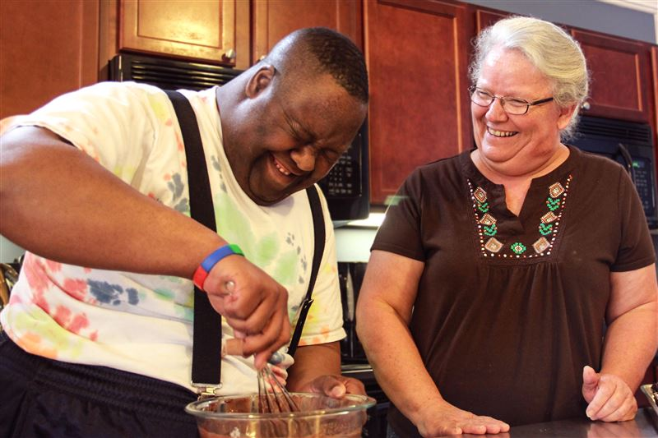
Providing Orientation Training to Direct Support
Professionals (DSPs) and Supervisors:
Supporting People in their Homes and Communities
Division of Developmental Services
Department of Behavioral Health and Developmental Services
July 2016
Effective Date: September 1, 2016
Notes:
To Supervisors/Trainers of Direct Support Professionals:
This slideshow and supervisor/trainer narrative and notes have been developed for you to use in your orientation training of staff (or as a refresher for experienced staff). They are designed to convey the DBHDS-required core training content and assist you and the DSPs you support prepare for and pass the Orientation Manual Test.
The slides outline critical information contained in the manual for you to emphasize with staff. The slideshow contains trainer narrative following the manual, along with resources, discussion items and notes that should be helpful in expanding the conversations you have with staff. While the narrative is there to help you explain important concepts, you should not be reading to staff, but having a discussion.
There is an additional required slideshow for supervisors and trainers available on the DBHDS Learning Management System. It describes the requirements for supervisors and training of DSPs prior to DSPs providing supports through Waivers. This additional slideshow includes the need for both Supervisors and DSPs to complete training and pass the associated Orientation Test, as well as other supervisor responsibilities.
Narrative:
Welcome to the DBHDS Division of Developmental Services’ Orientation Training for Direct Support Professionals (DSPs). This training is designed to assist DSPs in learning how to support individuals who have developmental disabilities (DD) in their homes and communities. It follows along with the DSP Orientation Manual (available at www.dbhds.virginia.gov). Every DSP should have received training on the topics contained in the manual prior to meeting with your supervisor and viewing this slideshow.

Slide 2
DSP Orientation Manual Sections
The Values that Support Life in the Community
Introduction to Developmental Disabilities
Waivers for People with Developmental Disabilities
Communication
Positive Behavior Supports
Health and Safety
Notes:
Narrative: When you finish this training you will have knowledge of:
The characteristics of developmental disabilities and Virginia’s DD Waivers,
Person-centeredness, positive behavioral supports, effective communication,
DBHDS-identified health risks and the appropriate interventions, and
Best practices in the support of individuals with developmental disabilities.

Slide 3
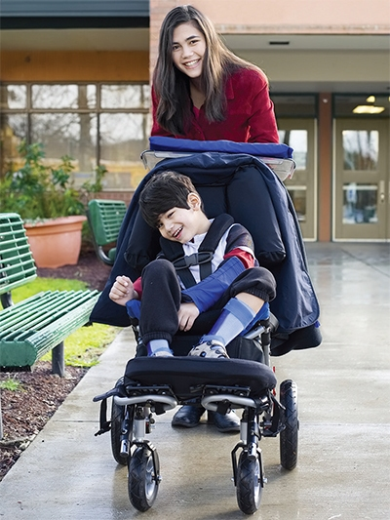
Section I: Values that Support Life in the Community
Slide 3
Notes:
Narrative: The goal of Section I: Values that Support Life in the Community is to familiarize you with the vision and values that should guide you in your support of people with developmental disabilities in Virginia.

Slide 4
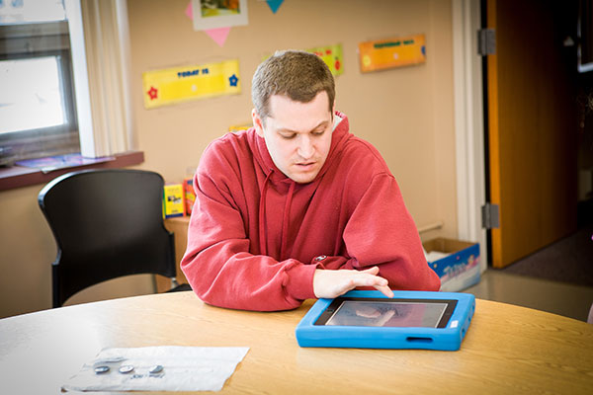
Section I: Values…
Virginia’s Vision and Principles of
Person-Centered Practices
Notes:
Narrative: A vision for Virginia and a set of principles and practices were developed by the statewide PC Practices Leadership Team of self-advocates, family members, representatives of CSBs, private providers, advocacy groups, and state agencies.
Resources: Additional resources about person-centered planning, which are useful for this discussion, can be accessed on the DBHDS website at http://www.dbhds.virginia.gov/.
.
These materials will provide information on the history of person-centered planning, as well as expand on the vision and principles presented here.
Information about training opportunities in person centeredness can be found at:
http://www.personcenteredpractices.org/.

Slide 5


Section I: Values…
Vision for Virginia
We see a Virginia where people of all ages and abilities have the supports needed to enjoy the rights of life, liberty, and pursuit of happiness and the opportunity to have a good life.
Notes:
Discussion: Have someone volunteer to read this aloud and discuss how this vision relates to your life and what supports you need to have a good life. Discuss what this means in the work you do. Point out that every person wants to have the same opportunities to have a good life on his own terms and in a way that works for him.

Slide 6








Section I: Values…
Having a good life means different things to different people.
Notes:
Narrative: What “a good life” means to people of all ages and abilities was described by a team of self-advocates and people who support them and adopted by Virginia’s PCP Leadership Team to be considered in everyone’s individual support plan.
“A good life” for anyone includes joy and happiness, health and safety, hopes and dreams, meaningful activities, intimate relationships with family and friends, having a home, transportation, work, money (bank accounts), and the ability to contribute to family and community.
These are all things we want people using services to experience. It is expected that all DSPs will be working towards these through the supports they provide.

Slide 7

Section I: Values…
We believe a good life is best led by the person following these person-centered principles.
Notes:
Narrative: The Leadership Team agreed that the person’s “voice” (whether it’s through words or behavior) directs the planning process.
It also agreed upon 5 principles of all person-centered practices for all providers to follow.
Virginia’s process of supporting people with disabilities is built upon the following 5 principles of person-centered practices.

Slide 8

Section I: Values…
Virginia’s Person-Centered Principles
Listening
People are listened to and their choices respected
Notes:
Narrative: The necessity of truly listening to people was by far the most mentioned principle Virginia needs to learn to follow. Listening, not just to the words, but to the many other ways of telling you what I like and don’t like, what I want to do each day and what I don’t, and how I want to be treated by you and the community. And listening not only to the person, but to each other, to the team, to the people who support me the most, who know me best.
Discussion: Discuss how hard it is to listen well and ways to be sure one is listening. Listening is more than hearing, it is seeing and then understanding what we have heard and seen from that person’s perspective not just our own.

Slide 9
Section I: Values…
Virginia’s Person-Centered Principles
Listening
Relationships with family, friends, and people in the community are supported.
Community
Notes:
Narrative: PC practices are all about community. Nothing (but food and water) is more important to us than relationships with others. PC planning and other practices increase the likelihood that people will have positive and enduring relationships. New and intimate relationships, contributing to family and community, receiving from family and community are all a part of what makes a good life for everyone and should be addressed in everyone’s individual support plan.
Discussion: Talk about the people in your community with whom you’ve developed relationships just by being out at the same place at the same time every week or month or so. For example, Judy, the check-out lady at Kroger; Gloria who does my hair; Alan, who fixes our cars; Jan, at 7-11; Ashley, at Grace’s Pizza.
Have staff think about the people they see in their neighborhoods and communities, that while not necessarily “close” relationships, they make you feel connected and a part of something larger and important. Discuss how they developed these relationships with people in the community, and how the supports that are provided can help make these connections happen for people they will be supporting. Take the time to talk about how close relationships affect the quality of everyone’s life.

Slide 10
Section I: Values…
Virginia’s Person-Centered Principles
Listening
Personal informed choice and control are supported.
Community
Self-Direction
Notes:
Narrative: It is becoming more and more popular across Virginia and the country for people with disabilities to direct their own supports and services. For individual support planning, increased self-direction might be in facilitating one’s own meeting, planning the venue, agenda and people to be invited.
For people who cannot do these things alone, personal choices are discovered by the people who care about the person. They use their collective wisdom to support the person and increase personal control in the person’s life.
Discussion: Talk about what it means to you (what it looks like) for the person you support to have informed choice and be in control of the supports you provide.

Slide 11
Section I: Values…
Virginia’s Person-Centered Principles
Listening
People have opportunities to use their gifts and talents.
Community
Self-Direction
Talents & Contributions
Notes:
Narrative: Contributing to family, neighborhoods and communities and receiving in return is what makes life meaningful to us. Everyone has gifts and talents to share with others, everyone needs to be valued and appreciated and everyone working together can make great things happen.
Discussion: Discuss how important work is in our lives. What are the positive aspects of working that help us feel useful, connected and rewarded? The Employment First initiative (discussed at slide #23) asks that we consider work before other daytime options.
Do we believe that everyone can find meaningful work?
How do the people you know creatively use their talents at work?
If work isn’t an option at this time, how can a person volunteer in his or her community to contribute and build connections?

Slide 12
Section I: Values…
Virginia’s Person-Centered Principles
Listening
There is a shared responsibility for supports and choices.
Community
Self-Direction
Talents & Contributions
Responsibility
Notes:
Narrative: Accountability is shared across planning and support partners and with the person being supported. People need to be fully informed of the risks and responsibilities of their personal choices, but be able to fully trust their partners to support them in making the right choices. Health and safety are the bottom line of a good life, however they are not enough.
Support others in the way you would want to be supported in trying new things. We aren’t always successful on the first try and neither will those we support be successful all the time. Encourage them to try and then be there to support them when they do fall to get up and try again.
Discussion: Review the 10 items in “From the Standpoint of People You Support” on page 11 of the Orientation Manual.

Slide 13
Section I: Values…
Virginia’s HCBS (Home and Community Based Services) Waivers
1) Building Independence Waiver
2) Community Living Waiver
3) Family and Individual Supports Waiver
4) Alzheimer’s Assisted Living Waiver
5) Elderly or Disabled with Consumer
Direction (“EDCD”) Waiver
6) Technology Assisted Waiver (“Tech”)
Notes:
Narrative: One significant way that Virginia provides funding for supports is through Home and Community-Based Services (HCBS) Waivers. HCBS Waivers allow Medicaid to fund supports to people in their communities.
Waiver services take place in a person’s home, in regular places in the community or in licensed settings or homes where either staff provide Medicaid-funded supports.
There are six types of Waivers in Virginia. While all of the waivers listed above are under the authority of the Department of Medical Assistance Services (DMAS), the Building Independence, the Community Living, and the Family and Individual Supports Waivers are administered on a day-to-day basis by the Department of Behavioral Health and Developmental Services (DBHDS) and support people with developmental disabilities (DD).
Note about family members as providers: Families that choose to become a paid provider of services must follow the same policies and regulations as other providers. It can be very challenging for families to make the change from caring about the person as a parent or family member to providing supports as a DSP. Lines can become blurred for families and they have to consciously distinguish between roles.

Slide 14
Section I: Values…
People want DSPs who…
Are respectful and polite
Are flexible and creative
Respond quickly
Keep promises
Seek win-win solutions
Are honest and person-centered
Are good listeners and communicators
Notes:
Discussion: Review the list of characteristics on page 3 of the Orientation Manual. What examples can you provide of how you demonstrate these characteristics?

Slide 15
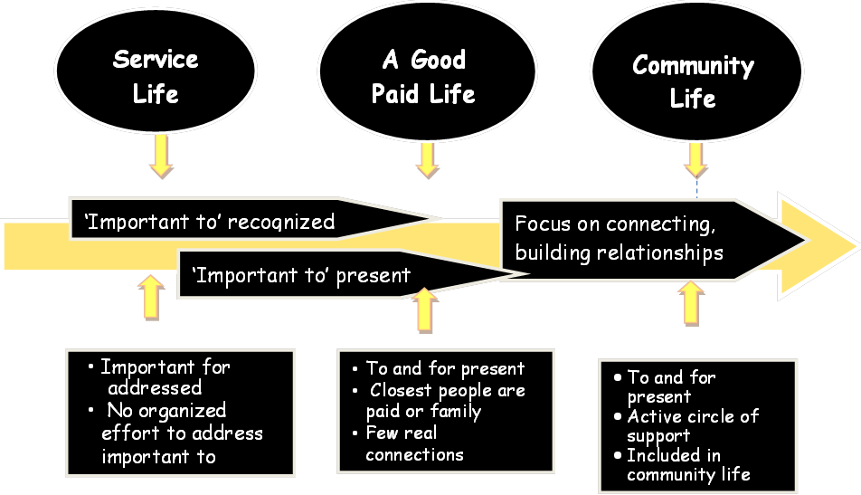
Section I: Values…
Notes:
Narrative: This first section of the orientation manual focuses on the values that will guide you as you provide support. Many of these concepts are built on person-centered thinking and the work of Michael Smull, and others from The Learning Community, whose focus of research has been moving people with disabilities from a “service life” to a “true community life” as illustrated on this slide.
Discussion: Review the Learning Community chart (seen on this slide), which is on page 4 in the Orientation Manual, that shows person-centered practices efforts to move more people toward a community life and discuss how it relates to your agency. This chart demonstrates efforts that have been taking place over the past 30 years.
Many of the people supported in DD services fall at the center of the arrow where they have very few unpaid people in their lives. By supporting them to connect with others in their communities, we help them become contributing members with friends who don’t leave because they change jobs. Think about the friends you spend time with each day. Would you miss them if they left? Do you think that they want you to have what’s important to you in your life?

Slide 16
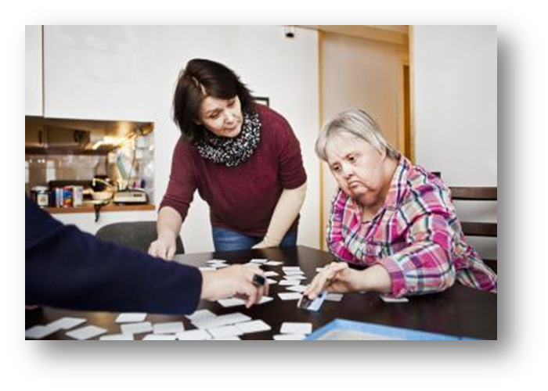
Section I: Values…
Valuable Concepts in Direct Support
Notes:
Narrative:
We will be discussing 12 valuable concepts in direct support:
Person-Centered Thinking
Respect
Person-Centered Planning
Dignity of Risk
Community Connections
Natural Supports
Work
Alternatives to Isolating Programs
Personal Choice & Decision Making
Individual Rights
Confidentiality

Slide 17
Section I: Values…
Person-Centered Thinking
Important TO and Important FOR
Important TO…
…are those things in life which help us to be satisfied, content, comforted, fulfilled, and happy. They include:
People to be with/ relationships
Status and control
Things to do
Places to go
Rituals or routines
Rhythm or pace of life
Things to have
Important FOR…
…are those things that keep a person healthy and safe. They include:
    Prevention of illness
Treatment of illness/medical conditions
Promotion of wellness (e.g.: diet, exercise)
Issues of safety: in the environment, physical and emotional well-being, including freedom from fear
They also include what others see as necessary for a person to:
Be valued and
Be a contributing member of their community
Notes:
Narrative: Person-centered thinking is a set of core skills that DSPs use to see beyond disabilities to support people in obtaining lives of their choosing.
At the base of all person centered thinking skills is the ability to discover what is important to a person while balancing what is important for them. This is true about all people, not just those with a disability. All of us have things in our lives that are important to us and important for us. We all struggle to strike a balance between doing things that are good for our health and having things in our
lives we cherish.
Discussion: Review and discuss the Important To and Important For items on the slide.

Slide 18
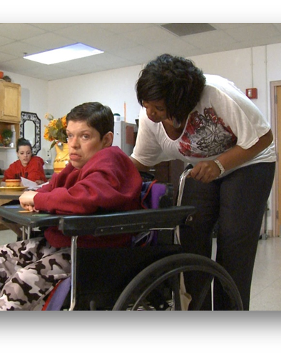
Section I: Values…
Person-Centered Thinking
see the person, not the disability
listen to and respect the person’s choices and preferences
balance what’s important TO someone with what’s important FOR them
record what’s learned to improve the support provided
Notes:
Narrative:
Person-centered thinking is a set of skills used to get to know a person. Getting to know someone then allows DSPs to act on the information and support a person in obtaining a life of their choosing.
Core person centered thinking skills for DSPs are the ability to:
Understand the importance of being listened to, even when people communicate in non-traditional ways;
Understand the importance of and guide others in having positive control over their lives;
Understand the significance of a person’s daily rituals and routines;
Respectfully address significant issues of health and safety, while supporting a person’s choice and control over his or her life;
Define the core roles and responsibilities of a DSP;
Pay attention and record new things you learn about a person and his/her preferences;
Support a person’s dreams, relationships, and community connections; and
Recognize that dreams and preferences are ever changing and that getting to know someone is an on-going journey; not a destination.

Slide 19
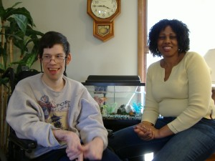
Section I: Values…
Respect
DSPs…
honor people’s rituals and routines
learn backgrounds and cultures
encourage talking for oneself
ask permission when supporting
Notes:
Narrative: The term “respect” has many meanings, including a positive feeling towards another person or the person’s skills, opinions or other characteristics and the honoring of a person’s beliefs, ideas or culture. Respect requires seeing the individual as a person first. Lack of exposure to people who differ from us in customs or standards contributes to a lack of respect.
All people, including those with disabilities, are thought of more positively when in a position to contribute to the community. People with disabilities can get the respect of others by being supported to perform useful and meaningful activities. As a DSP, respect for individuals you support can be achieved by first listening and developing an understanding of their culture, background, hopes and dreams, and then supporting each person to follow through on things that are important to him or her.
There is a tendency to have lowered expectation of individuals with disabilities. Low expectations limit individuals’ opportunities to try new things and interfere with their achievements. It is your responsibility to move away from a focus on the limitations and turn towards a focus on talents and abilities. This enables the focus to shift to respect and empowerment.
Discussion: Talk about the True Story on page 8 of the Orientation Manual.

Slide 20
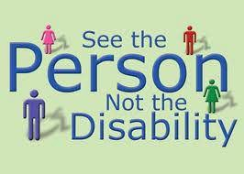
Section I: Values…
Respect and Language
DSPs…
use person first language
use everyday language
consider their tone of voice
don’t use jargon and labels
remember that their attitudes and interactions influence others
Notes:
Narrative: Your choice of words in speaking and your attitude (conveyed through the tone of your voice) are very important. Language can act as a separator when you use “special” language or professional jargon when talking about people with disabilities such as “client,” or “consumer.” Special language says people with disabilities are different. Instead, use everyday language, words, and phrases you would use when talking about co-workers, friends, and family members. For example, instead of saying John was placed in a job, say, he found a job or instead of saying Jane transitioned from high school, say, she graduated. As a DSP, how you talk will influence the attitudes and interactions of others.
“Person First” language emphasizes the person and not the disability. The first choice is always to call someone by their name. If you have to refer to someone and mention disability, always put the person first. The phrase, “a disabled person,” can be disrespectful and emphasizes the disability rather than the person. You should say, “a person with a disability.” Instead of saying “someone with Down’s,” say, “a person has Down syndrome.” Referring to the person first lets others know he or she is, first and foremost, a person who deserves respect.
Read: Person First Language by Kathie Snow https://www.disabilityisnatural.com
Read: Language to Avoid http://www.partnership.vcu.edu/DSP_orientation/downloadables/LANGUAGE%20TO%20AVOID.pdf

Slide 21
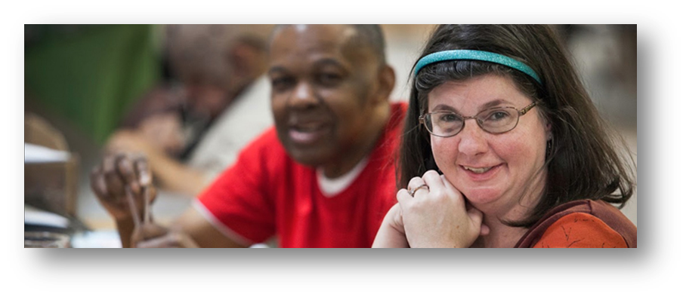
Section I: Values…
Person-Centered Planning
DSPs need to be able to:
plan WITH the person using a team approach
listen and contribute
continue listening and learning to improve the supports and the person’s plan
Notes:
Narrative: The core of person-centered planning is to empower the person who uses paid supports to make decisions and choices that direct and shape his/her own life. The goal is to move from a needs-based system to a support-based approach. The support-based approach helps to develop personal goals and a life that is meaningful to the person using supports, while still addressing their health and safety.
Person-centered planning always includes the person who is the focus of the plan and other people who are selected by them to participate. This leads to the achievement of goals that are meaningful to that person.
Discussion:
1. In Virginia’s Individual Support Plan, the term “desired outcomes” is used in the person-centered planning process. Talk about the types of outcomes that DSPs might be supporting. Read “Consider for a Moment” on page 8 in the Orientation Manual.
2. Talk about A Credo for Support available at :
http://www2.gnb.ca/content/dam/gnb/Departments/pcsdp-cpmcph/pdf/docs/CredoforSupport.pdf or https://www.youtube.com/watch?v=wunHDfZFxXw (video).
Read or listen to it if DSP did not read or listen while studying the Manual.
3. There are 10 items listed in a box on page 11 of the manual (From the standpoint of those you support). Talk about which of these are the most difficult to follow.

Slide 22
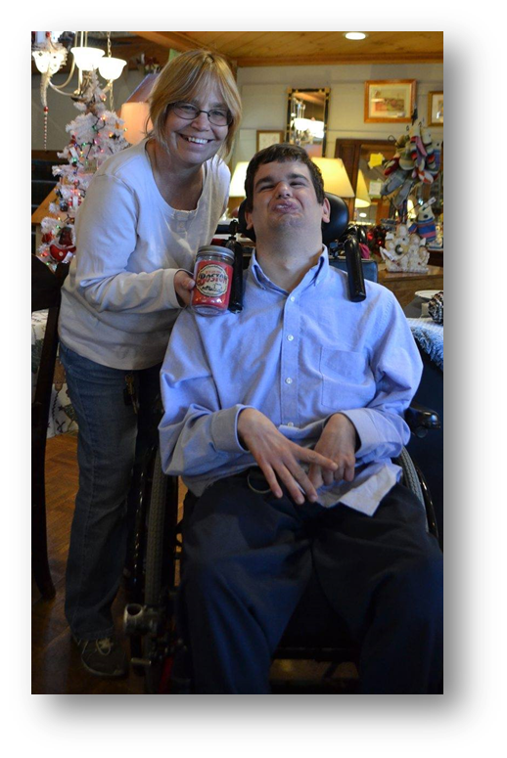
Section I: Values…
Dignity of Risk
DSPs need to be able to:
assure typical experiences in life
support informed decisions
understand your role
safely support risk
Notes:
Narrative: The concept of dignity of risk is the right of a person to make an informed choice to engage in experiences meaningful to him/her and which are necessary for personal growth and development. Normal living often includes risks. Dignity of risk allows people to lead normal lives. Overprotection of people with disabilities keeps them from many life situations that they have the right to experience, and it may prevent meaningful connections and fulfillment of their hopes and dreams.
Discussion: What’s your role and what does it look like?
Rather than protecting people with disabilities from disappointments and sorrows, which are natural parts of life, support them to make informed decisions. This enables them to experience the possibility of success and the natural risk of possible failure. Occasionally, as support staff we believe we know the outcome for those who “dream too big.” Dignity of risk demands we try to help people investigate and reach for their dreams, while keeping health and safety at the forefront of our services.

Slide 23
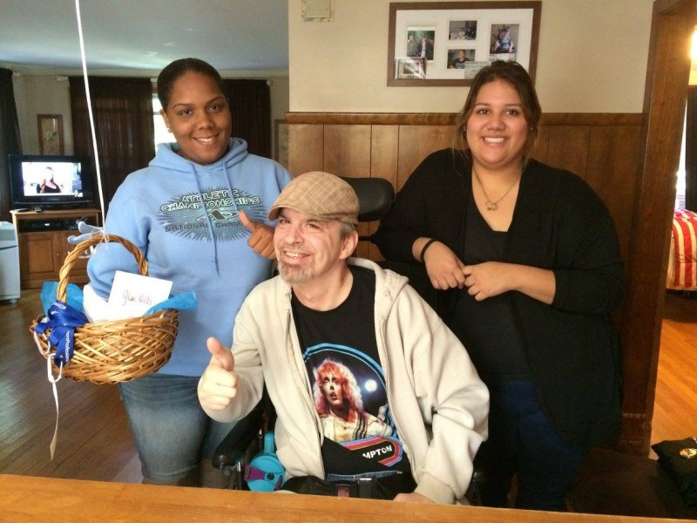
Section I: Values…
Community Connections
DSPs…
support people to be involved in their community
encourage independence and participation
find community opportunities and resources for the person to connect with friends, neighbors and other community members
Notes:
Narrative: Community is a group of people who come together for a common reason. People may belong to several communities, some which are based on a common interest, others that are based on geography such as a neighborhood. People within a community may be very different from one another. Being part of a community brings people together, and people will learn that it is okay to be different. Positive and regular interactions bring a community together.

Slide 24
Section I: Values…
Community Connections
Community presence may include doing things in the community on a regular basis and being recognized by others who attend, but not really interacting with others. If a person is not there, they are not missed.
Community participation may include doing things in the community on a regular basis, knowing several people by name and having conversations with them about personal lives. The person does things at the event that others depend on and they would be missed if they were not there on a particular day.
Community connection may include a person being included in social gatherings outside of the primary connection, others recognizing and appreciating their contributions, and forming friendships that extend beyond the reason they are gathered. When a person is not there they are missed and people ask about them.
Notes:
Narrative: There are three ways to be part of your community – presence, participation, and connection.
Discussion:
1. Go over the definitions on the slide and use the following examples as a summary:
Community presence example: Jill moves to a new neighborhood. She begins walking to get to know the neighborhood. She meets people on the street, chats, sometimes exchanging names. Jill begins to be recognized as someone who lives and walks in the neighborhood and she begins to see the same people often. Neighbors may know her name.
Community participation example: Jill sees a notice for a neighborhood clean-up/watch committee. She begins going to the meetings on a regular basis and helps clean up the neighborhood on clean-up days. She is getting to know neighbors because they talk while she is at the meetings.
Community connection example: Jill becomes particularly fond of one of her neighbors that she met at the clean-up committee. They discovered they have a common interest in swimming. Soon they are going to the pool together and start calling/texting one another to chat. They have met each other’s families and become friends.
2. Encourage DSPs to read and explore ideas and suggestions from the following resources:
A Guide to Developing Community Connections by Patsy Davies & Claudia Bolton
http://www.allenshea.com/CIRCL/connections.pdf
Friends: Connecting People with Disabilities and Community Members by Angela Novak Amado
http://rtc.umn.edu/docs/Friends_Connecting_people_with_disabilities_and_community_members.pdf

Slide 25
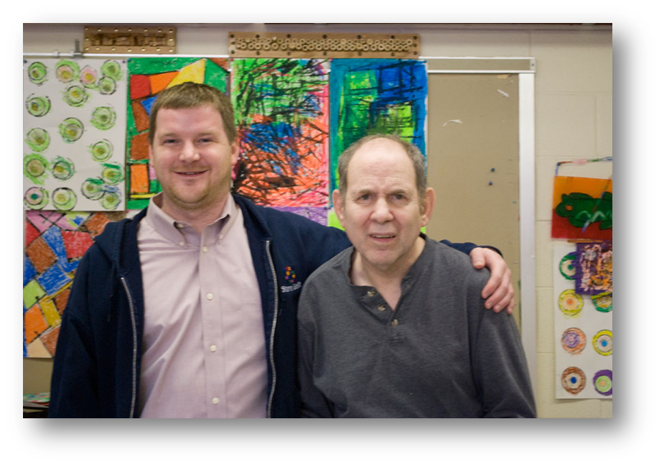
Section I: Values…
Natural Supports
DSPs should be able to:
learn who people want to be around
connect people by interest not disabilities
help locate and nurture unpaid relationships
Notes:
Narrative: The term natural supports refers to the resources that are already present and available to all persons in community environments. This includes family, friends, co-workers and neighbors, members of clubs or civic groups and local merchants.
Imagine for a minute what it would be like to wake up every morning knowing that the only people you will interact with all day will be those paid to be with you.

Slide 26
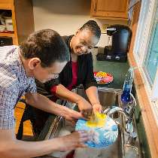
Section I: Values…
Work
DSPs …
talk to people about work
understand the benefits of work
focus on Employment First!
Notes:
Narrative: Our culture values work. It is expected that adults will work to earn money to support themselves. This value is true for people with disabilities. Additionally, we recognize that working in the community provides so much more than just a paycheck. Numerous studies have shown that people with disabilities who are working in the community report other non-monetary benefits to working.
Employment First is a concept that Virginia values. It means offering the option of integrated, community employment as the first choice of day activity to people entering services. If the person has no reference for choosing work (has no work experience), they should have an opportunity to do work assessments to see what it is like. Those who are not currently working should have frequent opportunities to learn about work, the types of jobs people do, and to be exposed to working people within their interest areas.
Discussion:
1. Ask for the benefits of working, such as:
Working people have higher levels of self-efficacy: they have higher expectations of what they can accomplish, and this spreads to other areas of their lives.
Working people feel more connected to the greater community.
Working people report having better health and sense of well-being.
Working people report having meaning in their lives.
Working people make money. Income from paying jobs helps supplement their resources and improves the quality of the lives they can live.
2. Discuss DSPs roles in encouraging work (page 17 of Manual).

Slide 27
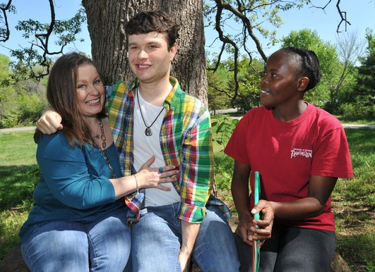
Section I: Values…
Alternatives to Isolating Programs
DSPs should be able to:
focus on community, avoiding separation or special groups
support the person’s ability to contribute
encourage finding meaningful work
Notes:
Narrative: With the focus on community life, there is no longer a need for specialized programs that restrict or exclude people from an ordinary or extraordinary life. Using paid supports does not mean a person with a disability has to participate in specialized programs or groups of people with similar disabilities, with little to no access to ordinary activities.
Alternatives to isolating programming refers to supporting a person in natural settings, with families and friends, by providing flexible supports that work well for them.
People with disabilities, should live in comfortable homes in safe neighborhoods. They should have the choice to work a regular job or to engage in other typical activities that they and the community value.

Slide 28
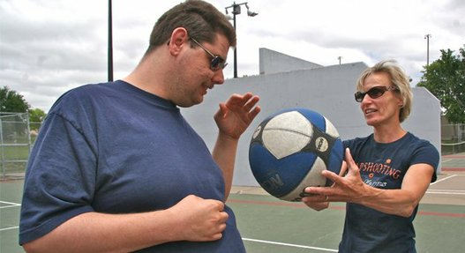
Section I: Values…
Personal Choice & Decision Making
DSPs …
listen to preferences as choices
encourage and honor choices big and small
help the person consult with others
Notes:
Narrative: Personal choice means making decisions about all the details of our lives. Each day we are engaged in making choices. We ask ourselves, “Should I hit the snooze button or get up?” “Should I call in or go to work?” “What should I wear?”
We also make major decisions about who to live with and what sort of work we want to do. We are in control and it feels good to be empowered and able to make our own decisions. Everyone is entitled to make decisions about their lives.
Informed consent refers to one’s ability to make a decision based on a clear understanding of the facts, results of the choice, and possible future consequences. Some people do not show the capacity for informed consent and need supports from family members, an authorized representative, or a legal guardian. This is typically reserved for decisions or choices that might have an effect on a person’s health and safety. This does not mean that the day-to-day choices or expression of hopes and dreams should be restricted. DSPs are responsible for encouraging choice and consulting with alternate decision-makers when unsure.
Discussion: Review “Methods of Helping People Make Choices” on page 19 & 20 of the Orientation Manual.

Slide 29
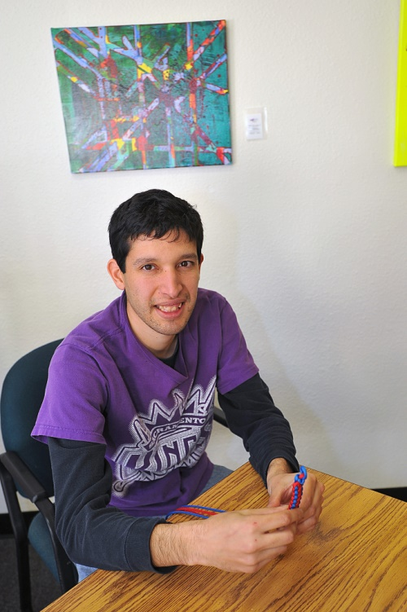
Section I: Values…
Individual Rights
DSPs…
understand human rights policies and consult with a supervisor when there are concerns
report concerns of abuse or neglect
include others in decisions involving risk
Notes:
Narrative: All people, no matter their ability, retain basic human rights. Like you, people with disabilities are entitled to enjoy the rights and freedoms to privacy, to have personal possessions, to marry, to exercise free speech, to live in neighborhoods, to complain, to vote, etc. It is also the right of the person to be free from abuse, neglect and not to have restrictions on his or her rights and freedoms.
As a DSP, you are considered a “mandated reporter,” and are required to report violations of individuals’ rights, including suspicion of abuse or neglect. Though policies vary, you are required to report to your agency’s director.
Some people you support may have had their legal rights limited through the appointment of a guardian, conservator or another legal process. This does not mean they cannot make day-to-day choices and decisions or should have their dreams or plans go unheard. It is the DSP’s responsibility to seek guidance and help with decision making when appropriate and/or needed to preserve the health and safety of the person you support.
Note to supervisors: As an employee of a community agency providing supports to individuals with intellectual and other developmental disabilities, DSPs must be aware of these basic human rights, any specific human rights policies followed by your agency, and their responsibility as a mandated reporter. Supervisors/trainers should give DSPs a copy and to explain your agency’s policy to them.

Slide 30

Section I: Values…
Confidentiality
DSPs…
are aware of privacy rights
do not discuss individuals’ personal information without permission
are sensitive to how individuals are introduced in the community
Notes:
Narrative: Confidentiality is a right each of us has to privacy and respect of information given to and shared among professionals about us. People generally expect that their medical records, financial records, psychological records, criminal records, driving records, etc. are going to be kept in a confidential manner.
DSPs must remember to have this same respect for the private information about individuals whom they support. No one would like to think that his or her doctor or counselor openly discusses his or her diagnosis, illnesses, or care plan at home or a party.
While DSPs generally read and sign a confidentiality agreement related to employment, it is important to avoid sharing confidential information about the individuals being supported.
Discussion: Discuss the “True Story” on page 22 of the Orientation Manual and how this story impacts their thoughts on confidentiality.

Slide 31
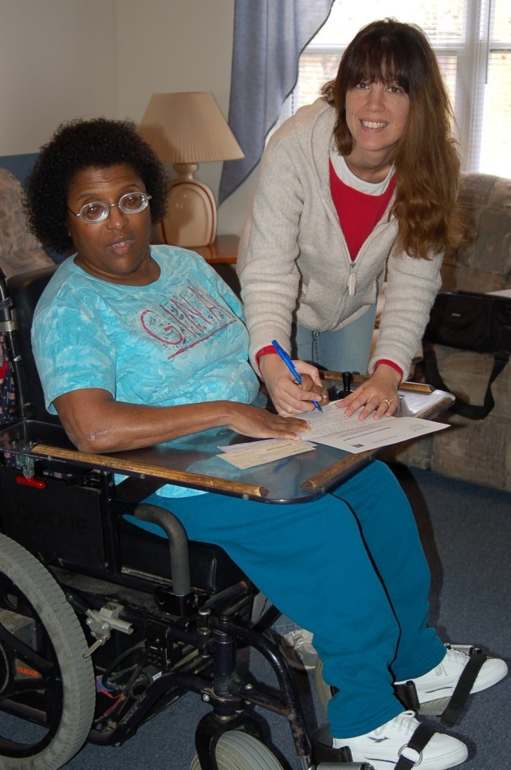
Section II: Introduction to Developmental Disabilities
Slide 31
Notes:
Narrative: In this section, we will discuss the definition of developmental disabilities, as well as some of the causes. While this information is important for a better understanding of the people you will support and will help you in your work, it is also important to understand the myths and misunderstandings which get in the way of people living meaningful lives in the community. We will also discuss how you can become a “roadblock remover” for people you support.

Slide 32
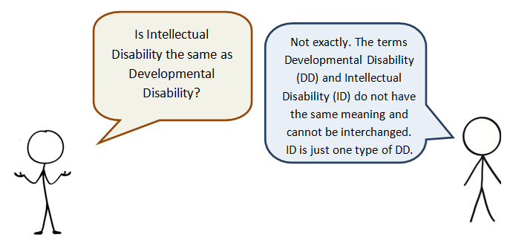
Section II:
Introduction to DD
Section II: Introduction DD
Notes:
Narrative: The term developmental disability (as defined by the Developmental Disabilities Act) means a severe, chronic disability of an individual that is attributable to a mental or physical impairment or combination of mental or physical impairments that are manifested before the individual attains age 22 and are likely to continue indefinitely. Developmental disabilities result in substantial limitations in three or more of the following functional areas:
self-care
receptive and expressive language
learning
mobility
self-direction
capacity for independent living
capacity for economic self-sufficiency
Intellectual disability is one type of developmental disability and diagnosis must occur before the age of 18.

Slide 33
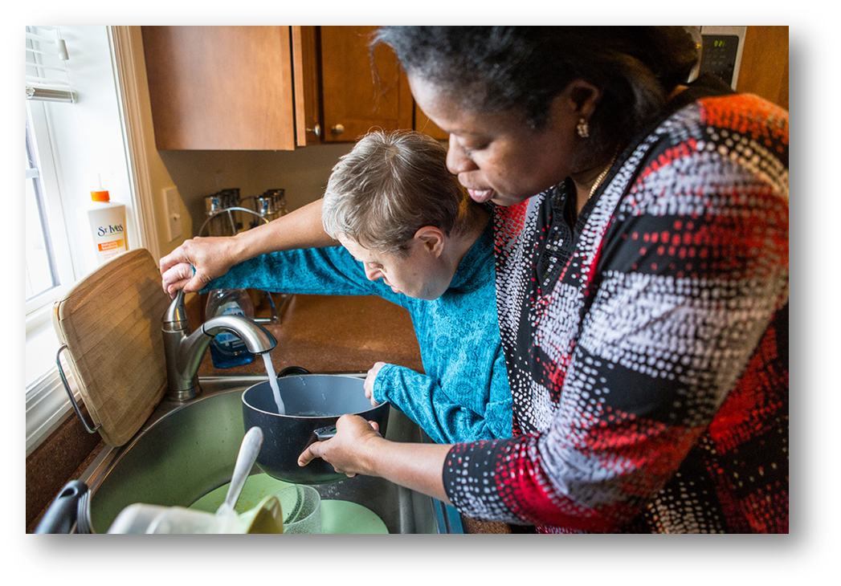
Section II:
Introduction to DD
Defining Intellectual Disability
Notes:
Narrative: The term intellectual disability (as defined by the American
Association of Intellectual and Developmental Disabilities- AAIDD) means a person has significant limitations in intellectual functioning (reasoning, learning, problem solving) and in adaptive behavior, which covers a range of everyday social and practical skills. Thus disability originates before the age of 18.

Slide 34
Section II:
Introduction to DD
More about DD
Includes people with autism, cerebral palsy, and other mental or neurological conditions
May be only physical
May or may not have an intellectual disability
Notes:
Narrative: People with autism, cerebral palsy, and other mental or neurological conditions (seizures) are also considered to have a developmental disability.
Other developmental disabilities may be strictly physical, such as blindness or deafness from birth or childhood.
People with developmental disabilities may or may not also have an intellectual disability. Some developmental disabilities, such as Down syndrome, fetal alcohol syndrome and Fragile X syndrome, almost always occur with an intellectual disability.
Discussion: Look over “Factors to Consider” on page 25 of the Orientation Manual and talk about why they are important to consider.

Slide 35
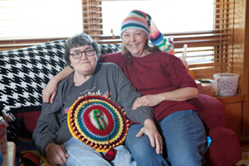
Section II:
Introduction to DD
Some causes of intellectual disability
Genetics
Other physical causes
Social and environmental factors
Unknown
Notes:
Narrative: Some Causes of Intellectual Disability (Orientation Manual p. 25) include:
Genetics -something you are born with that is passed down by parents (e.g., Down syndrome, Fragile X).
Other physical causes (e.g., fetal alcohol syndrome, car accidents, shaken baby syndrome).
Social or environmental factors (e.g., lack of stimulation, trauma/abuse during the developmental years, lack of family and educational supports to promote mental development and adaptive skills).
Approximately 40% to 50% of individuals with ID have no known cause of their disability.

Slide 36

Section II:
Introduction to DD
Myths and Misconceptions
People with developmental disabilities are all alike and all require the same supports.
Notes:
Narrative: People with DD are individuals like everyone else and may need unique supports to live a desired life.
Over the years, people with intellectual and other developmental disabilities have been placed in group settings partly because people have decided that it is cheaper and easier, and partly because people do not understand their various disabilities. The individuals in a given group often have nothing in common other than the fact that they all have at least one developmental disability. It is important to note that people with disabilities are often best supported using very different approaches.
Disability is just one aspect of a person. It does not define them. Getting to know someone’s personality, likes, dislikes, needs and desires along with understanding their disability is the best way to determine what supports may be needed. Having a developmental disability might mean needing supports to reach an outcome that a person without a disability might reach by himself.
The presence of a developmental disability does not change the fact that someone has his own, self-determined goals. Each person with a developmental disability might need some supports, just as we all do in different areas of our lives. However, the same amount and types of supports needed for one person may not be needed for another.

Slide 37

Section II:
Introduction to DD
Myths and Misconceptions
People with developmental disabilities are ill or sick.
Notes:
Narrative: A developmental disability is not an illness, and people living with developmental disabilities are not “patients” (unless they happen to be temporarily hospitalized). You cannot catch a disability.
While developmental disabilities cannot be cured, individualized and age-appropriate supports are likely to enable people to reach their personal outcomes and increase their level of independence.
Just like anyone else, a person with a developmental disability may or may not have co-occurring conditions such as medical conditions, physical disabilities, or a mental illness.

Slide 38
Section II:
Introduction to DD
Myths and Misconceptions
People with developmental disabilities need specialized services to meet all of their needs.
Notes:
Narrative: Each of us, including those of us with developmental disabilities, has very different strengths and support needs.
We all continually grow and change in terms of the supports we need to be successful. One person may not need support or assistance with a certain task, while another may require support to successfully complete the same task. Similarly, someone who needs support today to complete a certain task may or may not need the same support tomorrow to be successful in accomplishing the same task.
People with a developmental disability can shop at the same store as people without a disability. They may or may not need support and assistance to do their shopping and money management.
A person with a developmental disability who has a medical condition can be treated by the same doctor as a person without a disability who has the same medical condition. Persons with a developmental disability may or may not need help telling the doctor how they feel, understanding the diagnosis or taking prescribed medication.
Just as for all of us, the supports provided must be individualized.

Slide 39
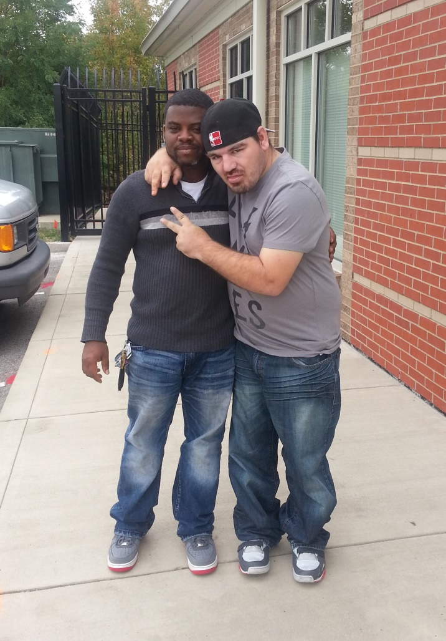
Section II:
Introduction to DD
DSPs…
see the person not the disability
are creative, taking each person’s wishes seriously
are positive and don’t let history get in the way
are a model for others
Notes:
Discussion: Talk about the roles of a DSP in supporting people with disabilities as described on page 28 of the Orientation Manual.
View (or discuss if DSP has already viewed) the two videos:
Direct Support Professional Profile
https://www.youtube.com/watch?v=79_8Igkh_9c
and
The Harley Story https://www.youtube.com/watch?v=XWmcXHRMisU42/

Slide 40
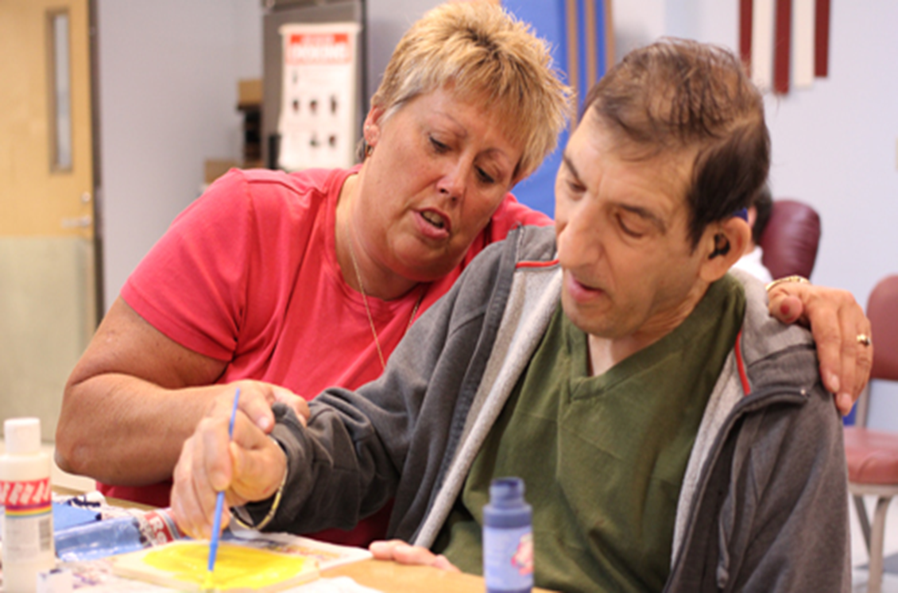
Section III: Waivers for People with
Developmental Disabilities
Slide 40
Notes:
Narrative: In this section, you will learn about the variety of supports and services that are available through Waivers and how people become eligible for Waiver supports and services. The assessment, planning, implementing, and documenting activities are also discussed.

Slide 41
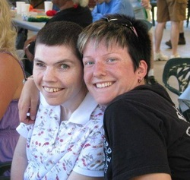
Section III: Waivers for People with Developmental Disabilities
Virginia’s Waivers
Built upon
Individual supports
Person-centered approach
Individual choices, outcomes, and needs
Notes:
Narrative: Virginia’s Waivers are built on the idea of individualized supports. Services are developed and funded based on a person-centered approach as discussed in Section I. Each person (with assistance if needed) chooses different types and levels of supports based on his or her desired goals, outcomes, choices and needs.

Slide 42
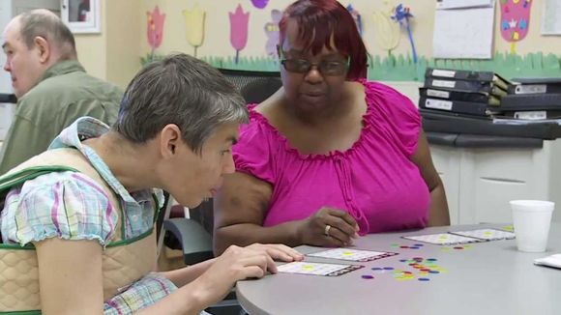
Section III: Waivers for People with Developmental Disabilities
Waiver Services
Can be
Consumer-directed
Agency-directed
OR
A combination of both
Notes:
Narrative: Most services are agency-directed services, in which the provider agency hires staff to work with the person. Some are consumer-directed services (also known as self-directed), in which the person (or his/her family) employs the staff person. People can also use a combination of both agency-directed and consumer-directed services.

Slide 43
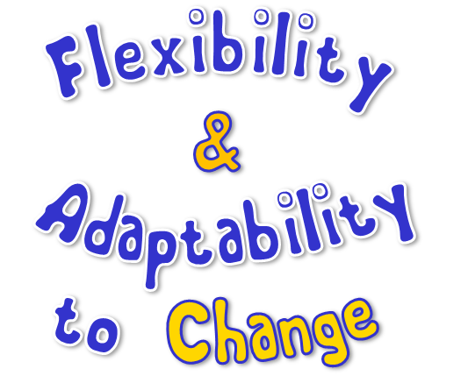
Section III: Waivers for People with Developmental Disabilities
Re-Designed Waivers
More targeted and flexible services
More choices and opportunities
Greater consistency, equity, and quality
Increase flexibility
Notes:
Narrative: Virginia recently redesigned the Waivers for people with DD and there is now one process to qualify for and access supports and services. The redesigned Waivers:
Provide more targeted, flexible, needs-based services;
Create more choices and opportunities;
Promote consistency, equity, quality and accountability across the waivers; and
Increase flexibility in service design.

Slide 44
Section III: Waivers for People with Developmental Disabilities
Three Waivers support people with DD
Community Living Waiver
Family and Individual Supports Waiver
Building Independence Waiver
Notes:
Narrative: In the re-design of the Waivers, the three that support people with DD are:
Community Living Waiver
Family and Individual Supports Waiver
Building Independence Waiver
Discussion: Section III of the Orientation Manual contains a list of waiver services. Talk about why it is important for DSPs to 1) know about Waivers and 2) be familiar with the different services that are available.

Slide 45
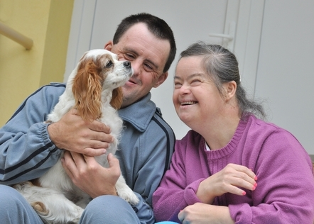
Section III: Waivers for People with Developmental Disabilities
The Community Living Waiver
Notes:
Narrative: The “Community Living Waiver” is a comprehensive waiver that includes 24/7 residential services for those who require that level of support. It includes services and supports for adults and children, including those with intense medical and/or behavioral needs.

Slide 46
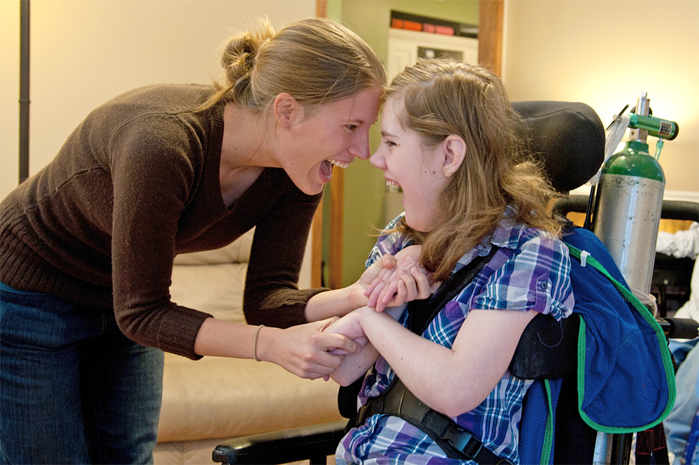
Section III: Waivers for People with Developmental Disabilities
The Family and Individual Supports Waiver
Notes:
Narrative: The “Family and Individual Supports Waiver” supports people who live with their families, friends, or in their own homes. It provides support to people with some medical or behavioral needs and is available to both children and adults.

Slide 47
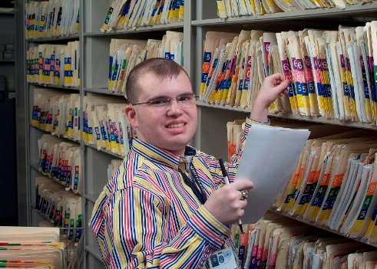
Section III: Waivers for People with Developmental Disabilities
The Building Independence Waiver
Notes:
Narrative: The “Building Independence Waiver” supports adults 18 and older who are able to live in the community with minimal supports. This Waiver does not include 24/7 residential services. People using this Waiver own, lease, or control their own living arrangements.

Slide 48
Section III: Waivers for People with Developmental Disabilities
Waiver Service Categories
Employment and Alternate Day Options
Self-directed and Agency-directed Options
Residential Options
Crisis Support Options
Medical and Behavioral Support Options
Additional Options
Notes:
Narrative: Waiver services are divided into the following categories:
Employment and Alternate Day Options
Self-directed and Agency-directed Options
Residential Options
Crisis Support Options
Medical and Behavioral Support Options
Additional Options
Each of the options contain multiple services which are available in one or more of the DD Waivers. All services are not available in all Waivers, so you may need to ask your supervisor about options. It is important that you know about the variety of supports that are available so that you can assist in planning for each person you support. You can refer to the Orientation Manual or other agency documents as needed to become familiar with the array of service options rather than trying to remember all of them.

Slide 49
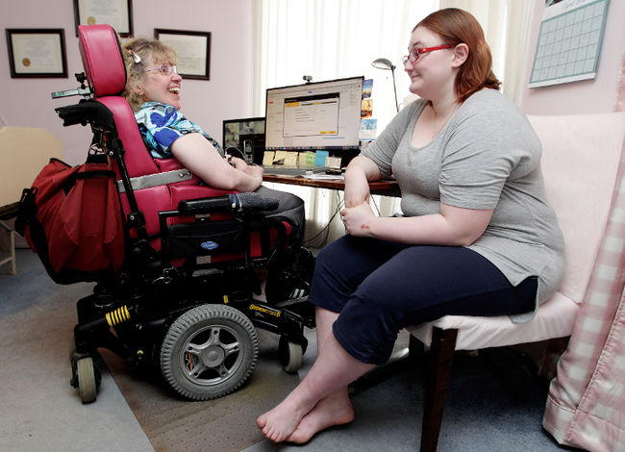
Section III: Waivers for People with Developmental Disabilities
Eligibility for Waiver Services
Have a diagnosis of developmental disability,
Meet Medicaid financial eligibility,
Meet the Level of Care Criteria as determined by the Virginia Individual DD Eligibility Survey (VIDES), and
Accept services within 30 days.
Notes:
Narrative: In order to be eligible for services funded through Waivers, a person must meet the following criteria:
Have a diagnosis of developmental disability,
Meet Medicaid financial eligibility,
Meet the Level of Care Criteria as determined by the Virginia Individual DD Eligibility Survey (VIDES), and
Accept services within 30 days.
In order to use services through the Waivers, a person needs to be determined eligible for services and assigned a slot. There are a limited number of slots and everyone who is eligible does not get to receive services right away. If a slot is not available, the SC determines the individual’s priority needs level and places the person’s name on the waiting list via the Virginia Waiver Management System (WaMS). A Critical Needs Summary documenting the person’s level of urgency is also completed by the SC.
When a slot becomes available, the DBHDS-supported regional committee will assign the slot to the person on the waiting list who is found to have the greatest need for services.

Slide 50
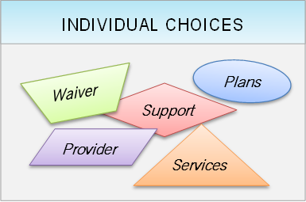
Section III: Waivers for People with Developmental Disabilities
Notes:
Narrative: Eligible individuals for whom a slot is available must be allowed to choose:
whether they want to participate in the Waiver program,
what services they will receive,
who the service provider(s) will be,
what’s in their plan and
the supports to be provided.

Slide 51
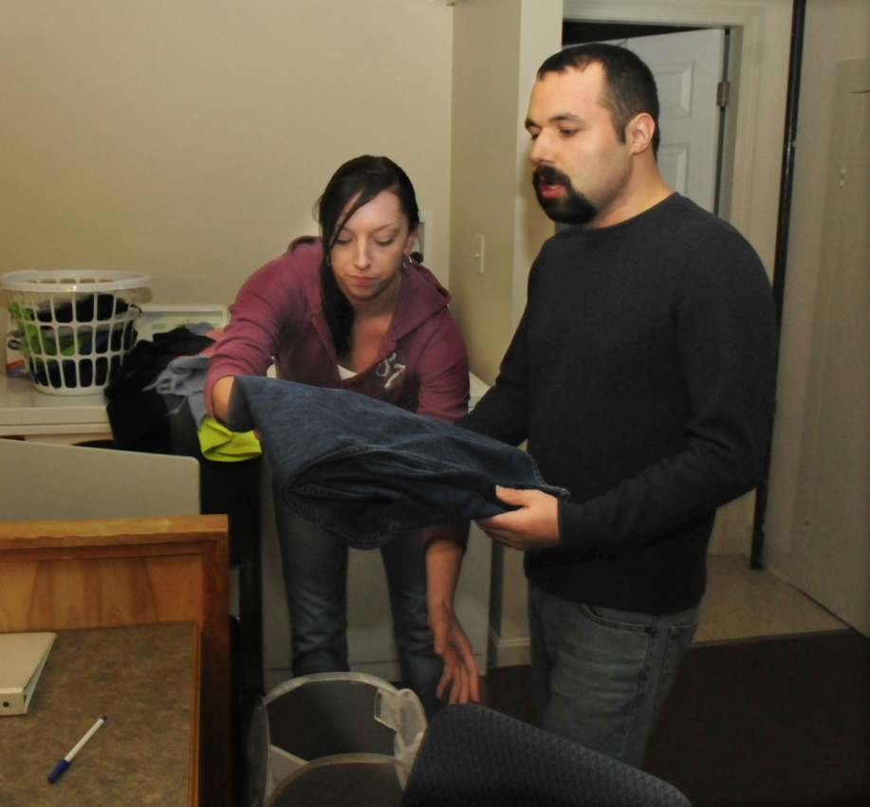
Section III: Waivers for People with Developmental Disabilities
Services are offered by the Support Coordinator
and authorized by DDS
Notes:
Narrative: Each person who is enrolled in a Waiver is assigned a support coordinator (SC). Support coordinators may also be called “case managers” (CM). SCs work for or contract with the CSB that serves the area in which the person lives.
The SC is responsible for linking the person with service providers, as well as coordinating and monitoring the services. The SC, Waiver service providers, the person’s family members and others he/she chooses, meet together to help him/her develop an Individual Support Plan (ISP).
All Waiver services must be authorized by the Division of Developmental Services (DDS) prior to the start of services. The SC must review service providers’ service plans (called Plans for Supports) to ensure that the plans match what was decided at the planning meeting. The SC also ensures that the individual’s choices are the focus and driving force of the plan prior to requesting authorization. Changes in type and amount of services can be made only with prior authorization from DDS.

Slide 52

Section III: Waivers for People with Developmental Disabilities
Assessment and Personal Profile
DSPs…
share information about what the individual wants in his or her “good life”
consider what’s working and not working in 8 life areas
contribute in many ways through conversations and written notes
Notes:
Narrative: All Waiver services must be delivered according to the written Individual Support Plan (ISP). The ISP is based on information learned about the person, such as:
What is important to him/her in order to live his/her idea of a good life,
What is important for helping him/her stay healthy, safe and a valued member of the community,
What he/she is interested in doing,
What he/she does well, and
What he/she needs help with from the provider (support).
You will be asked to participate in a team approach to providing supports, which may include answering questions, attending team meetings or actually completing an individual’s assessment.
As a team member in providing supports, you will make contributions to the ISP – especially the “Personal Profile,” which is a personal description of the person to help the team focus on what’s important to the person, what needs to stay the same, and what needs to change for the person to have a good life.

Slide 53
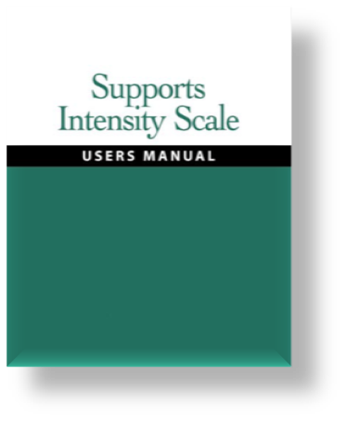
Section III: Waivers for People with Developmental Disabilities
Supports Intensity Scale (SIS)
DSPs…
have valuable information for SIS interviews
offer information based on knowing the person
Notes:
Narrative: Each person using Waiver services is assessed using the “Supports Intensity Scale” TM (SIS). This scale is completed every three years with the person and other people who know him/her well. This instrument gives service providers consistent information about the people they support.
In addition, each person using Waiver services will have a “Risk Assessment” (which is part of the SIS) completed annually to determine health and safety needs and help plan supports for especially serious medical and/or behavioral issues.
You may be asked questions about people you support in order to help complete one of these assessments.

Slide 54

Section III: Waivers for People with Developmental Disabilities
Planning Team
DSPs…
might help the individual plan the meeting
might attend with the person
share information with permission
Notes:
Narrative: The ISP is developed by a team with the person at the center of planning. Other members of the team include family members, guardian/authorized representative (if there is one), friends, SC, and service providers.
The team must meet at least once a year to develop the ISP for the next year.
These meetings should be fun and informal, with all team members helping the person feel comfortable expressing his/her hopes, desires, and worries about services and supports. Team members (with permission from the person) present what they’ve learned and make suggestions related to his/her desired outcomes, preferences and supports to be provided in the upcoming year. Provider roles and responsibilities are decided upon and the shared plan is agreed to by all team members.

Slide 55
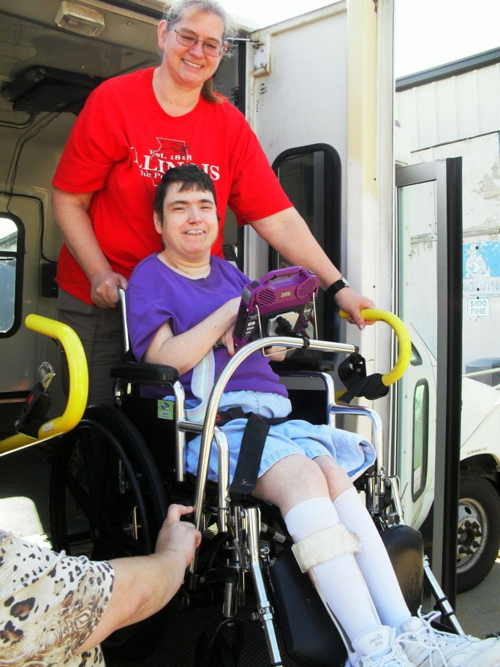
Section III: Waivers for People with Developmental Disabilities
Plan for Supports
DSPs…
know the outcomes, activities and instructions in the Plan for Supports
follow the instructions as described in the Plan
know how to respond to change
Notes:
Narrative: Each provider develops a Plan for Supports with the person to address the outcomes that they agreed to at the meeting for their service area. In this way, the supports and activities that lead to reaching the desired outcomes are discussed and become a part of each Plan for Supports.
A Plan for Supports is based on the role that each service fills in the person’s life. For example, a group home (or residential) provider might not help the person learn a job, but would help him/her to meet more people in the neighborhood or become a better cook. Each Plan for Supports becomes a part of the larger ISP.
Discussion: Review a Plan for Support of a person using your agency’s services. Read and discuss each component, including the role of the DSP in reading, understanding, and implementing the plan.

Slide 56

Section III: Waivers for People with Developmental Disabilities
PC Reviews and Documentation
DSPs write notes…
that convey vital information needed for Person-Centered Reviews
complete checklists to record that support activities were provided and that relate to outcomes and describe supports
Notes:
Narrative: The Plan for Supports must be reviewed in writing once every three months to make sure it is still working for the person. This review looks at whether services are being delivered as described in the Plan for Supports, how well they support the person and whether the person is satisfied with the services. The person-centered review helps determine the appropriateness of the services and whether the supports being provided are moving him/her closer to achieving his/her desired outcomes. All Waiver providers’ person-centered reviews are sent to the SC for his/her review.
Each provider must maintain documentation that shows:
Supports were provided as described in the Plan for Supports;
What supports were provided and when;
That the Plan for Supports is being reviewed on a regular basis to determine status, movement or progress towards outcomes; and
That changes to the Plan for Supports are made as needed or desired by the person.
Discussion: Formats and styles for this documentation vary from agency to agency. Recommended formats are available on the DBHDS website. Review a good set of quarterly documentation from a DSP in your agency, and how it is reflected in the PC quarterly review. You may also review the DSP’s role in documentation on page 36 of the Orientation Manual.

Slide 57
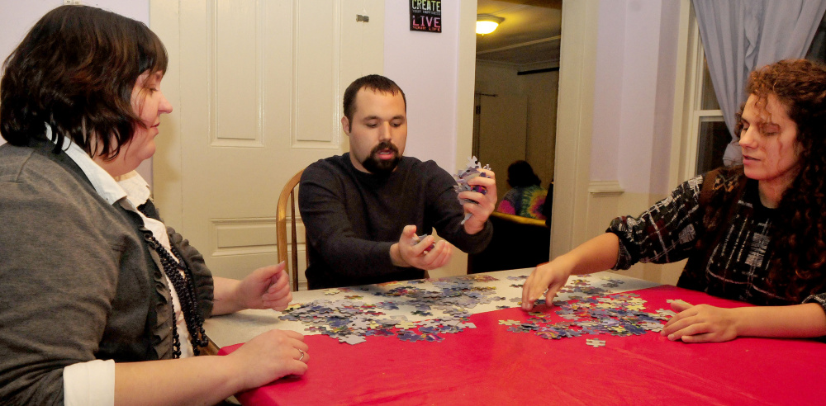
Section IV: Communication
Section IV: Communication
Slide 57
Notes:
Narrative: In this section, you will learn more about communication. The types of communication, pitfalls in communicating, and the use of behavior to communicate are discussed.

Slide 58
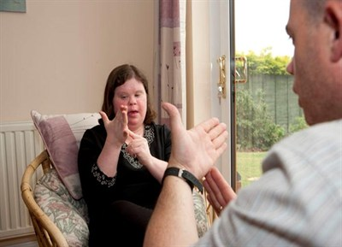
Section IV: Communication
People Communicate in a Variety of Ways
Some ways include:
Speaking
Writing
Gestures
Body language
Signs
Behaviors
Actions
Notes:
Narrative: We usually think of communication as speaking or writing, but the definition of communication also includes information back and forth between people through a system of signs, or behaviors like gestures, body language and actions. Actions are things like smiling, laughing, kicking, head banging, or even hurting oneself. All people have the need to communicate to express choice, feelings, emotions, needs, likes and dislikes.
Everyone communicates in some way. Some people use words to communicate, however, we do not need to use only words to communicate. We use behaviors to communicate with facial expressions (smiles, frowns, eye blinking), pointing or other physical gestures, vocal sounds, eye contact, body movements, or with our actions or behaviors.
Discussion: If you make a suggestion to someone and they roll their eyes, what are they communicating? What are some other ways to communicate without using words?

Slide 59

Section IV: Communication
Two Types of Communication
Expressive
Receptive
Notes:
Narrative: Communication works two ways: expressing information (expressive skills) or receiving information (receptive skills). Expressive communication means talking or communicating in any form and receptive communication means understanding what someone is trying to tell you. Expressive communication refers to how people “share or express” information. Receptive communication refers to how people “receive” information, or “what information they take in.”
Some people cannot speak (expressive skills), but may understand what is being said to them (receptive skills). Some individuals can speak clearly and are easily understood (expressive skills), yet may not understand what is said to them (receptive skills).

Slide 60
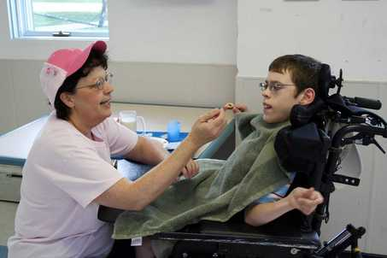
Section IV: Communication
DSPs…
Don’t assume that not speaking means not understanding
Listen to what people say with their words and their actions
Notes:
Narrative: If you give someone broccoli and she makes a grimace or spits them out, what is that person communicating? If you give a person ice cream and he smiles and gestures for more, he is communicating what he does like.
People may communicate through signs, symbols, behaviors, or by using an iPad or other assistive technology. Although some people may not use words to communicate, it does not mean that they cannot understand what others are saying. Intellectual or physical challenges may be the reason some people lack the ability to talk, but it does not mean that they do not understand what’s happening around them.

Slide 61

Section IV: Communication
DSPs…
Take the time to understand what someone is saying through his actions
Model age-appropriate and positive communication
Notes:
Narrative: Some people have trouble using words to communicate because of physical (e.g., a hearing or motor impairment) or genetic factors related to their intellectual or other developmental disability. Sometimes medications affect verbal communication, and when medications are changed, the ability to communicate may reappear. Sometimes a brain injury can affect someone’s ability to communicate.
As a DSP, you need to pay close attention to all forms of communication. People who communicate without using language usually develop a way to express their likes and dislikes, ask for things and show pleasure, displeasure, pain, or unhappiness through movements and behaviors. Sometimes, it can be hard to figure out what someone is trying to communicate, and you need to think like a detective to decode what they are trying to say with their behavior.
Discussion: Briefly go over the items on page 40 of the Orientation Manual and discuss any concerns or observations.

Slide 62
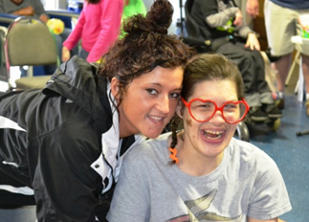
Section IV: Communication
DSPs…
Respect that everyone needs to communicate
Know that behaviors are ways to communicate
Help find ways for people to express themselves
Notes:
Narrative: A person’s behaviors, even ones that we don’t like, are attempts to communicate. If you can’t make yourself understood, or feel that no one is paying attention to your requests, you might become so frustrated that you use challenging behaviors. Knowing what you want and being unable to express it to others is an endless battle for people with limited or poor expressive skills. Think about how you might behave if others could not understand you.
As a DSP, it is your responsibility to listen to both words and behaviors and help the people you support find appropriate ways to express themselves about things that stress and frustrate them.
Discussion:
1. Think about why the individual might be exhibiting challenging behaviors. Is she trying to tell you she’s frustrated, in pain or bored? Put yourself in the person’s shoes.
Respect that all individuals need to communicate in order to express themselves, be understood and have control over their environments.
2. Think about how you would feel if you were unable to speak or write and had to develop another means of communication. What would you do?
3. Review the “Pitfalls to Avoid When Communicating with Individuals You Support” on page 41 of the Orientation Manual.

Slide 63
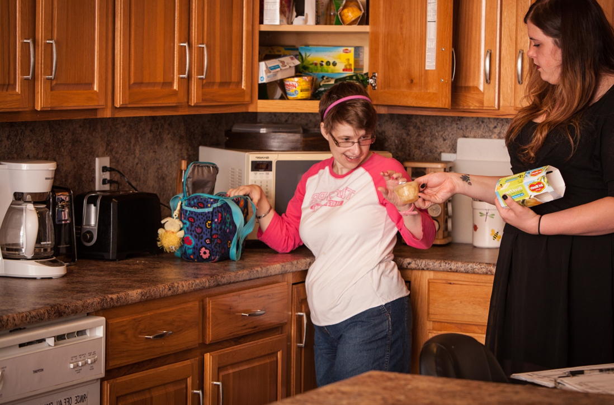
Section V: Positive Behavior Supports
Slide 63
Notes:
Narrative: This section provides introductory information about Positive Behavior Support by discussing some principles and practices which have been effective in supporting many people with developmental disabilities. The Positive Behavior Support planning process and how people use behavior to communicate are also discussed.

Slide 64
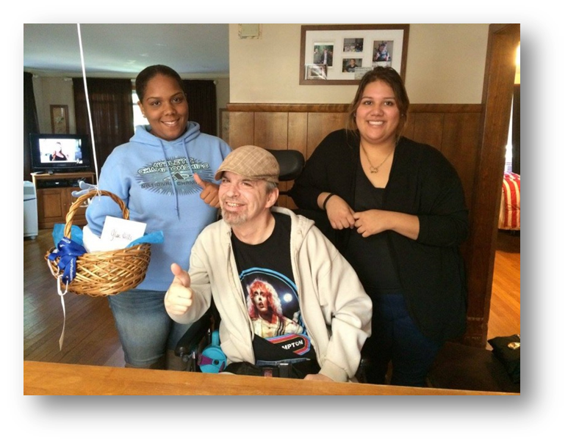
Section V:
Positive Behavior Supports
PBS is…
…a person-centered approach
and focuses on:
Changing the surroundings and supports
Teaching new skills that increase choice/control
PBS is the preferred DBHDS approach to supporting individuals with behavioral concerns.
Notes:
Narrative: Positive Behavior Support (PBS) is a person-centered approach to addressing challenging behavior by changing the surroundings and support, while teaching the person new skills to better communicate and provide more choice and control over his/her life.
PBS is the preferred approach adopted by the DBHDS to ensure people have supports to be successful.
Rather than eliminating difficult behaviors, PBS stresses personal growth with the end result being an improved quality of life for the person. Minimizing problem or challenging behavior is a secondary goal. More training about Positive Behavior Support practices may be obtained from your agency or DBHDS staff.

Slide 65

Section V:
Positive Behavior Supports
PBS has…
…four basic values:
Respect for the rights of ALL citizens
Respect for personal choice and control
Dignified treatment of people
Assurance that people with disabilities are not abused and neglected
Notes:
Narrative: Some people with disabilities have communication difficulties (such as being unable to talk or understand spoken language) that get in the way of expressing their needs and feelings in usual ways (See Section IV). This may lead to expressing those needs by using behaviors that appear unusual or disturbing to others.
In the past, people who had difficult behaviors were considered in need of institutionalization or more restrictive environments until they learned behaviors that “showed” that they were "ready" for life in the community. This has proven to be WRONG. Current research shows that giving someone choice and control over their own life often minimizes challenging behaviors, which is why using a person-centered approach is one of the foundations of PBS. Teaching positive behavior in someone’s home, work, or other community setting is a better way to help him/her learn ways to communicate that others will understand.
In order to be successful with behavior supports, staff must treat people with dignity and respect. Support staff must view behavior as a way for the person to control and direct his or her own life. If the desire for personal choice and control is not respected, the result may be someone has learned negative behaviors in order to gain some control. If this has gone on for a long time, it can be very challenging for staff and others who live and work around the person

Slide 66
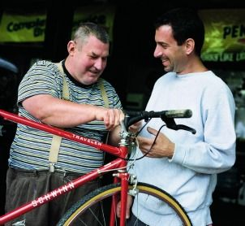
Section V:
Positive Behavior Supports
DSPs…
Follow PBS plans
See all behavior as communication
Seek ways to increase choice and control
Teach new, positive ways of meeting needs
Notes:
Narrative: A positive behavior support plan looks carefully at someone’s behavior and figures out what might need to change in his/her schedule or home or work environment. It will provide information about how you should support them and respond when the behavior occurs. It also determines what new behavior the person could use to get what he/she needs and wants, and how to teach the person the new, acceptable behavior.
Positive behavior support plans are designed to help all of the staff in the person’s life to respond in the same way. Just as you may not like the same things day after day, PBS plans need to change over time to meet the person’s needs in order to remain effective.
Writing a Behavior Support Plan will not be one of your responsibilities as a DSP. However, the professional who does develop the PBS plan will need to seek your help in trying to figure why the behavior is occurring. If you regularly support the person, you may be an expert on the ways he/she behaves, and your input is extremely valuable to the person who is developing the plan. You may be asked to provide some information in order to help pinpoint the purpose of the behavior and when the behavior occurs. You should think about:
what is going on around the person at the time?
who else is present?
what happens immediately after the behavior occurs?
Discussion: Review the roles for DSP on page 47 & 48 of the Orientation Manual.
Also talk about: 10 Things You Can Do to Support a Person with Difficult Behaviors
by David Pitonyak (http://www.dimagine.com/10things.pdf)

Slide 67
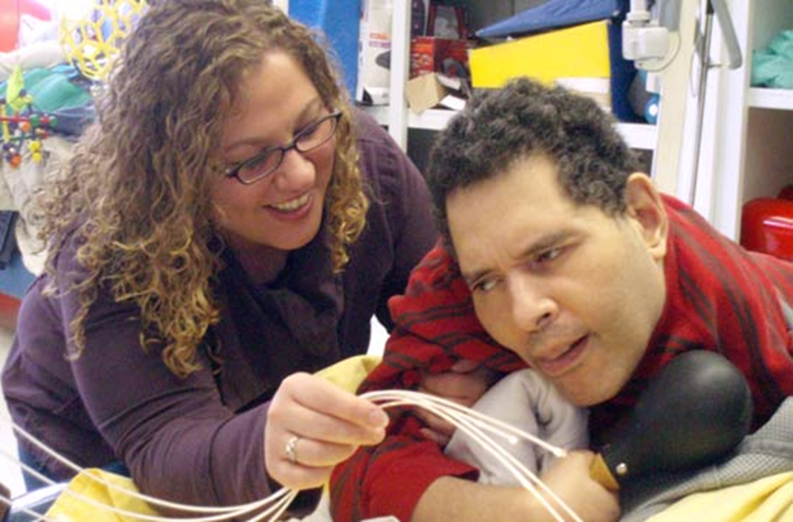
Section VI: Health and Safety
Slide 67
Notes:
Narrative: In this section, you will learn how to support people to maintain their safety and health, get good nutrition, and understand the importance of personal hygiene and regular medical and dental care. You will also learn about how to watch for eight health conditions that need special attention.

Slide 68
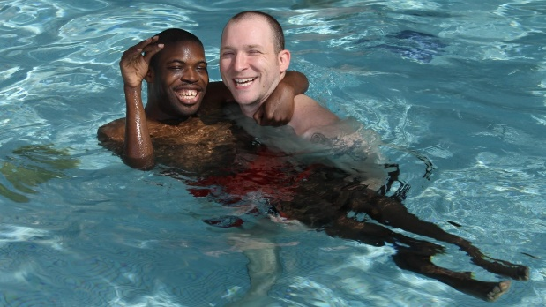
Section VI: Health and Safety
Health and Safety Considerations
Review all agency policies and procedures for health and safety
Additional training will be available
Balance of Important TO and Important FOR
Notes:
Narrative: As a DSP, you have important responsibilities for health and safety in home and community activities. Your agency will provide you with the processes that are used in day-to-day health and safety issues and what to do in case of an emergency.
Additionally many health and safety issues will depend on the type of program in which you work. For instance, DSPs who support people in employment and alternate day options and residential options play a vital role in carefully observing people and in reporting any changes in their behavior, appearance, or habits that may relate to health and safety. Residential staff members often have the additional responsibility of arranging for and accompanying people to doctor or dental appointments. All programs have written guidelines to follow for health and safety and emergency situations and have procedures for reporting critical incidents. As a DSP, become familiar with all agency protocols.
In addition to the information in this section, you will likely receive First Aid and CPR training, as well as health and safety training related to your specific agency, to assist you in helping people stay healthy and safe. You may also receive training and be tested in procedures for safe administration of medication. This chapter is not intended to replace that training. Your role is to help the people you support be safe in all situations, access quality health care when they need it, assist them in learning and using skills that maintain health and safety, and help them to be aware and informed regarding their own health and safety concerns.

Slide 69

Section VI: Health and Safety
Maintaining Good Health through Good Nutrition
All people need good nutrition
Special diets help with difficulty chewing or medical conditions
As people age nutrition becomes even more important!
DSPs…
Resist the temptation to use food as a reward or for reinforcement
Notes:
Narrative: People with disabilities have the same needs for good nutrition and proper weight management as people without disabilities. Since developmental disabilities are often associated with other medical conditions, such as epilepsy, allergies, diabetes, and heart problems, you may support people who are required to follow a special diet for health reasons or food allergies.
Fortunately, today there are a variety of food products available for people who have specific food allergies. Many restaurants offer a range of meals and are accustomed to responding to the needs, likes and dislikes of individual diners. Depending on the needs and interests of the people you support, your role may vary. You may help people plan nutritious and well-balanced meals, oversee meal preparation, monitor and encourage appropriate amounts of foods, and/or assist in making healthy food choices when dining out.
Your guidance and assistance will be especially important with aging adults, whose nutritional needs, appetite, and vulnerability to illness are often changing. Just as most of us hope to stay in our home as we grow older, so do the people we support. The supports you provide will play a critical role in helping to make that possible.

Slide 70

Section VI: Health and Safety
The Food Plate
Recommendations from Choose My Plate:
    Focuses on variety, amount, and nutrition from all five food groups
    Includes foods and beverages with less saturated fat, sodium, and added sugars
    Eating the right amount of calories based on age, sex, height, weight, and physical activity level
Notes:
Narrative: There are resources to help with good nutrition.
For more information on good health through good nutrition go to: http://www.choosemyplate.gov/MyPlate

Slide 71
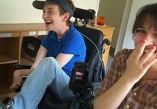
Section VI: Health and Safety
Personal Hygiene
DSPs…
Recognize the importance of good hygiene
Know that people need support with personal care in different ways
Respect peoples’ privacy with personal hygiene
Support good hygiene for value in the community
Notes:
Narrative: Personal hygiene plays a major role in how others view a person. It is important for all of us to wear clean clothing, keep our hair clean and healthy and bathe regularly. Because people with disabilities, are often seen by others as “different,” it is even more important to have good personal hygiene. Dirty clothing and sloppy appearances get in the way of meeting new people and making friends. When dressed in clean, well-fitting and stylish clothing, we are more likely to be seen in a positive manner.
It is possible that you will support some people who need reminders or guidance to maintain their personal appearance. Depending on needs, your assistance could range from physically bathing to helping someone shop for attractive shirts that are appropriate for his new job. Some may need reminders to bathe themselves, shampoo their hair, shave, brush their teeth, or use the toilet. Others may need you to do many hygiene tasks for them, such as changing a disposable brief or putting on deodorant.
Good hygiene, especially dental care, is also important for health reasons. Lack of attention to bathing or to routine care of teeth and gums can lead to serious medical conditions. Some of the people you support may not understand this or may not like doing these activities. It will be your role to find creative ways to encourage participation in necessary bathing, shampooing, and other personal hygiene activities if needed.

Slide 72


Section VI: Health and Safety
Regular Medical and Dental Care
DSPs…
Know the connection between clean teeth and health
Watch for any signs of illness and/or changes in routines or abilities
Notes:
Narrative: Regular medical and dental care is crucial in helping people enjoy a healthy life. Typically, appointments are scheduled and residential staff or family members accompany the person. It is important to work closely with each person’s primary care physician and other medical and health professionals to make sure regular routine tests and screenings are completed. DSPs often play an important role in communicating to the health professional what someone might be experiencing.

Slide 73

Section VI: Health and Safety
Regular Medical and Dental Care
DSPs…
Keep scheduled dental and medical appointments and know how to respond in emergencies
Report and record any dental or medical concerns immediately
Notes:
Narrative: Dental care is equally important as medical care. Helping individuals maintain a healthy mouth by regular brushing, flossing and routine dental visits can dramatically decrease health related issues such as infections and discomfort.
All DSPs should be on the lookout for changes in appearance or behavior that may indicate some symptom of illness. Some people may not be able to fully communicate what they are feeling (physically and emotionally). It is important to be diligent in observing, monitoring, and reporting any of these changes.
Discussion: Review the listing of possible concerns on page 54 of the Orientation Manual and discuss if any are currently a concern for the people the DSP will be supporting.

Slide 74
Section VI: Health and Safety
Medication and Side Effects
Complete all training and testing in required Medication Administration Procedures (MAR)
Some people with DD take multiple medications
Know the possible side effects of medication
Give the right medication, to the right person, in the right dose, by the right route and at the right time!
Learn about each person’s medication protocols!
Notes:
Narrative: If you work for an agency licensed by DBHDS, you will complete training and testing in the required Medication Administration Procedures before administering medications. This is a course approved by the Virginia Board of Nursing. The safe and accurate administration of medications is one of the most important duties you will perform as a DSP. Medication errors can cause great harm or even death. Therefore, it is essential that, when giving either prescription or over-the-counter medications, you follow the procedures and safeguards you will be taught in this required course.
Some people take multiple daily medications. All medications can have side effects – some of which can be harmful. Side effects may indicate that the medication dosage or type may need to change. In addition, people on more than one medication may experience symptoms related to the interactions of their medications.
As a DSP, you should become familiar with how medications affect the people you support. Side effects are sent by the dispensing pharmacy and are maintained in each person’s Medication Administration Record (MAR). In addition to the known side effects, the changes in daily behavior and patterns described above may be a sign of a negative drug reaction. Always report a concern.

Slide 75
Section VI: Health and Safety
Emergency Care
DSPs
Receive additional training in First Aid and CPR
Call for emergency help when needed
Follow all agency and program procedures
Any condition which would be considered an emergency if it happened to a member of your family is also an emergency if it occurs with a person you support. Call 911 at the first sign of a medical emergency!
Notes:
Narrative: It is best that all staff receive training in First Aid and Cardiopulmonary Resuscitation (CPR) prior to supporting people alone. This will enable you to react appropriately and possibly to save someone’s life while medical care is on the way.
During a health or medical emergency be sure to follow your agencies emergency procedures including contacting administrative staff.
Any condition which would be considered an emergency if it happened to a member of your family is also an emergency if it occurs to a person you support. Call 911 at the first sign of a medical emergency!

Slide 76
Section VI: Health and Safety
Other Health Concerns
People with DD might have other medical concerns.
For example:
Seizures
Diabetes
Difficulty walking
Sleep apnea
Food or drug allergies
Difficulty with sight or hearing
Learn about each individual’s unique medical needs!
Notes:
Narrative: In addition to the potential for illness and injury, you may find yourself supporting people with ongoing health conditions including (but not limited to) seizures, diabetes, Alzheimer’s, sleep apnea, arthritis, heart disease, visual/hearing impairments, food/drug allergies, and mobility concerns. All DSPs are responsible for being aware of and knowledgeable about the signs and symptoms of the health conditions of those you support.
Each staff member should also be aware of mobility issues. Information regarding mobility concerns should be available - along with relevant strategies on how to support someone who is at risk of falling in their daily routine. These support strategies should be included as part of their Plan for Supports.

Slide 77

Section VI: Health and Safety
Exercise
DSPs…
Recognize that people they support may not have experienced an exercise routine or formal fitness program.
Know that 30 minutes of exercise is recommended most days of the week.
Are creative and think of ways to get people moving in safe, healthy and preferred ways.
Notes:
Narrative: Along with regular medical care and good nutrition, exercise is another important element for a healthy life. Many people have never experienced a regular exercise program. Though they may face some physical challenges, there are a variety of activities designed for older adults and people with disabilities.
Exercise can be fun and exciting. We all benefit from moving more, so explore physical activities the person enjoys doing and find ways to include in their daily routine.
Most major health organizations recommend at least 30 minutes of exercise most days of the week, using a combination of cardiovascular exercise (walking, swimming, and/or aerobics) and resistance exercise (weights). There are many ways to incorporate exercise into a daily routine that can be creative and interesting.

Slide 78
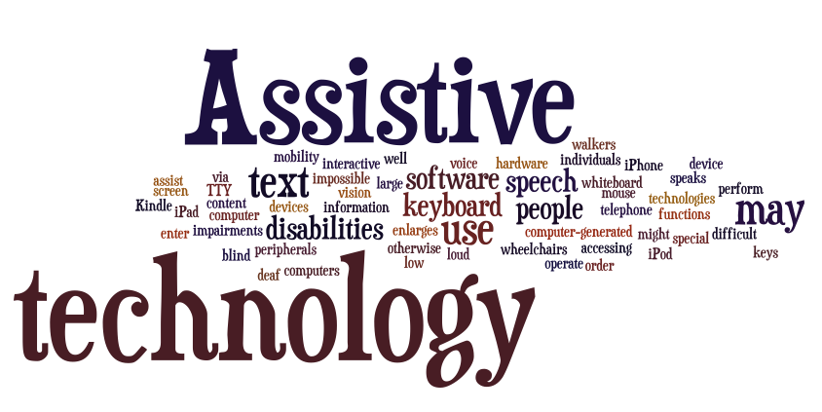
Section VI: Health and Safety
Assistive Technology
Items or devices that maintain or improve abilities.
For example:
custom eating utensils
shower benches
communication devices
picture boards
Notes:
Narrative: Assistive technology refers to any item, device, piece of equipment, or set of products that is used to maintain or improve the abilities. Assistive technology allows us to function with more independence, provides more choices, and results in an increased sense of confidence. Assistive technology devices may range from simple and inexpensive everyday items to complex computer systems. Some devices are not designed just for people with disabilities; they can make life easier for anyone.
As a DSP, learn how to properly use any specialized equipment so that you can provide assistance as needed.

Slide 79
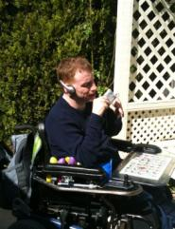
Section VI: Health and Safety
Assistive Technology
DSPs…
Support the safe use of assistive technology
Receive training on how assistive technology is used by specific individuals
Teach individuals how to use their assistive devices
Notes:
Narrative: Assistive technology benefits all of us as we age. It may be a key element in helping people remain in their home and community as they age. It also helps maintain as much independence as possible, as physical and cognitive abilities change due to the aging process. If someone you support could benefit from any of the devices mentioned above or other equipment, mention this to your supervisor, the person’s coordinator, or family member. It is possible that the needed item may be available through Medicaid or Medicare.

Slide 80
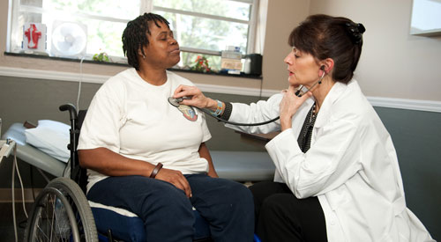
Section VI: Health and Safety
IMPORTANT Health Conditions for people with DD
Health issues that are often overlooked and
need to be monitored:
1. Skin Care (pressure sores; skin breakdown)
2. Aspiration Pneumonia
Falls
Urinary Tract Infections
5. Dehydration
6. Constipation & Bowel Obstruction
7. Sepsis
8. Seizures
Notes:
Narrative: There are 8 health issues that are often overlooked and need to be more carefully monitored. These conditions can progress rapidly and result in bigger problems, even death. They include:
1. Skin Care (pressure sores; skin breakdown)
2. Aspiration Pneumonia
3. Falls
4. Urinary Tract Infections
5. Dehydration
6. Constipation and Bowel Obstruction
7. Sepsis
8. Seizures
General process for you to follow if health conditions are noted:
Call 911 if there is an emergency.
Immediately talk with your supervisor about any health condition.
Follow all agency/program procedures for contacting medical professionals, reporting medical issues, and documenting medical conditions.

Slide 81
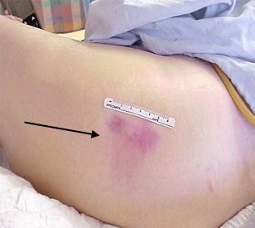
Section VI: Health and Safety
Skin Care
Healthy skin aids in regulating body temperature, protecting internal organs from injury and environmental elements, and protecting against infection.
Signs and symptoms of possible skin problems include, but are not limited to:
Unusual or abnormal color (pale, pink, red, or bluish);
Rashes or lesions;
Changes in skin temperature;
Parasites; and
Pressure sores – areas of skin damage resulting from a lack of blood flow due to pressure, friction, or pulling on the skin.
Notes:
Narrative: Healthy skin aids in regulating body temperature, protecting internal organs from injury and environmental elements, and protecting against infection.
Signs and symptoms of possible skin problems include, but are not limited to:
Unusual or abnormal color (pale, pink, red, or bluish);
Rashes or lesions;
Changes in skin temperature;
Parasites; and
Pressure sores – areas of skin damage resulting from a lack of blood flow due to pressure, friction, or pulling on the skin (skin that gets worse over time, blisters, pain, itching, and crater-like appearance).
Your role if signs or symptoms are noted:
Whenever skin issues are noted, medical staff should be notified immediately and the reporting and documentation procedures for your program followed. Be sure to report any signs of skin breakdown or pressure sores or ulcers immediately to your supervisor.

Slide 82
Section VI: Health and Safety
Skin Care
People at risk for skin breakdown include, but are not limited to, those who:
Use a wheelchair or who are in bed a lot of the time, require assistance when moving, have loss of bowel or bladder control, and have poor nutrition and hydration;
Have problem sensing pain or pressure;
Have limited ability to communicate;
Have circulatory problems; and/or
Are older adults, or are obese or very thin.
Notes:
Narrative:
Preventing skin breakdown:
Use adaptive items such as water or air mattresses, foam mattress pads, chair cushions, gel cushions, heel and elbow protectors;
Close daily inspection of skin to detect early redness or discoloration;
Prevent friction during lifting and re-positioning;
Provide good skin care (skin clean and dry); free from moisture, urine, stool, and wound drainage – minimize skin exposure to moisture – avoid harsh scrubbing or rubbing of skin;
Ensure frequent repositioning – if using a wheelchair assist in shifting weight every 15 minutes;
Encourage activity;
Protect bony areas with soft material; and
Apply moisturizer to dry skin areas.
People at risk for skin breakdown include, but are not limited to, those who:
Use a wheelchair or who are in bed a lot of the time, require assistance when moving, have loss of bowel or bladder control, and have poor nutrition and hydration;
Have problem sensing pain or pressure;
Have limited ability to communicate;
Have circulatory problems; or
Are older adults, or are obese or very thin.

Slide 83
Section VI: Health and Safety
Aspiration Pneumonia
Aspiration pneumonia is an inflammation of the lungs and airways to the lungs from breathing in foreign material. Aspiration pneumonia develops from inhaling food, vomit, liquids, or saliva into the lungs.
Signs and Symptoms of aspiration pneumonia include, but are not limited to:
Chest pain,
Cough,
Fatigue,
Fever,
Shortness of breath, wheezing, and
Bluish discoloration of the skin caused by lack of oxygen (e.g., mouth, nail beds, finger tips).
Notes:
Narrative: Aspiration pneumonia is an inflammation of the lungs and airways to the lungs from breathing in foreign material. Aspiration pneumonia develops from inhaling food, vomit, liquids, or saliva into the lungs. This may occur when someone has difficulty swallowing and has watery eyes or coughing while consuming food or fluids.
Signs and Symptoms of aspiration pneumonia include, but are not limited to:
Chest pain,
Cough,
Fatigue,
Fever,
Shortness of breath, wheezing, and
Bluish discoloration of the skin caused by lack of oxygen (e.g., mouth, nail beds, finger tips).
Your role if signs or symptoms are noted:
Medical staff should be notified immediately and reporting and documentation rules for your program followed. Be sure to report any signs of aspiration pneumonia immediately to your supervisor.

Slide 84
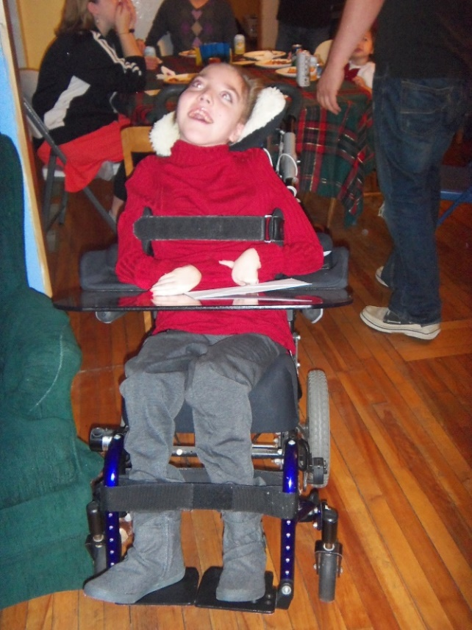
Section VI: Health and Safety
Aspiration Pneumonia
People at risk for aspiration pneumonia include, but are not limited to, those who:
Are less alert due to medicines or illnesses;
Have a disorder of the esophagus (the tube that moves food from the mouth to the stomach);
Have problems with swallowing;
Have poor gag reflex; and/or
Are older
Notes:
Narrative:
Preventing aspiration pneumonia:
Correct position while eating and sleeping;
Correct diet texture and fluid consistency to meet the person’s needs;
Good hand washing and respiratory hygiene;
Not attempting to assist with meal if sedated;
Up-to-date vaccinations and seasonal flu shots; and
Healthy diet and adequate fluids.
People at risk for aspiration pneumonia include, but are not limited to, those who:
Are less alert due to medicines or illnesses;
Have a disorder of the esophagus (the tube that moves food from the mouth to the stomach);
Have problems with swallowing;
Have poor gag reflex; and
Are older

Slide 85
Section VI: Health and Safety
Falls
Falls refer to any situation in which someone descends (or falls) suddenly and involuntarily toward a lower surface or the ground. Fall complications can include broken bones, head injuries, problems with daily activities, and need for home health care.
Factors that contribute to falls include, but are not limited to:
Health issues and medications;
Fatigue or illness;
Cluttered rooms, area rugs, wet or slick surfaces, improper lighting;
Wet or slick surfaces without non-skid footwear;
Lack of appropriate medical adaptive equipment; and
Being shoved or running into a barrier.
Notes:
Narrative: Falls refer to any situation in which someone descends (or falls) suddenly and involuntarily toward a lower surface or the ground. Fall risk is important to address as 1 in 3 older adults fall daily. Fall complications can include broken bones, head injuries, problem with daily activities, and need for home health care.
Factors that contribute to falls include, but are not limited to:
Health issues (e.g., arthritis, diabetes, skeletal deformities);
Fatigue or illness
Cluttered rooms, area rugs, wet or slick surfaces, improper lighting;
Wet or slick surfaces without non-skid footwear;
Lack of appropriate medical adaptive equipment;
Being shoved or running into a barrier.
Your role if someone falls:
Once a fall occurs don’t attempt to move the person until you have assessed him/her to see if there may be a fracture. Call 911 if you suspect injury, continue to monitor, and consult with a physician if the person starts to have frequent falls. No matter how minor the fall may be, remember to document and REPORT ALL FALLS as signs and symptoms of injury/fracture may not appear immediately.

Slide 86
Section VI: Health and Safety
Falls
People at risk for falls include, but are not limited to, those who:
Are older and have loss of muscle;
Have arthritis, diabetes, and skeletal problems;
Have visual and/or hearing loss;
Take medications that cause gait concerns; or
Do not have appropriate adaptive equipment
Notes:
Narrative:
People at risk for falls include, but are not limited to, those who:
Are older and have loss of muscle;
Have arthritis, diabetes, and skeletal problems;
Have visual and/or hearing loss;
Take medications that cause gait concerns; and/or
Do not have appropriate adaptive equipment
Prevention of falls:
Plan space so that it is well lit and without obstacles;
Ensure people have appropriate adaptive equipment for mobility and vision;
Make sure that regular medical checkups are scheduled (i.e., primary care physical, optometrist);
Ensure use of non-skid shoes when in the bathroom or other areas where surfaces are slippery;
Monitor medications and look for side effects;
Provide adequate time for moving from place to place and walk at his/her own pace; and
Lock wheels on wheelchairs and/or beds when transferring.

Slide 87
Section VI: Health and Safety
Urinary Tract Infections
A UTI is an infection of the urinary tract, which is the body’s system for removing wastes and extra water.
There are two different types of UTIs – the lower UTI relates to infections that occur in the urethra and bladder – and the upper UTI is more severe and relates to infections that may involve the kidneys.
Lower UTI symptoms:
Pain or burning during urination;
Increased frequency, urgency of urination, incontinence;
Lower abdominal, pelvic or rectal pain or pressure;
Confusion, behavioral changes, increased falls;
Mild fever or “just not feeling well;” and
Changes in urine (such as milky, cloudy, bloody or foul-smelling).
Notes:
Narrative: A UTI is an infection of the urinary tract, which is the body’s system for removing wastes and extra water. Women are more susceptible than men due to their anatomy and reduced bladder function later in life.
There are two different types of UTIs – the lower UTI relates to infections that occur in the urethra and bladder – and the upper UTI is more severe and relates to infections that may involve the kidneys.
Lower UTI symptoms, include but are not limited to:
Pain or burning during urination;
Increased frequency, urgency of urination, incontinence;
Lower abdominal, pelvic or rectal pain or pressure;
Confusion, behavioral changes, increased falls;
Mild fever or “just not feeling well;” and
Changes in urine (such as milky, cloudy, bloody or foul-smelling).
Upper UTI symptoms develop rapidly and may not include the symptoms for a lower UTI and require emergency care. Symptoms include fairly high fever (higher than 101F); shaking chills; nausea; vomiting; and flank pain (pain in the back or side, usually only on one side at waist level).
Your role if symptoms are noted:
People with UTI symptoms should see their health care professional as soon as possible or go to an emergency department for an evaluation. You should immediately notify your supervisor and follow your agency’s documentation rules.

Slide 88
Section VI: Health and Safety
Urinary Tract Infections
People at risk for UTIs include, but are not limited to, those who have:
Incontinence of bowel or bladder,
Limited mobility,
Extended periods of catheterization,
A suppressed immune system, or
A spinal cord injury or other nerve damage around the bladder that causes the bladder not to completely empty (which allows bacteria to grow).
Notes:
Narrative:
Preventing UTIs
Drink plenty of fluids,
Do not postpone urination – urinate when you feel the need,
Keep genital areas dry and clean,
Change clothes when incontinent and consider cotton underwear,
Wipe from front to back to avoid introducing bacteria into the vagina or urethra, and
Decrease length of time that catheters or tubes are placed in the urethra or bladder and change on schedule if prolonged use is needed.
People at risk for UTIs include, but are not limited to, those who have:
Incontinence of bowel or bladder,
Limited mobility,
Extended periods of catheterization,
A suppressed immune system, or
A spinal cord injury or other nerve damage around the bladder that causes the bladder not to completely empty (which allows bacteria to grow).

Slide 89
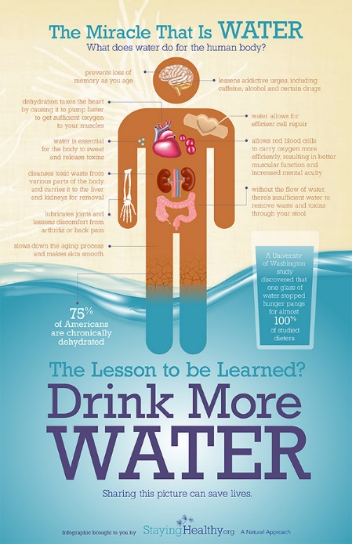
Section VI: Health and Safety
Dehydration
Dehydration occurs when we lose more fluids than we are taking in. The lack of water in the body may result from either a decrease in fluid intake or an increase in fluid loss. Diarrhea and vomiting are the most common reasons why someone loses excess fluid.
Dehydration symptoms include, but are not limited to:
Urine is concentrated and more yellow,
Dry mouth and nose,
Dry skin,
Decreased tear production,
Headache,
Dizziness,
Sleepy or tired, and
Light headed (especially when standing)
Notes:
Narrative: Dehydration occurs when we lose more fluids than we are taking in. The lack of water in the body may result from either a decrease in fluid intake or an increase in fluid loss. 75% of our body weight is water. Water helps transport waste, supports tissue and cell hydration and helps regulate your temperature. Dehydration can be an important factor in illness and even death. Diarrhea and vomiting are the most common reasons why someone loses excess fluid.
Dehydration symptoms include, but are not limited to:
Urine is concentrated and more yellow,
Dry mouth and nose,
Dry skin,
Decreased tear production,
Headache,
Dizziness,
Sleepy or tired, and
Light headed (especially when standing)
SEVERE dehydration symptoms can include confusion, lack of sweating, little or no urination, weakness, coma, organ failure (esp. kidney), changes in vital signs (increase in pulse and decrease in blood pressure), and “tenting” of skin (sticks together, stays upright when pinched together).
Your role if symptoms are noted:
People who have symptoms of dehydration should see their health care professional as soon as possible or go to an emergency department for an evaluation. You should immediately notify your supervisor and follow your agency’s documentation rules.

Slide 90
Section VI: Health and Safety
Dehydration
Hydration is important for everyone! Hydration considerations include:
The average person requires 64 ounces (8 cups) of water daily;
Some people cannot tolerate that much fluid and must have restrictions – their medical doctor should be consulted regarding the recommended amount for them based on their health concerns;
Good hydration is important with or without a g-tube-especially if a person drinks thickened liquids;
Some people may have difficulty swallowing which can lead to a decrease in fluid intake; and
If caring for someone who cannot communicate to ask for something to drink, remember to offer fluids frequently (every hour) to keep them hydrated.
Notes:
Narrative:
Preventing dehydration:
Offer clear fluids including water, broths, popsicles, Jell-O;
Have a variety of beverages available, as not everyone likes the same thing;
Drink frequently during the daytime, rather than drinking large amounts at one time;
Cool off indoors with a fan if person has been outside and temperature is high; and
If appropriate, offer Pedialyte, Gatorade or Powerade (these contain electrolytes).
Hydration is important for everyone! Hydration considerations include, but are not limited to:
The average person requires 64 ounces (8 cups) of water daily;
Some people cannot tolerate that much fluid and must have restrictions – their medical doctor should be consulted regarding the recommended amount for them based on their health concerns (e.g., individuals with congestive heart failure and end stage renal disease);
Good hydration is important with or without a g-tube-especially if a person drinks thickened liquids;
Some people may have difficulty swallowing which can lead to a decrease in fluid intake (e.g., Parkinson’s disease, dementia, stroke); and
If caring for someone who cannot communicate to ask for something to drink, remember to offer fluids frequently (every hour) to keep them hydrated.

Slide 91
Section VI: Health and Safety
Constipation and Bowel Obstruction
Constipation is the slow movement of feces through the intestine which results in infrequent bowel movements and hard, dry stools.
Constipation signs and symptoms include, but are not limited to:
Changes in bowel habits;
Infrequent bowel movements (less than 3 a week or more than 3 days between);
Difficulty passing stools – straining, painful;
Hard, dry, lumpy, small stools;
Belly pain relieved by bowel movement; swollen abdomen;
Bright red blood in stools; and
Leaks of wet, diarrhea-like stool between regular bowel movements.
Notes:
Narrative: Constipation is slow movement of feces through the intestine which results in infrequent bowel movements and hard, dry stools. The longer it takes for stool to move through the large intestines, the more fluid is absorbed and the harder stool becomes, making it difficult and sometimes impossible to pass.
Constipation signs and symptoms include, but are not limited to:
Changes in bowel habits;
Infrequent bowel movements (less than 3 a week or more than 3 days between);
Difficulty passing stools – straining, painful;
Hard, dry, lump, small stools;
Belly pain relieved by bowel movements; swollen abdomen;
Bright red blood in stools; and
Leaks of wet, diarrhea-like stool between regular bowel movements
Severe constipation can result in serious complications including rectal bleeding, nausea, vomiting, weight loss, bowel obstruction, fecal impaction, hemorrhoids, anal fissures and rectal prolapse. Two serious constipation issues are fecal impaction and bowel obstruction. Fecal impaction is when hard, dry stool is in the large intestines, often the rectum and cannot be passed. Individuals with fecal impactions often have breathing difficulties due to the collection of the stool in the colon. Fecal impaction can be life threatening. A bowel obstruction is either a partial or complete blockage of the small or large intestines.
Your role if symptoms are noted:
You should immediately notify your supervisor and follow your agency’s documentation rules if a person is constipated. A general rule to follow is that if there is no bowel movement in 2 days, report immediately to medical staff. If you suspect an individual has a bowel obstruction, call 911.

Slide 92
Section VI: Health and Safety
Constipation and Bowel Obstruction
People at risk for constipation include, but are not limited to, those who:
Have diet changes, low fiber, high fat, high refined sugar, excessive caffeine;
Lack regular exercise and are inactive or immobile;
Do not have adequate fluid intake and hydration;
Are stressed;
Have a disruption of regular routine (travel, change in daily schedule);
Have medical and psychological conditions;
Take medications;
Have poor bowel habits (holding back bowel movements);
Use laxatives and/or enemas excessively; and
Are older.
Notes:
Narrative:
Preventing constipation:
Drink plenty of fluids (64 ounces of water daily);
Avoid caffeine, high fat foods, and refined sugars;
eat a well-balanced fiber-rich diet with fruits (raisins, prunes, apples), vegetables, whole grains;
Exercise regularly;
Establish regular bowel habits including providing privacy for individual using the bathroom; and
Schedule regular toileting especially after meals when the urge to defecate is normally the highest.
People at risk for constipation include, but are not limited to, those who:
Have diet changes, low fiber, high fat, high refined sugar, excessive caffeine;
Lack regular exercise and are inactive or immobile;
Do not have adequate fluid intake and hydration;
Are stressed;
Have a disruption of regular routine (travel, change in daily schedule)
Have medical and psychological conditions;
Take medications (e.g., pain meds, anxiety/depression meds, diuretics, vitamins, sleep meds);
Have poor bowel habits (holding back bowel movements);
Use laxatives and/or enemas excessively; and
Are older.

Slide 93
Section VI: Health and Safety
Sepsis
Sepsis is a serious medical condition caused by an overwhelming immune response to infection. Sepsis can arise unpredictably and can progress rapidly. Sepsis springs from two factors: an infection (such as pneumonia or a urinary tract infection) and a powerful and harmful response by the body’s own immune system.
Stages and symptoms of sepsis include, but are not limited to:
Sepsis – fever, increased heart and respiratory rate, probably infection
Severe sepsis – decreased urine output, change in mental status, decrease in platelet count, difficulty breathing, abdominal pain, abnormal heart pumping function
Septic shock – severe sepsis symptoms plus extremely low blood pressure that doesn’t adequately respond to simple fluid replacement
Notes:
Narrative: Sepsis is a serious medical condition caused by an overwhelming immune response to infection. Sepsis can arise unpredictably and can progress rapidly. Sepsis springs from two factors: an infection (such as pneumonia or a urinary tract infection) and a powerful and harmful response by the body’s own immune system.
In severe cases, one or more organs fail. In the worst cases, blood pressure drops, the heart weakens and the patient spirals towards septic shock. Once that happens, multiple organs – lungs, kidneys, liver – may quickly fail and the person can die.
Stages and symptoms of sepsis include, but are not limited to:
Sepsis – fever, increased heart and respiratory rate, probably infection
Severe sepsis – decreased urine output, change in mental status, decrease in platelet count, difficulty breathing, abdominal pain, abnormal heart pumping function
Septic shock – severe sepsis symptoms plus extremely low blood pressure that doesn’t adequately respond to simple fluid replacement
Your role if signs or symptoms are noted:
Medical staff should be notified immediately and documentation rules for your program followed. Be sure to report any signs of sepsis immediately to your supervisor.
Preventing sepsis: The best way to prevent sepsis is early diagnosis.
Treatment is most successful when treated quickly with antibiotics to fight the infection and fluids to maintain blood pressure. The most common cause of sepsis is acquired pneumonia so seek treatment early!

Slide 94

Section VI: Health and Safety
Sepsis
People at risk for sepsis include, but are not limited to, those who have:
Weakened immune systems (children, infants, elderly);
Chronic illnesses (diabetes, AIDS, cancer, kidney/liver disease);
Severe burn or physical trauma resulting in damage to internal tissues; and
An infection due to damage to internal tissues – invasive medical procedures – kidney infection – UTI and pneumonia.
Notes:
Narrative:
Preventing sepsis: The best way to prevent sepsis is early diagnosis.
Treatment is most successful when treated quickly with antibiotics to fight the infection and fluids to maintain blood pressure. The most common cause of sepsis is acquired pneumonia so seek treatment early!
People at risk for sepsis include, but are not limited to, those who have:
Weakened immune systems (children, infants, elderly);
Chronic illnesses (diabetes, AIDS, cancer, kidney/liver disease);
Severe burn or physical trauma resulting in damage to internal tissues; and
An infection due to damage to internal tissues – invasive medical procedures – kidney infection – UTI and pneumonia.

Slide 95
Section VI: Health and Safety
Seizures
Seizures are defined as abnormal movements or behavior due to electrical activity in the brain. Seizures might include shaking and convulsions, and can last a few seconds or over 5 minutes.
Possible signs of a seizure include, but are not limited to:
Brief blackout followed by a period of confusion;
Changes in behavior;
Drooling or frothing at the mouth;
Eye movements;
Shaking of the entire body;
Grunting or snorting;
Loss of bladder or bowel control;
Sudden falling;
Teeth clenching;
Tasting a bitter or metallic flavor;
Temporary stop in breathing;
Uncontrollable muscle spasms with twitching and jerking limbs; and
Mood changes
Notes:
Narrative: Seizures are defined as abnormal movements or behavior due to electrical activity in the brain. Seizures might include shaking and convulsions, and can last a few seconds or over 5 minutes. Seizures have many causes and can lead to brain damage or even death. Epilepsy is a disorder of the brain. Diagnosis occurs when a person has had two or more seizures. There are many types of seizures.
Possible signs of a seizure include, but are not limited to:
Brief blackout followed by a period of confusion;
Changes in behavior;
Drooling or frothing at the mouth;
Eye movements;
Shaking of the entire body;
Grunting or snorting;
Loss of bladder or bowel control;
Sudden falling;
Teeth clenching;
Tasting a bitter or metallic flavor;
Temporary stop in breathing;
Uncontrollable muscle spasms with twitching and jerking limbs; and
Mood changes such as sudden anger, unexplainable fear, paranoia, joy or laughter

Slide 96
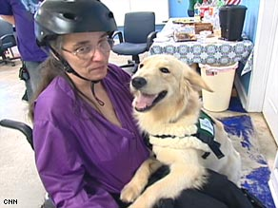
Section VI: Health and Safety
Seizures
People at risk for seizures include those who have:
A history of seizures,
Had a head injury,
Had brain infections,
Had a stroke,
Had a brain tumor,
Alzheimer’s disease, and
Genetic factors.
Notes:
Narrative:
Your role if someone has a seizure:
Always follow the protocols by the person’s healthcare provider. It there is no protocol, provide a cushion for their head and remove glasses; loosen tight clothing; turn on side; don’t put anything in the person’s mouth; don’t hold the person down; as seizure ends, offer help.
Most seizures are not medical emergencies, however call 911 if:
The seizure last longer than 5 minutes or one seizure follows another;
The person does not resume normal breathing after seizure;
There is no medical ID and no history of seizures;
There is an injury;
The person is pregnant or has diabetes;
The seizure happens in water; or
The person requests an ambulance.
You should also immediately notify your supervisor and follow your agency’s documentation rules.

Slide 97

Notes:
Narrative: You have completed the required training topics covered in the “Orientation Manual for DSPs and Supervisors” and these slides, discussed information with your supervisor, and now you are ready to complete the “Orientation Tests.” After passing the test, you will sign an Assurance indicating that you have met the initial requirements. This Assurance will be placed in your personnel record by your supervisor and you will receive a copy for your own records. Keep this in a safe place in case you ever change employers.

