Slide 1


Support Coordination/Case Management Training
Understanding and assessing “Change in Status” and “ISP Implemented Appropriately”
Notes:
Hello, and thank you for joining us for this Support Coordination and Case Management training on Understanding and assessing “Change in Status” and “ISP Implemented Appropriately.” As you are aware, in accordance with indicators in the Settlement Agreement as well as Licensing and Medicaid regulations, Support Coordinators are required to assess both if a person’s ISP is being implemented appropriately and also if the person has had a change in status. This training is designed to help you understand more clearly what those two terms mean and introduce a tool to help you document them.

Slide 2

Primary Reasons
People have needed supports
Services are responsive and effective
People are healthy, safe, and connected
Notes:
These are the primary reasons for assessing for change in status and appropriate implementation of services. We want to ensure consistently that people have needed supports, that the services they have are responsive and effective, and that they are health, safe and connected to their communities and to people they care about.

Slide 3
The Role of the Supervisor
This training is part of a phased approach to ensuring that two critical phrases are understood and applied consistently by Support Coordinators - “change in status” and “ISP implemented appropriately.” Supervisors are key in supporting SCs to understand this process and apply the concepts described.
Train
Look-behind
Assess
Notes:
Once you, as a supervisor or agency trainer, receive this information, you will be prepared to provide training to SC/CMs in your organization. DBHDS will review evidence of agency-provided training and sample documentation and provide assistance through the provision of technical assistance.

Slide 4
Objectives
By the end of this training, you will be able to identify:
the definition of “change in status”
the definition of “ISP implemented appropriately”
how to assess for these two factors during face to face visits
how to document and report findings
how respond when concerns occur
Notes:
By the end of this training, you will be able to identify the definitions of “change in status” and “ISP implemented appropriately,” how to assess, document and report findings, and what to do if you discover something concerning.

Slide 5
About the Definitions
The two phrases “change in status” and “ISP implemented appropriately”
are critical to ensuring the health and wellness of people supported
must be understood and applied consistently across Support Coordinators/Case Managers
require careful consideration with each encounter with a person who has services and supports under Virginia’s DD waivers and through discussions with people supporting the person
Notes:
The definitions of the two phrases “change in status” and “ISP implemented appropriately” are critical to ensuring people’s health and wellness, and require Support Coordinators to understand them, and apply them consistently and with careful consideration and robust discussions

Slide 6

Relationship to Requirements
"Face-to-face visit" in the person’s service setting (e.g. residential, employment, or day) means an in-person meeting between the support coordinator and the individual and family/caregiver, as appropriate, for the purpose of assessing the individual's status and determining satisfaction with services, including the need for additional services and supports.
12VAC30-122-20
Notes:
As was mentioned earlier, the requirements for assessing change in a person’s status are not just in the Settlement Agreement. Assessing an individual’s status is also required by Medicaid DD Waiver regulations that outline what should happen during a face to face visit, including assessing the person’s status and determining satisfaction with and need for services.

Slide 7
Relationship to Requirements
At face-to-face meetings, the case manager shall
observe and assess for any previously unidentified risks, injuries, needs, or other changes in status;
assess the status of previously identified risks, injuries, or needs, or other changes in status;
assess whether the individual's service plan is being implemented appropriately and remains appropriate for the individual; and
assess whether supports and services are being implemented consistent with the individual's strengths and preferences and in the most integrated setting appropriate to the individual's needs.
12VAC35-105-1245
Notes:
The Office of Licensing’s regulations also address what a Support Coordinator’s duties are at face to face visits, including assessing change in status and whether the ISP is being implemented appropriately.

Slide 8
Relationship to Requirements
The local department of social services adult protective services unit or child protective services unit, as appropriate, and the DBHDS Offices of Licensing and Human Rights and DMAS shall be notified immediately of the emergency discontinuation of services by the support coordinator and the provider when the individual's health, safety, or welfare may be in danger.
12VAC30-122-100
Notes:
Waiver regulations require Support Coordinators to report to DSS, Licensing, Human Rights and DMAS when services are terminated for health and safety reasons.

Slide 9
Support Coordinator Role includes…
Advocating for individuals in response to their changing needs;
Planning for transitions in the individual's life;
Knowing and monitoring the individual's health status, any medical conditions, and his medications and potential side effects, and assisting the individual in accessing primary care and other medical services, as needed; and
Understanding the capabilities of services to meet the individual's identified needs and preferences
12VAC35-105-1240
Notes:
Licensing regulations also outline the role of the Support Coordinator. In addition to advocating for people, planning for transitions, and understanding services that meet people’s needs, Support Coordinators must know and monitor each person’s status, health conditions, and medications. Support Coordinators must also support the person in accessing needed services.

Slide 10
Support Coordinator Role includes…
Communicating with providers to share vital information
Communicating with Care Coordinators of the Managed Care Organizations (MCOs) to update them on an individual's needs and services and obtain results of their HRAs
Collaborating with care coordinators regarding medically related issues to develop coordinated plans to mitigate risks and risks of harm
Reporting alleged abuse, neglect or exploitation to Adult Protective Services (APS) and Child Protective Services
https://sccmtraining.partnership.vcu.edu/chapter10/chapter10.html
Notes:
Finally, guidance detailed in the Support Coordination online training states that Support Coordinators must communicate and collaborate with all team members and MCOs, and report any suspected instances of abuse, neglect or exploitation to the appropriate DSS protective services unit. This training can be found on VCU’s Partnership for People with Disabilities website.

Slide 11

Change in Status
Has the person’s standing changed?
Notes:
One way to thinking about a person’s status is to consider their “standing.” Are they in a good position in their current circumstances? Do they have access to needed supports and services and are they occurring as expected? A lack of what’s needed can put a person in a disadvantageous position or even in danger. It is the Support Coordinator’s role to monitor how each person is doing in relation to health and wellness, self-direction, community inclusion and other aspects of life. For a person to develop to the fullest extent possible and have the life they want, the right supports need to be offered, considered, and chosen by the person. Once chosen, the SC’s role is to monitor the ongoing provision of those supports, assist with any needed changes, and report concerns as needed to ensure health and safety.

Slide 12
Change in Status (definition)
“Change in status” refers to changes related to a person’s mental, physical, or behavioral condition and/or changes in one’s circumstances to include representation, financial status, living arrangements, service providers, eligibility for services, services received, and type of services or waiver.
Notes:
Change in status is defined as “changes related to a person’s mental, physical, or behavioral condition and/or changes in one’s circumstances to include representation, financial status, living arrangements, service providers, eligibility for services, services received, and type of services or waiver.

Slide 13

Change in Status
  A person’s status can change for various reasons.
  For example:
  It has been six months since the annual meeting and the person…
    is not yet receiving a needed service
    has been removed from a service that was not replaced
    has declined a service that was needed
    is not making progress toward his outcomes
Notes:
A person’s status or can change for various reasons. If there is a prolonged period with a lack of progress more action is needed.

Slide 14
Action Cycle
NOTE: Issues related to abuse, neglect, or exploitation or other health and safety concerns must be reported immediately to APS/CPS and DBHDS* as appropriate
Report concerns as needed to your supervisor and appropriate state agency (APS/CPS), and DBHDS Human Rights and/or Licensing
Document issue in the record
Explore the issues and make efforts to resolve concerns
Document the resolution of the issue
Convene and mobilize the team
Implement plans to resolve issue
*DBHDS determines departmental response and follows up as needed
> 2 weeks unresolved (unless urgent and needing immediate reporting)
Notes:
Considering that a person’s status can change at any time and for many reasons, the Support Coordinator’s actions are likely to occur in a cycle. When concerns are noted, SCs should explore the issue and discuss with the individual, SDM if applicable, and the provider. Efforts to resolve concerns might be easily address through this discussion. If issues are not resolved in a fairly quick manner (e.g. less than two weeks), report the concerns to the SC supervisor and the appropriate agency. Remember that issues of abuse, neglect and exploitation must be reported to Licensing, Human Rights, and APS or CPS as appropriate immediately. DBHDS will determine if a departmental response is needed and follow up as appropriate. SCs should explore and attempt to resolve the concerns, and document activities in the record. If a concern has not been resolved in two weeks, the Support Coordinator should convene the team for a meeting to discuss the concern and possible resolutions. Plans should be implemented as soon as possible and documented in the record.

Slide 15
Important Contacts
Virginia Department of Social Services 24-hour, toll-free Adult Protective Services (APS) hotline at (888) 832-3858
Virginia Department of Social Services 24-hour, toll-free Child Protective Services (CPS) Hotline at (800) 552-7096
DBHDS Office of Human Rights
http://www.dbhds.virginia.gov/assets/doc/QMD/human-rights/human-rights-contacts.pdf
DBHDS Office of Licensing
http://www.dbhds.virginia.gov/assets/doc/QMD/OL/ol-complaint-form_nov_18_19_distributed.pdf
Notes:
In case you do not already have it, here is contact information for the APS and CPS 24 hour hotlines as well as DBHDS Offices of Licensing and Human Rights.

Slide 16


Meeting Options
Convening a team meeting when unable to resolve concerns
Efforts should be made to explore and resolve issues, where possible, before considering a meeting. When needed, meetings include the person, Substitute-Decision Maker, if applicable, Support Coordinator/Case Manager, relevant providers needed for their combined expertise and involvement, and others desired by the person. They can be in person, by conference call, and/or Support Coordinator/Case Manager by phone to all parties.
Notes:
Support Coordinators should work to resolve concerns and involve their supervisor if needed. If the SC is unable to resolve the concern, a team meeting should be called. The meeting should include the SC, the person and their substitute decision maker, as applicable, relevant providers, and anyone else the person chooses to be at their meeting. Meetings can be in person, but can also be by phone or conference call.

Slide 17

ISP Implemented Appropriately
“ISP implemented appropriately” means that services identified in the ISP are delivered consistent within generally accepted practices and have demonstrated progress toward expected outcomes, and if not, have been reviewed and modified.
Consider all of the following:
the assessment, the written plan, targets, data collection, reviews, and changes as needed
Notes:
The definition of “ISP implemented appropriately” is that “services identified in the ISP are delivered consistent within generally accepted practices and have demonstrated progress toward expected outcomes, and if not, have been reviewed and modified.” When determining if a person’s ISP is being implemented appropriately, remember to consider the assessment, the written plan, targets, data collection, reviews, and changes as needed.

Slide 18
ISP Implemented Appropriately
Generally accepted practice includes:
ISPs that:
  include activities that are allowable
  include skill-building as required
  address preferences and health-related needs
  are overseen by qualified supervisors
  Services that:
  are provided in accordance with the plan (which includes the assessment, the written plan, targets, data collection, reviews, and changes as needed)
  are provided by qualified providers
  And documentation that:
  matches desired outcomes and describes progress
Notes:
When we say “generally accepted practices,” we mean that the plan has activities that are allowable by regulation, include skill building as required by the service, address preferences as well as health related needs, and are overseen by qualified supervisors. Services must be delivered by qualified staff and in accordance with the full plan. Routine documentation must match desired outcomes and describe progress.

Slide 19

ISP Implemented Appropriately
A note about providers…
SCs are not responsible for checking individual staff qualifications, but should be able to identify that those providing support understand the needs and preferences of the person. Part of the role of a Support Coordinator/Case Manager is to monitor services and support - be sure to ask, observe, and learn.
Are DSPs providing person-centered supports consistent with the ISP and behavior support plan, as applicable? Do the DSPs know the person and their role in providing these services?
Notes:
When a Support Coordinator is doing a face to face visit, he or she should also be monitoring services and supports provided. SCs are not responsible for checking individual staff qualifications. SCs should talk with DSP supervisors and observe DSPs providing supports to determine if those supports are person centered and consistent with ISP and behavioral support plans. DSPs should know the plans and their role in providing the services.

Slide 20

ISP Implemented Appropriately (definition)
Generally accepted practice includes:
  The Support Coordinator’s assessment of whether a service is being implemented, that is, consistent with generally accepted practices and if there are no records of expected progress or no progress is evident after six months of implementation then further review is required.
Any progress or lack of progress should be included in an explanatory note in the person’s record.
Notes:
Generally accepted practice also includes the SC’s assessment of whether a service is being implemented and how the person is progressing towards their outcomes. If no expected progress towards outcomes is being made after six months, the SC should further review the plan. It is possible that outcomes, key steps or activities made need to be adjusted or removed, and this warrants further discussion with the team. Progress, or lack thereof, should be documented in the contact note, which will be discussed later in this training.

Slide 21
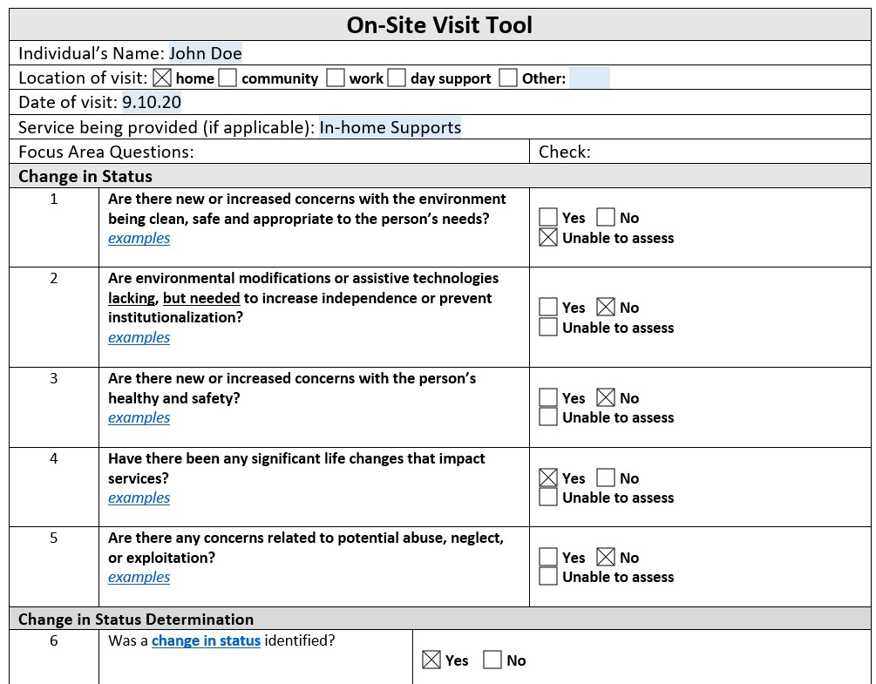
On-Site Visit Tool
This training introduces a tool to support on-site visits and to help assure both “change in status” and “ISP implemented appropriately” are applied more consistently.
Notes:
In order to assist Support Coordinators with meeting requirements consistently, we are introducing the On-Site Visit Tool. The On-Site Visit Tool is a means to support an SC’s face to face visits in order to have improved monitoring, quality assurance, and meaningful implementation of the SC’s oversight.

Slide 22
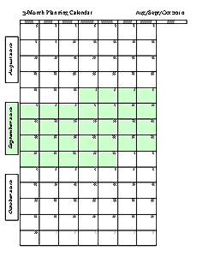

On-Site Visit Tool
Complete once monthly when visits occur, but no less than once per quarter
ECM = 1 time per month
TCM = at least once per month if you see
the person during the month, no
less than once per quarter
Notes:
The On-Site Visit Tool must be completed for each person receiving supports once each month when visits occur, but no less than one time per quarter, and uploaded to WaMS under the attachments under Person’s information. This equates to once per month for people w/ Enhanced Case Management (ECM) and at least once every three months for people w/ Targeted Case Management (TCM). If you see a person with TCM more than once quarterly, the standard would be once per month during the months when visits occur.

Slide 23
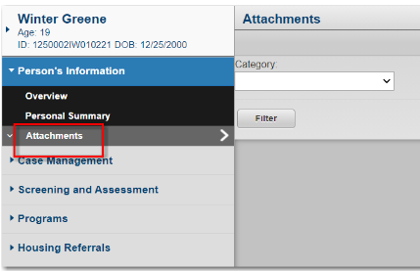
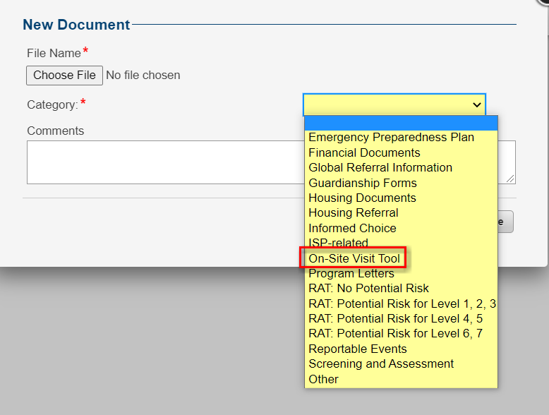
On-Site Visit Tool
Upload the checklist to WaMS under attachments in the Person’s Information section outside of the ISP (select On-Site Visit Tool drop down)

Slide 24
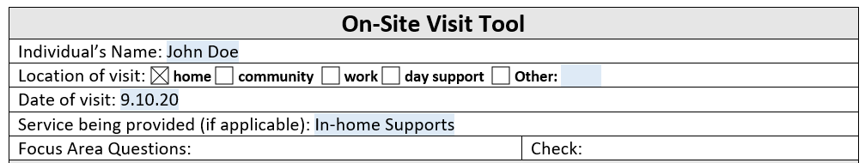
On-Site Visit Tool
Captures information:
Name, location, date of visit, service provided
Focus areas and actions needed related to:
  Change in Status and ISP Implemented Appropriately
Space to document who will be notified and any plan changes, if needed
Notes:
The On-Site Visit Tool captures basic information, focus areas related to change in status and ISP implemented appropriately, and has space to document who will be notified when reporting and any plan changes are needed.

Slide 25
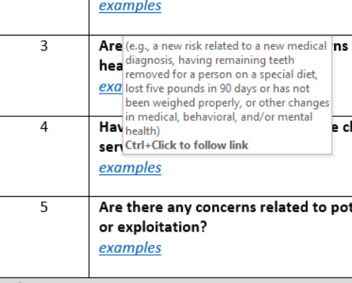
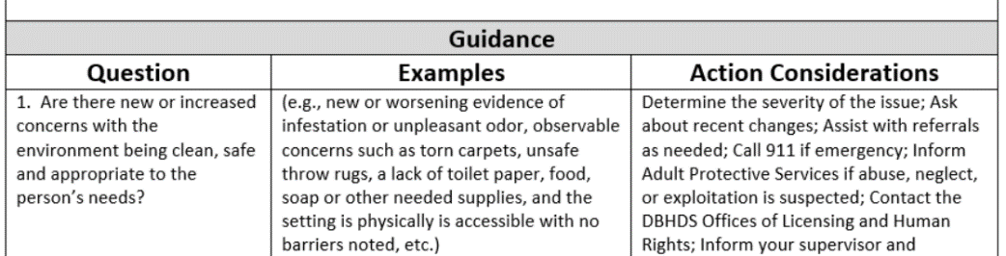
On-Site Visit Tool
The OSVT has examples that can be viewed by hovering over links or using “control+click” to navigate to instructions and a crosswalk at the bottom of the format.
Notes:
When using the OSVT format, you can hover your cursor over links to see additional guidance or “control+click” to be taken to a crosswalk with instructions, examples, and actions to consider depending on the answer provided.

Slide 26
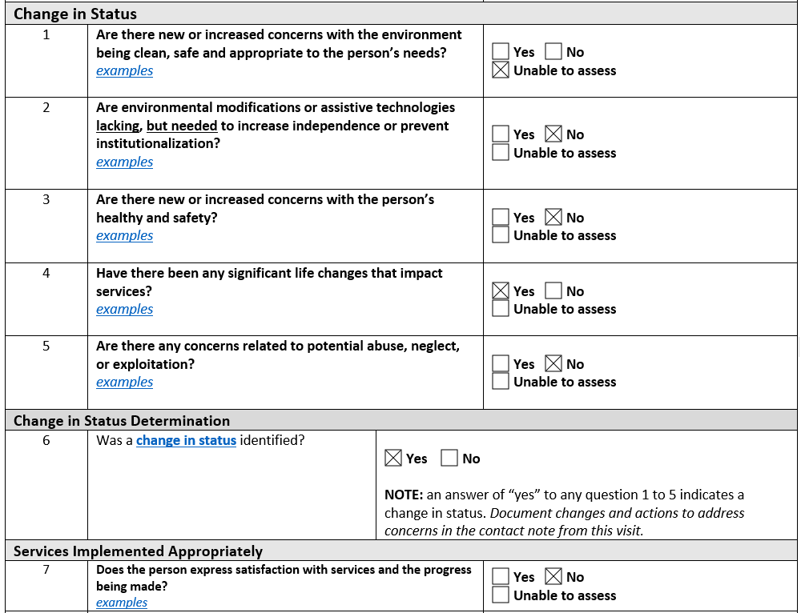
On-Site Visit Tool
Questions guide assessment
Notes:
The tool contains a list of questions that guide the assessment.

Slide 27
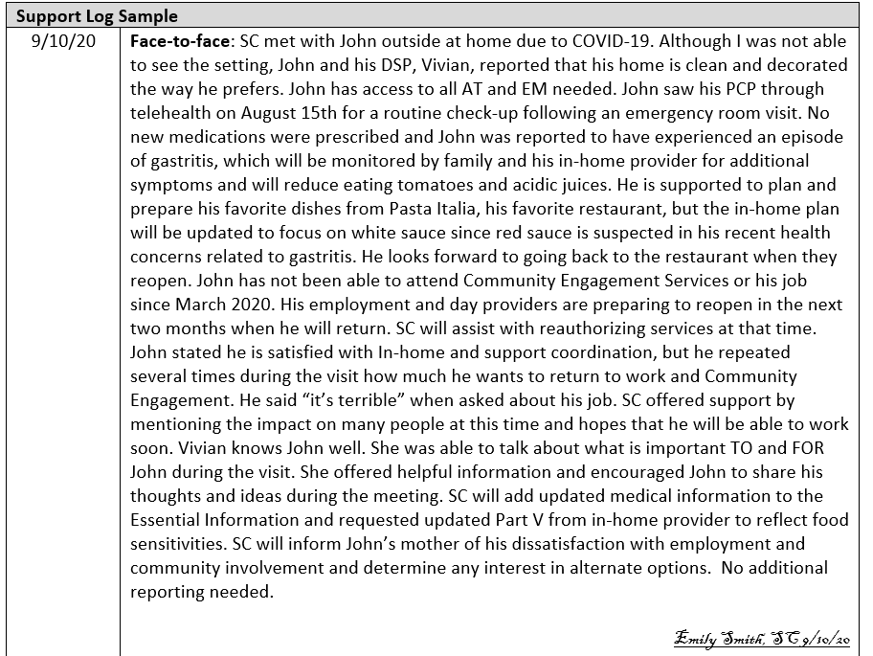
On-Site Visit Tool
Details and actions are described in the contact note in the EHR
Notes:
Details regarding the assessment are captured in the contact note from the visit, which is stored in the electronic health record at the CSB.

Slide 28
On-Site Visit Tool
About signatures
Only one signature is needed
  Only the Support Coordinator’s signature is needed on the OSVT
  The Support Coordinator lists who will be notified, which serves as an affirmation that reporting will occur
  Details must be included in the contact note
Notes:
As detailed on this slide, only the SC signature is needed and it is not required for uploading. The Support Coordinator lists who will be notified, which serves as an affirmation that reporting will occur. Details must be included in the contact note.

Slide 29
On-Site Visit Tool
DBHDS will collect results from the On-Site Visit Tool and a sample of SC notes to:
Assure that Support Coordination services adequately meet the Settlement Agreement provision V.F.2 in a consistent manner
Confirm that assessments occur in relation to change in status and ISP implemented appropriately
Assure reporting is occurring where concerns are noted
Formulate systemic responses to address areas of concern
Notes:
By using the On-Site Visit Tool, DBHDS will be able to collect results in order to report compliance with Settlement Agreement provisions, assure that concerns are being reported, and formulate systemic responses.

Slide 30



How to assess
Home
Work
Community
Notes:
Assessment occurs in a variety of locations, but the process is similar – remember to observe, document, and take actions as needed.

Slide 31
How to Assess
Assessing for “change in status” and “ISP implemented appropriately” includes observing and asking questions through which Support Coordinators can assess for changes and monitor the services provided. The following questions are designed to guide the assessment.
On-Site Visit Tool Examples
Notes:
Now that the definitions of “change in status” and “ISP implemented appropriately” and their key elements have been discussed, we can talk about how Support Coordinators assess for these things. During face to face visits, SCs should be observing and asking questions about the supports being provided. The questions on the On-Site Visit Tool will guide the assessment. We will look at some examples on the next several slides.

Slide 32
How to Assess: Change in Status
1. Are there new or increased concerns with the environment being clean, safe and appropriate to the person’s needs?
(e.g., new or worsening evidence of infestation or unpleasant odor, observable concerns such as torn carpets, unsafe throw rugs, a lack of toilet paper, food, soap or other needed supplies, and the setting is physically is accessible with no barriers noted, etc.)
2. Are environmental modifications or assistive technologies lacking, but needed to increase independence or prevent institutionalization?
(e.g., there is an appropriate integration of setting and supports available to promote the individual’s independence and/or access to the greater community, wheelchair, walker, communication device, etc.)
Notes:
Support Coordinators should assess if the environment is clean, safe, and appropriate. Things to consider include, but are not limited to, if there is evidence of infestation or unpleasant odor, observable concerns with the environment and the setting is physically is accessible and with no barriers noted. If the SC feels that the environment is not clean, safe, or appropriate, it must be indicated on the On-Site Visit Tool, with a contact note that describes next steps to remediate the concern. Depending on the severity, next steps might include a discussion about recent changes or needs, reporting to the appropriate person and / or agency, or making needed referrals. SCs should report these concerns to their supervisor and document. The ISP should be updated if appropriate. SCs should also assess if the person needs any environmental modifications or assistive technologies. This includes assessing if there is an appropriate integration of setting and supports available to promote the individual’s independence and/or access to the greater community, and if any new supports like a wheelchair, walker, communication device, etc. may be needed. If new items are needed, the SC should first assess if it is an immediate need or risk. The SC should amend the ISP, make the appropriate referrals and convene a team meeting, if necessary.

Slide 33
How to Assess: Change in Status
3. Are there new or increased concerns with the person’s healthy and safety?
(e.g., is there a new diagnosis from the past 90 days that could increase risk, such as going to the emergency room for an accident, injuring oneself and without effective behavioral services, signs of inadequate care like skin breakdown or choking that could have been avoided, or other changes in physical appearance: hygiene, weight, physical marks, etc.)
4. Have there been any significant life changes that impact services?
(e.g., the loss of a day, residential, or behavioral service provider, change in financial status, benefits, eligibility for services, or a change in waiver status, etc.)
5. Are there any concerns related to potential abuse, neglect, or exploitation?
(e.g., apparent bruising, unexplained scratches or pain, evidence of significant untreated health issues such as dental pain, body odor, soiled clothing, missing funds are reported, etc.)
Notes:
The Support Coordinator should asses for any changes in the person’s health status, to include things like a new diagnosis, dental concerns, changes in weight, and other changes in medical, behavioral, and mental health status. SCs should address and make a plan to resolve the issues, have a plan to reduce the possibility of recurrence, and as always, update the ISP to reflect changes. SCs should ask if there have been any significant life changes that may impact the person’s services, such as the loss of a provider, a change in financial status, benefits or eligibility. Take necessary action steps to remedy the concern, and remember to make an RST referral if needed. If abuse, neglect or exploitation is suspected, the SC should call 911 if health and safety is at immediate risk and notify the Department of Social services Adult or Child Protective Services Hotline to file a report. Be certain to submit a report to the DBHDS Office of Human Rights and if there is an injury or the allegation involves sexual abuse, submit a report to the DBHDS Office of Licensing. Be certain to report to your supervisor per agency policies and document the issue. If needed, convene a team meeting and ensure any concerns have been addressed and resolved. You will follow-up to confirm corrective actions have been taken to reduce chances of reoccurrence and offer alternate service options as needed. Make referrals and update the ISP if needed.

Slide 34
How to Assess: Change in Status
6. Was a change in status identified?
This question is the determination of “change in status.” An answer of “yes” to any question 1 to 5 indicates a change in status. If necessary, the last section will capture who will be informed of the change and the parts of the plan that will be updated. Details will be recorded in the contact note from this visit.
Notes:
Answering yes to any question 1 through 5 results in a yes for this question. Support Coordinators should continually assess for changes in status, based on the definition described earlier. If there is a change in status, the SC should consider the actions that are needed to address any concerns. Possible actions will be discussed later in this training.

Slide 35
How to Assess: Services Implemented Appropriately
7. Does the person express satisfaction with services and the progress being made?
(e.g., pleased with all services, locating new services in a timely manner, developing increased abilities, opportunities for inclusion, having more independence, etc.)
8. Are the paid supporters knowledgeable about the person and understand their role in providing support?
(e.g., do the DSPs know the individual’s needs and understand their role in providing support? Are meal plans followed to include special equipment, preparation, and preferences?)
9. Are behavioral services available and occurring as needed, and as authorized?
(i.e., number of days and hours authorized)
Notes:
Support Coordinators must assess the person’s (and Substitute Decision-Maker’s [SDM], as applicable) satisfaction with the services. This should be more than just a simple question; SCs should have a conversation with the person (and SDM, as applicable) about the services, the provider, the opportunities for independence and autonomy, and potential interest in other services. Support Coordinators need to also be sure to have a conversation with the person about their satisfaction with the progress they are making. If the person expresses dissatisfaction or interest in other services, the SC should discuss how to improve current services, explore other services or providers, and call a team meeting if needed. Support Coordinators need to ensure that the DSPs who are providing the services understand their role in providing supports and the person’s needs. If the SC believes the DSP is not able to fulfill their role, they should inform the provider agency, report as needed, refer the provider to their Community Resource Consultant, consider other services, and/or convene a team meeting if necessary.

Slide 36
How to Assess: Services Implemented Appropriately
9a. If no to question 9 for behavioral services, confirm the following:
An onsite assessment was completed?
A behavioral plan designed to decrease negative behavioral and increase functional replacement behaviors?
Caregivers are trained to implement the behavior plan?
Presence of data collection/reviews to improve supports?
Changes were made to the behavioral plan as needed?
Question 9a is only answered if the answer to question 9 is “no.” Consider each question. Discuss with the provider and review documentation as needed to determine the answers to these questions. If any answer is no, determine the actions needed such as communicating with the provider, seeking additional documentation, or offering alternate options to the person/Substitute Decision-Maker.
Notes:
If a person is receiving behavioral support services, there are elements of appropriately delivered services that are critical to confirm. Behavioral support plans require an annual on-site assessment, identification of behaviors to decrease as well as replacement behaviors, and baseline data on the frequency and severity of behaviors. Data collection and reviews should be conducted to determine if the plan is working, and providers and caregivers should always be trained on how to implement the plan. As with ISPs, behavior support plans must be changed and updated when a person’s needs or status changes.

Slide 37
How to Assess: Services Implemented Appropriately
10. Are nursing services available and occurring as needed, and as authorized?
(i.e., number of days and hours authorized)
10a. If no to question 10 for nursing services, confirm the following:
Services were provided consistently for past 90 days?
The hours provided are sufficient to ensure health and safety?
The services provided meet the person’s identified needs?
Question 10a is only answered if the answer to question 10 is “no.” Consider each question. Discuss with the provider and review documentation as needed to determine the answers to these questions. If any answer is no, determine the actions needed such as communicating with the provider, seeking additional documentation, or offering alternate options to the person/Substitute Decision-Maker.
Notes:
If the person receives nursing services, the Support Coordinator should confirm that the services are being provided as scheduled and authorized. SCs should ask the person and / or the provider if the nurse has visited when scheduled. Again, if the services are not being provided as scheduled, the SC may consider other service options, request a new plan from the provider, and call a team meeting if necessary.

Slide 38
How to Assess: Services Implemented Appropriately
11. Has the service being provided during this visit been occurring as needed, and as authorized?
(i.e., number of days and hours authorized); N/A only utilized if not receiving a service at the time of the visit.
12. Does the service being provided during this visit include skill-building if required?
(e.g., progress is occurring as expected, data is collected and reviewed by the provider; this is a required element in certain services to focus on increasing independence based on the ISP)
13. Does community involvement occur as described in the ISP?
(e.g., person has natural supports, do individual activity schedules and reports confirm going out to places they choose and like as indicated in the ISP, has access to reliable transportation, any modifications are supported as documented in the plan)
Notes:
The SC should confirm that the service being provided during the visit is occurring as expected. During the onsite visit, the SC should have a conversation with the person about all of the services they are receiving, and if they are getting the right services and the right amount. Again, if they are not, the SC may consider other service options, request a new plan from the provider, and call a team meeting if necessary. For services that require skill building, the SC should ensure that the ISP includes a skill building component, and that the provider is collecting data and reviewing it. If this is not happening, the SC should refer the provider to their Community Resource Consultant, and may consider other service options, request a new plan from the provider, and call a team meeting if necessary. Through conversations with the provider and documentation review, SCs should confirm that the person has community involvement, as described in their ISP. This includes if natural supports are being provided, that the person is going out to places of their choosing, and that there is reliable transportation. If these things are not occurring, the SC may consider making referrals for other service options, request a new plan from the provider, and call a team meeting if necessary.

Slide 39
How to Assess: Services Implemented Appropriately
14. Are services implemented appropriately?
This question is the determination of “services implemented appropriately.” An answer of “no” to any question 7 to 13 indicates that services are not implemented appropriately. If necessary, the last section will capture who will be informed of the change and the parts of the plan that will be updated. Details will be recorded in the contact note from this visit.
Notes:
Answering no to any question 7 through 13 results in a no for this question. Support Coordinators should continually assess whether or not the ISP is being implemented appropriately, based on the definition described earlier. If the ISP is not being implemented appropriately in any way, the SC must take action.

Slide 40
Determine Actions Needed
A variety of actions might be needed to address concerns. This could include reporting emergencies and concerns appropriately, bringing the team together, and offering alternate options. Use the reference chart provided with the tool as you consider possible actions. Possible actions include:
Call 911 if health and safety is at immediate risk;
Discuss with the provider;
Notify the Department of Social services Adult or Child Protective Services Hotline to file a report;
Submit a report to the DBHDS Office of Human Rights and if there is an injury or the allegation involves sexual abuse,
Submit a report to the DBHDS Office of Licensing
Report to the Substitute Decision-Maker or provider(s) as appropriate
Report to your supervisor per agency policies;
Document the issue;
Convene a team meeting if necessary;
Ensure any concerns have been addressed and resolved;
Confirm corrective actions have been taken to reduce chances of reoccurrence and offer alternate service options;
Make referrals if needed;
Update the ISP as needed
Notes:
One or more of these actions could be needed based on observation. Use the reference chart included with the OSVT and speak with your supervisor as needed to determine next steps.

Slide 41
Reporting and Plan Updates
15. Do any concerns observed or reported require reporting to the family or any providers?
Some observations/reports require informing the family or one or more waiver providers. For this question, list who will be contacted and describe what will be shared in the contact note from this visit.
16. Do any concerns observed or reported require reporting to DBHDS or other state agency or your supervisor?
Some observations/reports require reporting to the Department of Social Services, DBHDS, DMAS, or your supervisor. For this question, list who will be contacted and describe what will be shared in the contact note from this visit.
17. Is a change in the plan needed (additional outcomes, changes in steps or provider instructions)?
If results of the completion of this tool indicate that a change in the person’s ISP Parts I to IV or the provider-completed Part V, list the parts of the plan that will be updated. Describe the changes that will be discussed with the person and Substitute Decision-Maker and made to the plan in the contact note from this visit.
Notes:
If an SC has any concerns about a person’s health or safety, or a provider’s compliance with requirements, the concerns must be reported. Depending on the concern, the SC may need to share information with the family or provider, as well as their supervisor and/or a state agency. The SC lists on questions 15 and 16 who they will be report to, but the details would be contained in the contact note from the visit. In a similar way, if plan changes are needed, list the parts of the plan that will be updated on the form and detail those changes in the note.

Slide 42

Completing the note
Notes should include:
Full date of contact
Name and titles of person contacted
Place of contact
Type of contact
Summary of contact to include findings with changes in status and service implementation
Follow-up to include who will be contacted and what will be shared
How plans will change if needed
Satisfaction with services
Signature/electronic signature and date
Notes:
Success with this process is dependent on writing a quality note that summarizes the results of the visit and any actions that will be taken. Be certain to include these elements when preparing the note from your visit. DBHDS will be collecting notes to match back with the On-site Visit Tools (OSVTs) that are uploaded in WaMS. It is critical that the contents of the note match the results contained in the OSVT.

Slide 43
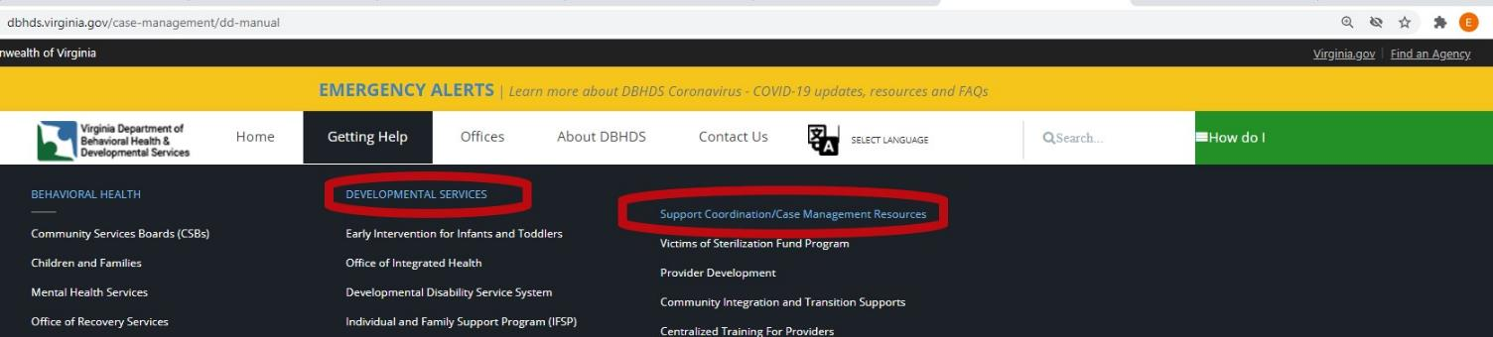
Resources
OSVT and related materials available online at:
http://www.dbhds.virginia.gov/
Notes:
To access the OSVT materials go to dbhds.virginia.gov and select “Getting Help” then “Support/Case Management Resources.”

Slide 44
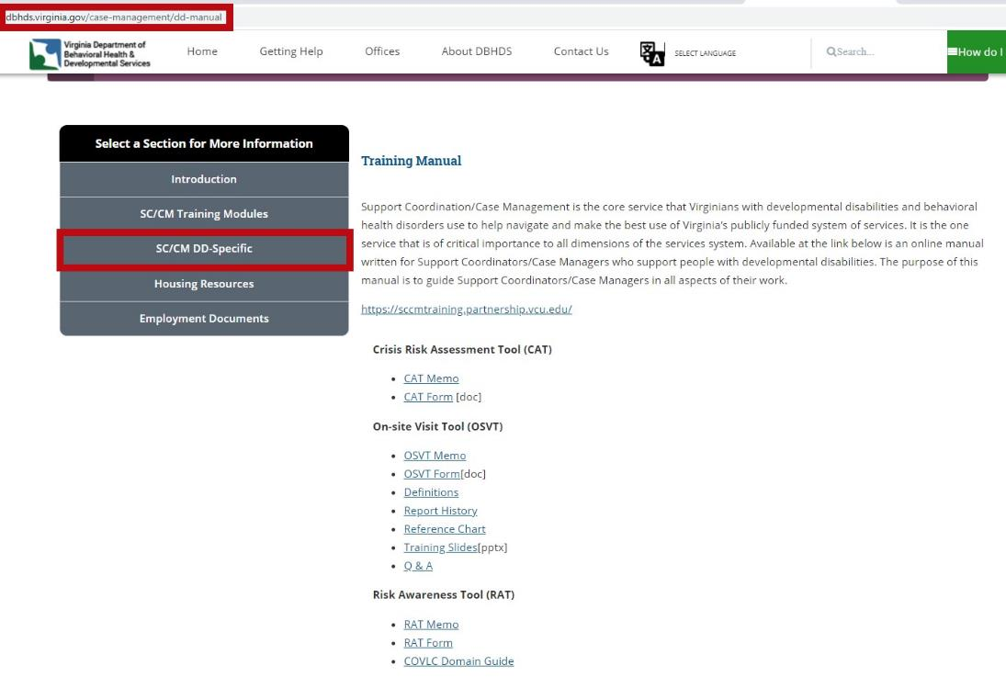
Resources
Notes:
Finally select “SC/CM DD-Specific” and scroll to the On-site Visit Tool section.

Slide 45
Resources
DBHDS Licensing Regulations
https://law.lis.virginia.gov/admincode/title12/agency35/chapter105/
DMAS Proposed DD Waiver Regulations
http://register.dls.virginia.gov/details.aspx?id=7347
SC/CM Training Modules and DD SC Manual through DBHDS
http://www.dbhds.virginia.gov/case-management
Notes:
Here are links to other important resources. Thank you for participating in this training.

