Slide 1




Marcus Alert

Slide 2
The Marcus-David Peters Act is a comprehensive approach to ensuring that Virginia provides a therapeutic, health focuses approach to behavioral health emergencies
Legislation was introduced in the 2020 Special Session of the General Assembly and signed by Governor Northam in December 2020

Slide 3
A Crisis System Transformation
Improve access and linkage to community services for the person in crisis.
Provide earlier crisis response within the continuum of care
Enhancement of community-based crisis service response

Slide 4
How will Marcus Alert achieve proposed outcomes?
Development of protocols and policies regarding response to behavioral health emergencies.
Creation of community response teams/mobile crisis response teams
Requirement of voluntary data base for all public safety and communication programs (911).

Slide 5

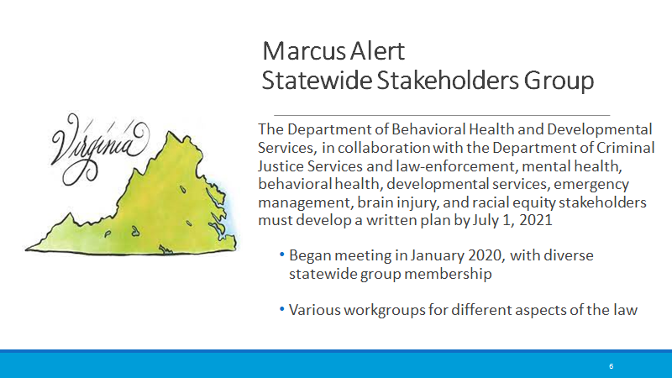

Slide 6
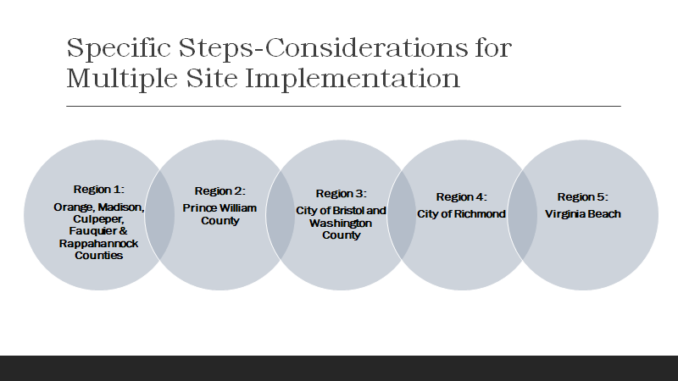

Slide 7
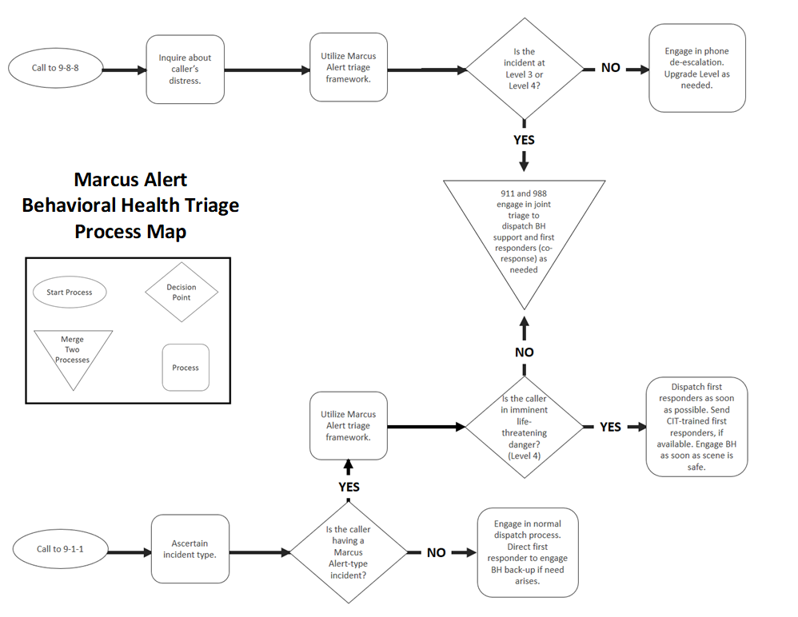

Slide 8
Four Level Framework
Routine Response
Could be handled over the phone.
Urgent Behavioral Health Response
Send a mobile behavioral health response
Urgent Co-Response
Behavioral Health and Police arrive together
Behavioral health takes lead once scene is deemed safe.
Emergent Response
Police take the lead
Co-response can step in if deemed safe.

Slide 9
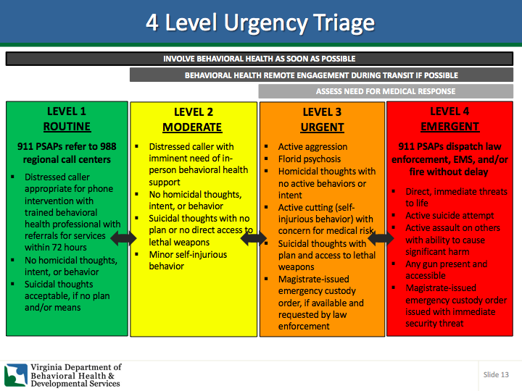

Slide 10
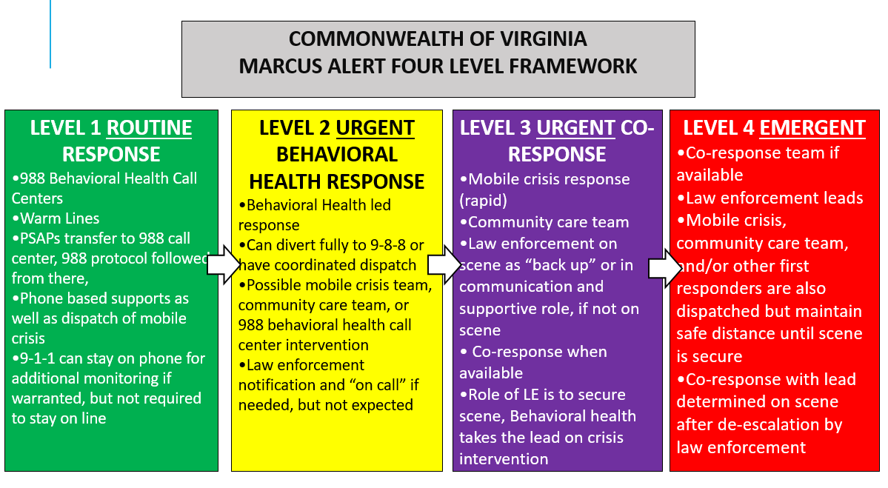

Slide 11
Established Implementation Workgroup
Established Mission Workgroup
Established voluntary database for PSAPS
Hired Marcus Alert Coordinator
Hiring Engagement Team
PWC Roll Out

Slide 12
PWC voluntary database status
PWC
Manassas City
Manassas Park
Already utilizing smart 911.
Creating marketing tools such as cards to pass out and social media posts.
Purchased Rapid SOS
Marketing flyers developed.
Purchased Smart 911
Developed two sided cards to pass out
Developing social media marketing tools

Slide 13
Trainings for PSAPS in PWC
CS provided 4 hour training
Services provided by CS
Crisis services available in the area
Introduction to Marcus Alert
Voluntary database
Additional training planned once Marcus Alert is finalized.
Final Marcus Alert triage levels
How and who to refer calls

Slide 14
Marcus Alert Timelines
December 1
Dispatch will start identifying calls using the 4-level triage.
Outreach teams and coresponder teams will be given priority
Behavioral health will take the lead on lower risk level calls
Spring 2022
Crisis Call Center will be operational
911 can transfer lower risk level calls
Regional behavioral health responses will be dispatched
July 1 2022
988 will become operational
Community can call 988 instead of 911
July 1, 2021
Voluntary Databases were created
Behavioral health responses can be dispatched

