Slide 1
Overview of Human Rights
New Employee Orientation
“To deny people their human rights is to challenge their very humanity.”
-- Nelson Mandela

Slide 2
Learning Goals and Objectives:
At the end of this class, employees will:
Become familiar with the role of the Office of Human Rights, and the Local and State Human Rights Committees.
Become familiar with the DBHDS Human Rights Regulations.
Understand how to protect the rights of individuals at this facility and their freedoms of everyday life.
Learn about the use of seclusion, restraint, and time out.
Become familiar with the DBHDS complaint resolution process and how to support individuals with it.
Understand the terms Abuse and Neglect, how to recognize what they are and how to report them.

Slide 3
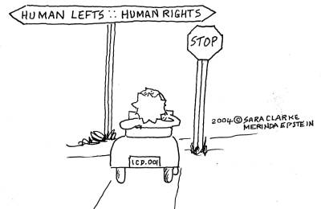
Local and State Human Rights Committees
Who are they?
What do they do?
Notes:
The function of the Local Human Rights Committee or LHRC is to ensure due process for the individuals served within our system. This helps us assure rights protection for every individual receiving services. The LHRCs are made up of volunteers across Virginia who serve in their respective regions. They are appointed by the State Human Rights Committee who we will be discussing in the next slide. Virginia Code regulates the appointment of health care providers, professionals and individuals with lived experiences and their family members to the LHRC. All requests by a facility for review by the LHRC must go through the Advocate.
Here are some specific examples of what the LHRC reviews as it relates to human rights:
any restrictions over the regulatory time frames
policies, procedures, program handbooks
individual behavioral treatment plans that utilize restrictive techniques
variances to the regulations
next friend/capacity determination
consent/authorized representatives
human research
The State Human Rights Committee or SHRC consists of nine members appointed by the State Board. The SHRC oversees the operation of the LHRCs. Additionally, the SHRC works with the State Human Rights Director to ensure the effective and efficient operation of the Office of Human Rights concerning human rights regulations and other laws, policies or regulations that are needed to ensure the protection of the rights of individuals.
Virginia Code regulates the appointment of health care providers, professionals and individuals with lived experiences and their family members to the LHRC.

Slide 4
Human Rights Regulations
Va. Code § 37.2-400 outlines assured rights of individuals receiving services
The Human Rights Regulations are enforced through the Code of Virginia (37.2-400)
The Human Rights Regulations define the structure for complaint resolution and enumerate DBHDS and Provider duties
https://law.lis.virginia.gov/admincode/title12/agency35/
DBHDS facilities must assure the rights contained in the regulations.
Notes:
The Virginia Administrative Code contains the Human Rights Regulations for the Commonwealth of Virginia and can be accessed on the website displayed on this slide.
The regulations are accessible to anyone through the Legislative Information System (LIS). You will always find the most updated regulations through the LIS. All individuals receiving services should have a copy of the regulations available to them. The facility advocate can also provide a copy of the regulations. They can also be accessed through the Human Rights Office page on the DBHDS website.

Slide 5
Access to Regulations
A complete copy of the Human Rights Regulations need to be provided to anyone who asks for one.
Providers must also display and give information about the disAbility Law Center of Virginia (dLCV).
Notes:
The dLCV is the designated protection and advocacy organization in Virginia helping clients with disability-related problems like abuse, neglect and discrimination. The dLCV may provide individuals with information, written materials or limited technical assistance that will assist them with being able to speak for themselves. The dLCV has specific strategic goals and focus areas to guide their work. Federal laws establish the eligibility criteria for their services and require the establishment of goals and focus areas.

Slide 6

It is the responsibility of all staff to be familiar with facility policy and state regulations related to the human rights of those we serve.
Notes:
You will learn about facility and DBHDS policies during the new employee orientation. Changes will be shared through formal communications when they occur and through annual retraining. An example of a policy that talks about human rights, abuse, neglect and exploitation is DI 201 Reporting and Investigating Abuse Neglect of individuals Receiving Services in Department Facilities.

Slide 7

What do we mean by the term human rights?
Notes:
Solicit answers from the class. Some responses may be:
Basic rights and freedoms that belong to every person
They apply regardless of where you are from, what you believe or how you choose to live your life
They can never be taken away, although they can sometimes be restricted
Human rights values can be dignity, fairness, equality, respect and independence
Human rights are protected by law
Tell the class that each individual receiving services is assured certain undeniable rights:
-Protection to exercise legal, civil and human rights
-Respect for basic human dignity
-Sound, therapeutic provision of care

Slide 8

How we Protect Rights
One way we protect rights is through written regulations. Individuals are entitled to know what their rights are under these.
Notes:
In order to make sure individuals served know their rights, providers will:
Display a poster listing the rights of individuals under these regulations. These posters should be in areas most likely to be noticed by the individual.
Included in the poster should be information about how an individual can contact their Human Rights Advocate (sometimes called an Advocate).
The poster should be presented in the manner, format, and languages most frequently understood by the those receiving services. This may mean utilizing contracted translation services to create the poster into different languages.
Each individual and their authorized representative (AR)** should be notified about these rights and how to file a complaint. This notification needs to be in writing and in any other form easily understood by the individual. We will discuss who an authorized representative is on the next slide.
Individuals and their AR need to be asked to sign the notice of rights.
Presenter: Please explain where the posters are located at your facility.
**ARs are discussed on the next slide.

Slide 9
When an individual lacks capacity
Authorized Representative
Attorney-in-Fact
Health Care Agent
Legal Guardian
Individual’s Family Member
Next-Friend
Supported Decision-Making Agreement
Notes:
When it’s determined that an individual lacks the capacity to consent or authorize the disclosure of information, the facility shall recognize and obtain consent or authorization for those decision for which the individual lacks capacity from the following if available:
Attorney-in-fact
Health care agent
Legal guardian or in the case of a minor, a parent with legal custody or other person authorized to consent to treatment
If one of the above is not available, then the Director shall designate a substitute decision maker as the AR in order of priority:
Family member – preference of individual as to which family member unless it’s clinically contraindicated; if there is no preference or the Director will select best qualified person
Next friend – the individual must have no objection to this designation
Substitute decision making – if the capacity of an individual to consent to treatment, services or research or authorize disclosure of information is in doubt, the facility should obtain an evaluation from a professional who is qualified by expertise, training, education or credentials and not directly involved with the individual to determine whether the individual has capacity to consent or to authorize disclosure of information.

Slide 10
Individuals we serve are entitled to have the same rights as everyone else and to be treated with dignity and respect. Receiving services through DBHDS does not remove those rights.
“Every human being is the author of his own health or disease.”
-- Budda
Notes:
It is important to remember this. There are caveats to this in the form of restrictions which will be discussed later in the presentation. There are specific policies in place when a restriction is placed on an individual.
Facilities need to recognize, respect, support and protect the dignity and rights of each individual at all times. In the case of a minor, providers need to take into consideration the expressed preferences of the minor and the parent or guardian.
It is the responsibility of the facility to develop, carry out, and regularly monitor policies and procedures that assure the protection of each individual’s rights.
Individuals have a right to treatment services that promote their potential to function independently.

Slide 11

Legal rights of individuals receiving services
12VAC35-115-20
Rights Assured by the Human Rights Regulations
Property
Legal documents
Buy or sell
Enter into contracts
Register and vote
Notes:
Facilities shall not deny any individual his legal rights solely because they have been voluntarily or involuntarily admitted, certified for admission or committed to services. 12VAC35-115-20 is the section of the Human Rights Regulations that addresses this. When we provide services with dignity and respect, we do so by ensuring key rights are preserved and provided.
Individuals have a right to acquire, retain and dispose of property. Valuable property should be stored in a safe place. They have the right to keep and use personal clothing and personal items and to have and spend money.
Individuals have the right to sign legal documents and enter into contracts.
They retain the right to vote with some exceptions (felony convictions if rights not restored and if someone has been declared mentally incapacitated in a Circuit Court). Both of these exceptions are not necessarily permanent.

Slide 12
Legal rights of individuals receiving services
12VAC35-115-20
Rights Assured by the Human Rights Regulations
Marry, divorce, separate
Professional licensure
Will, Advance Directive
Access lawyers & courts
Participate meaningfully in services & discharge plans
Notes:
Individuals have the right to get married, separated, divorce or have a marriage annulled.
Individuals have a right to hold a professional, occupational or vehicle operator’s license.
Individuals have the right to create and sign a will and/or create and sign advance directives.
Individuals have the right to access lawyers and courts.
We must help the individual, if needed, to meaningfully participate in their services and services should be uninterrupted.

Slide 13
Dignity rights of individuals receiving services
12VAC35-115-50
Rights Assured by the Human Rights Regulations
Use preferred name
Be protected from harm including abuse, neglect, and/or exploitation
Learn about and apply for and fully use public services and/or benefits
Have opportunities to communicate
Program services
Notes:
Dignity
Each individual has a right to exercise their legal, civil and human rights, including constitutional rights, statutory rights and the rights included in the Human Rights Regulations. They have the right to person-centered services, to be protected, respected and supported in exercising these rights. Facilities may not partially or totally take away or limit these rights solely because a person has a mental illness, intellectual disability, substance use disorder, or sensory condition that may pose a barrier to communication or mobility.
Name
Individuals have a right to be called by their preferred or legal name. This may be limited when a licensed professional makes the determination that the use of the name will result in demonstrable harm or have significant impact on the program itself or the individuals, treatment, progress and recovery. The issue will be discussed with the individual, the advocate will be informed of the restriction prior to it being implemented and the reason for the restriction shall be documented in the treatment record. The restriction shall be reviewed by the team every month and documented.
Free from abuse, neglect, exploitation
Individuals need to be treated free from abuse, neglect and exploitation. We will talk about abuse, neglect and exploitation in detail later.
Public services
Individuals should have help in learning about, applying for and fully using any public service or benefit to which they may be entitled.
Communication
Individuals should have opportunities to communicate in private with lawyers, judges, legislators, clergy, licensed health care practitioners, authorized representatives, advocates and the Office of the Inspector General and employees of dLCV. Individuals also have a right to communicate in the language of their choice which may mean the facility providing an interpreter or in the case of written material, a translator.
Program services
Individuals should be provided with general information about program services, policies and rules in writing and in the manner, format and language easily understood by the individual. Rules should be posted in all regularly accessed areas. Policies and rules are developed for safety and order. Policies and rules should be applied the same for each individual and individuals should not discipline each other.

Slide 14
Dignity rights of individuals receiving services
12VAC35-115-50
Rights Assured by the Human Rights Regulations
Choice of individual to stay updated
Clothing
Meals
Environment
privacy
bathroom facilities
outside air
windows
clean air
temperature
Notes:
Choice to stay updated
Be afforded the opportunity to have an individual of their choice notified of their general condition, location and transfer to another facility.
Clothing
Each individual must have sufficient and suitable clothing for their exclusive use. It is up to the facility to provide clothing if the individual does not have any.
Meals
Individuals shall receive nutritionally adequate, varied and appetizing meals that are prepared and served under sanitary conditions, are served at appropriate times and temperatures and are consistent with any individualized diet program. For example, if an individual is on a low salt diet, then it is up to the facility to provide low salt meals.
Environment
We must provide a humane, safe, sanitary environment that gives each individual at a minimum:
reasonable privacy and private storage space
adequate number of private, operating toilets, sinks, showers and tubs that are designed to accommodate individuals’ physical needs
direct outside air provided by a window that opens or by an air conditioner
windows or skylights in all major areas used by individuals
clean air, free of bad odors
room temperatures that are comfortable year-round and compatible with health requirements

Slide 15
Dignity rights of individuals receiving services
12VAC35-115-50
Rights Assured by the Human Rights Regulations
Practice religion
Be allowed to send and receive mail
Communicate privately by mail
Communicate privately by telephone
Have or refuse visitors
Notes:
Religion
Individuals have a right to practice a religion and participate in religious services subject to their availability provided that the services are not dangerous to the individual or others and do not infringe on the freedom of others. Participation in religious services may be reasonably limited based on other general rules limited privileges or times or places of activities.
Mail
Individuals should be provided with paper, pencil and stamps provide free of charge for a least one letter every day upon request. If the individual has funds to buy these items to send a letter every day, the provider does not have to pay for them. Individuals should be allowed to communicate privately with any person by mail and have help in writing or reading mail as needed.
Telephone
Individuals should be allowed to communicate with any person by telephone and have help in doing so. Use of the telephone may be limited to certain times and places to make sure that other individuals have equal access to the telephone and that they can eat, sleep or participate in an activity without being disturbed. (An example of this may be that telephone use will be limited when the person should be in a group.)
Visitors
Individuals have the right to have or refuse visitors. The facility may require visitations to be in a specific area or make certain areas off limits (such a bedrooms). This is for the safety of visitors and individuals.
We will discuss restrictions on all of these later on in the presentation.

Slide 16
Treatment rights of individuals receiving services
12VAC35-115-60
Rights Assured by the Human Rights Regulations
Based in law and sound therapeutic practice
Without discrimination
Tailored to the individuals needs and preferences
Notes:
Treatment or Services
Every individual receiving services should receive those services according to law and sound therapeutic practice without discrimination in the provision of those services. Facilities need to comply with all state and federal laws including application provision of the Americans with Disabilities Act. Services should be delivered that is tailored specifically to the needs and expressed preferences of the individual. In the case of a minor, the services should be tailored to the needs and expressed preferences of the minor and the minor’s parent or guardian.

Slide 17
Rights Assured by the Human Rights Regulations
Rights of individuals receiving services to participate in decision- making and consent
12VAC35-115-70
  Give or not give informed consent
  Freedom to refuse or withdraw consent and discontinue participation in any treatment, service or research requiring their consent at any time without fear or reprisal
  Have an AR make decisions for them
Notes:
Decision making
Every individual has the right to participate meaningfully in decisions regarding all aspects of services affecting them. This includes the right to:
consent or not consent to receive or participate in services
give or not give informed consent to receive or participate in treatment or services that pose a risk of harm greater than ordinarily encountered in daily life
give or not give informed consent to participate in human research
informed consent is always required for surgical procedures, ECT or use of psychotropic medications
notification must be given that the individual is free to refuse or withdraw their consent and discontinue participation in any treatment, service or research requiring their consent at any time without fear or reprisal
have an AR make decisions for them
Facilities should respect, protect and help develop every individual’s ability to participate meaningfully in decisions regarding all aspects of services affecting them. Individuals should be asked to express their preferences about decisions regarding all aspects of services and we should honor these preferences to the extent possible. Facilities should give every individual any help they need to participate meaningfully in their service plans and discharge plans in addition to any changes to those plans. This includes all other aspects of services received by them.
Note that the facility may initiate, administer or undertake a proposed treatment without the consent of the individual or the individual’s authorized representative in an emergency. All emergency treatment and services including the facts and circumstances justifying the emergency needs to be documented in the treatment record. The authorized representative needs to be informed of the treatment. Emergency treatment needs to be prescribed by a professional who is authorized by law to order the treatment. An example of an emergency treatment could be giving medications over objection.

Slide 18
Rights Assured by the Human Rights Regulations
Confidentiality rights of individuals receiving services
12VAC35-115-80
  Identifying information remains confidential
  Freedom to give authorization before the facility shares information
  Notice about exceptions for disclosure without consent
Notes:
Confidentiality
Every individual is entitled to have all identifying information that a provider maintains or know about them remain confidential. They have the right to give their authorization before the facility shares identifying information about them or their care unless the event that another state law or regulation require or permit disclosure (example: subpoena).

Slide 19
Rights Assured by the Human Rights Regulations
Rights of individuals receiving services to access and amend their records
12VAC35-115-90
  Read, see and get a copy
  Challenge, request to amend or receive an explanation for anything in their record
  Receive help to read and understand records – without charge
Notes:
Record access
Every individual and their AR have the right to see, read and get a copy of their treatment record except for information that is privileged in section 8.01-581.17 of the Code of Virginia and information compiled by the provider in reasonable anticipation of or for use in a civil, criminal or administrative action or proceeding. The facility may let certain other people see, read or get a copy of the record if the individual is restricted by law from seeing, reading or receiving a copy. The individual may challenge, request to amend or receive an explanation of anything in their record. Minors must have their parent’s or guardian’s permission before they can access their services record except for certain circumstances. The facility should give individuals any help they may need to read and understand their record without charge.
There may be restrictions on viewing records based on your facility policy.

Slide 20
Rights Assured by the Human Rights Regulations
Rights of individuals receiving services to work
12VAC35-115-120
  Engage or not engage in work-related activities
  Free from requirement to perform labor as a condition of treatment/services
Notes:
Manual labor
Individuals have a right to engage or not engage in work or work-related activities consistent with their service needs while receiving services. Personal maintenance and personal housekeeping by individuals receiving services are not subject to this. We cannot require, entice, persuade or permit any individual or their family member to perform labor for us as a condition of receiving services.

Slide 21
Rights Assured by the Human Rights Regulations
Human Research rights of individuals receiving services
12VAC35-115-130
  Research must follow DBHDS policy and law
  Choice to participate or not
  Provide informed consent
  LHRC approval and periodic updates
Notes:
Research
Every individual has a right to choose to participate or not participate in human research. Any research done at any of the facilities must follow all research policies established by DBHDS and the facility. We must obtain prior, written, informed consent of the individual or their AR before they begin to participate. The facility needs to provide a copy of the research committee approval to the LHRC and once the research has been initiated, the provider needs to update the LHRC periodically on the status of the individual’s participation.

Slide 22
Rights Assured by the Human Rights Regulations
Rights of individuals receiving services to complain
12VAC35-115-150
  Can complain about any potential human rights violation
  Resolution at the earliest possible step
  Freedom from retaliation
  Anyone can file a complaint on behalf of an individual
Notes:
Fair hearing
Each individual has a right to complain that the facility has violated any of the rights assured under the Human Rights Regulations. If an individual feels their rights have been violated, the advocate should be involved immediately. If an individual makes a human rights complaint, we must make every attempt to resolve the complaint at the earliest possible step. We may not threaten, permit or condone any retaliatory action against anyone filing a complaint. A family member or authorized representative may file a human rights complaint on behalf of the individual being served.

Slide 23
Restrictions of Rights
Facilities shouldn’t limit or restrict any individual’s freedom more than is needed to achieve a therapeutic benefit.
Restrictions must be justified, meet certain conditions, and documented in the treatment record.
Implementation of a restriction must be assessed and the need for the restriction determined by a licensed professional.
Notes:
From admission to discharge, every individual is entitled to enjoy all the freedoms of everyday life that are consistent with their need for services, protection , the protection of others and that do not interfere with their services or the services of others. These freedoms include:
freedom to move within the service setting, its grounds and the community
freedom to communicate, associate and meet privately with anyone the individual chooses
freedom to have and spend money
freedom to see, hear, or receive television, radio, books, newspapers
freedom to keep and use personal clothing and other personal items
freedom to make purchases in canteens, vending machines or stores selling a basic selection of food and clothing
receive services that are least restrictive
Restrictions can’t be imposed on an individual unless the restriction is justified and carried out according to the Human Rights Regulations. Specifically, restrictions must be justified and meet the following conditions:
least restrictive alternatives have been tried
restriction necessity
reason for the restriction
restriction has been explained to the individual and/or AR
written notice provided that includes
- reason
- criterial for removal
- right to a fair review
Restrictions that are court ordered or required by law must be documented in the service record.
A restriction for one individual may be support for another individual. Example: Individuals are off the unit in a group and one individual becomes disruptive to another one. The disruptive individual may be brought back to the unit where they will have to meet a determined criteria to be allowed off the unit. Instructors should come up with examples that are specific to their facility.
Conversations about restrictions should be person-centered and take place with individuals, AR’s, Advocates and other treatment team members as applicable.
When we use the term licensed professionals in this presentation, they include:
licensed physician
licensed clinical psychologist
licensed professional counselor
licensed clinical social worker
licensed or certified substance abuse treatment practitioner
licensed psychiatric nurse practitioner

Slide 24
ANY RESTRICTION
PUT INTO PLACE
MUST BE
INDIVIDUALIZED
Specific Restrictions
Telephone restriction
Visitor restriction
Mail restriction
Religious practices
Use of preferred or legal name
Notes:
Telephone
Access to the telephone may be limited only if the judgement of a licensed professional feels that communication with another person or persons will result in demonstrable harm to the individual or significantly affect his treatment.
The issue should be discussed with the individual and the Advocate informed of the reasons for the restriction prior to implementation. The reasons for the restriction should be documented in the treatment record. The restriction should be reviewed on a monthly basis by the treatment team.
Visitor
An individual’s access to visitors may be limited or supervised only when a licensed professional determines the visits will result in demonstrable harm to the individual or significantly affect the individual’s treatment or when the visitors are suspected of bringing/having brought contraband or if threatening harm to the individual.
The issue should be discussed with the individual and the Advocate informed of the reasons for the restriction prior to implementation. The reasons for the restriction should be documented in the treatment record. The restriction should be reviewed on a monthly basis by the treatment team.
Mail
Access to mail may be limited only if the provider has reasonable cause to believe the mail contains illegal material or anything dangerous. The facility may open the mail in the presence of the individual but not read it.
If it is the judgement of a licensed professional that communication with another person or persons will result in demonstrable harm to the individual’s mental health, the individual’s ability to communicate by mail may be limited.
The issue should be discussed with the individual and the Advocate informed of the reasons for the restriction prior to implementation. The reasons for the restriction should be documented in the treatment record. The restriction should be reviewed on a monthly basis by the treatment team.
Religious
Services or practices that present a danger of bodily injury or interfere with another individual’s religious beliefs may be limited. The issue should be discussed with the individual and the Advocate informed of the reasons for the restriction prior to implementation. The reasons for the restriction should be documented in the treatment record.
Name
The use of an individual’s preferred name may be limited when a licensed professional makes the determination that the use of the name will result in demonstrable harm or have a significant negative impact on the program itself or the individual’s treatment, progress and recovery. The issue should be discussed with the individual and the Advocate informed of the reasons for the restriction prior to implementation. The reasons for the restriction should be documented in the individual’s service record and reviewed by the team every month.
There may be restrictions on based on your facility policy.

Slide 25
When a restriction is put into place, it means the facility has cause to believe allowing a specific right would cause:
Restrictions Continued
Injury to the individual or others
Infringement on the rights of others
Unsafe or disorderly environment
And there is no less restrictive way to protect against these occurrences
Use of restriction must be reviewed and approved by the LHRC
Notes:
When a restriction is put into place, it means that the provider has cause to believe that allowing a specific right would cause
injury to the individual or others
a serious infringement on the rights of others
an unsafe and disorderly environment
and there is no less restrictive way to protect against these occurrences

Slide 26

Seclusion, Restraint and Time-Out Considerations
Notes:
The instructor should ask students to provide things that a provider should consider when using seclusion, restraints and/or time out. Considerations are listed below.
What are the individual’s preferred interventions?
Facilities should meet with the individual or their AR at admission to discuss and document in their service record their preferred interventions in the event their behavior or symptoms become a danger to themselves or others and under what circumstances, if any, the intervention may include seclusion, restraint, or time out. This allows for other ways to help the individual to avoid being placed in seclusion, restraints or time out.
What, if any, are the contraindications?
Facilities should document in the service record all known contraindications to the use of seclusion, any form of restraint and time out that includes medical contraindications and a history of trauma. The service record needs to be flagged and the information should be communicated to staff. Some examples of contraindications are a history of trauma, respiratory issues, cognitive impairment.
Have other less restrictive interventions been considered or tried?
This is going back to the individual’s preferred interventions. Seclusion, restraint and time out should be a last resort. Examples of interventions: quieter place to deescalate, quiet room/oasis room, taking a walk, listening to music, weighted blanket, etc.
Why place someone in seclusion, restraint and time out?
Seclusion, restraints and time out is utilized for behavioral reasons. They can only be used when there is an emergency, other interventions are not possible or will not work and staff have to act immediately to keep everyone safe. Imminent risk or immediate and impending threat of causing substantial physical injury to self or others or harm is occurring are reasons to use these interventions. They can’t be used just because staff think there may be a possibility that someone may get hurt.
Time out may not be utilized for more than 30 minutes per episode.
What happens while someone is in seclusion, or restraint?
Even though someone is in seclusion or restraints they have a right to:
Motion and exercise
Eat and drink at normal mealtimes
Use the restroom
Bathe as needed
Trained, qualified staff must stay with the individual and monitor the medical and mental status condition continuously until they are released. This must be done through continuous face-to-face observation. No observations should be done using electronic surveillance devices.
The provider must review the situation and write a new order or release the individual after four hours for adults, two hours for children/adolescents (9-17) and one hour for children under age nine.
The criteria for release should be explained throughout the intervention. As soon as the criteria is met, the individual must be released immediately.
When someone is released, the facility should go over the intervention with the individual. This is called a debriefing and is documented in the service record.
Seclusion or mechanical restraint for behavioral purposes in an emergency may be used only if a qualified professional involved in providing services to the individual has:
Conducted a face-to-face assessment within one hour and documented that alternatives to the proposed use of seclusion/mechanical restraint have not been successful in changing the behavior or were not attempted, taking into account the individual’s medical and mental condition, behavior, preferences, nursing and medication needs, and ability to function independently
Determined that the proposed seclusion or mechanical restraint is necessary
Documented in the service record the specific reason for the seclusion/mechanical restraint
Documented in the service record the behavioral criteria for release
Explain to the individual, in a way they can understand, the reason for using the intervention, the criteria for its removal and the individual’s right to fair review of whether the intervention was permissible
Staff training
Only staff who have been trained in the DBHDS patient management system should initiate, monitor, and discontinue the use of these interventions. Only specific licensed staff may authorize the release of an individual.
Facility policies and procedures
Each facility has their own policies and procedures for seclusion, restraint and time out based on DBHDS policies and procedures. All of these interventions must be documented in the service record including the intervention used, the rationale for implementation, what staff were involved, start and end time/date, and criteria for release, other interventions tried and any outcomes from the intervention.

Slide 27

Seclusion, Restraint and Time-Out Considerations
There are times when interventions such as seclusion, restraint and time out can never be used
Notes:
These interventions can never be used:
as a punishment
as retaliation
for the convenience of staff
just because someone has pending criminal charges
for any behavioral, medical or protective purpose unless other less restrictive techniques have been considered and documented that these other restrictive techniques did not work or would not succeed in reducing or eliminating behaviors that are self-injurious or dangerous to other people or that no less restrictive measure was possible in the event of a sudden emergency
Facilities can’t write standing orders saying that staff can use these interventions at any time for behavioral reasons.
These may never be used without lesser restrictive options having been considered and documented.
Facilities may use restraint or time out in a behavioral treatment plan to address behaviors that present an immediate danger to the individual or others but only after a qualified professional has conducted a detailed and systemic assessment of the behavior and the situations in which the behavior occurs.
No one is ever restrained in a prone position (face down). This can interfere with the ability to breath and cause an immediate medical emergency.

Slide 28
Rights Assured by the Human Rights Regulations
Human Rights Complaint Resolution Process
12VAC35-115-175
  Make a complaint
  Have a timely and fair review
  have someone file a complaint on their behalf
  Use these and other complaint procedures
  Make a complaint under any other applicable law
Notes:
Any individual has a right to complain that the provider has violated any of the rights assured under the Human Rights Regulations. A complaint can be about anything. Sometimes a complaint can result in an investigation of abuse or neglect. We will talk more about that in a few slides.
An individual must have a timely and fair review of the complaint.
Trainers: you should review your facility human rights complaints policy during this portion of the training.
An individual can have anyone file a complaint on their behalf.
An individual can utilize other complaint procedures that they wish.
They have the right to make a complaint under any other applicable law including to the protection and advocacy agencies (dLCV) and OSIG.
**Discuss how complaints can be filed at your facility if you have a specific person or department that they go through. For example, if your facility has a dedicated complaint phone line, a Patient Relations Department, etc. that complaints should go through, explain how these work.

Slide 29
More about Complaint Resolution:
The individual shall:
be contacted by the Director or the Director’s designee
have access to a Human Rights Advocate
be protected from retaliation and harm
have the complaint reviewed, investigated and resolved as soon as possible
receive a report with the Director’s decision and action plan within 10 working days
be notified in writing of their right to appeal
Notes:
The individual should be contacted by the Director or their designee regarding the complaint within 24 hours.
The individual may want to have assistance from the Human Rights Advocate regarding the complaint. If requested by the individual, the facility needs to help the individual in contacting the Advocate. The facility should assist the individual in understanding the complaint process, the facility’s complaint resolution policies and procedures and the confidentiality of involved information.
Filing a complaint should not result in retaliation, punishment, or harm to the individual. Additionally, we can’t prevent an individual from making a complaint or deny them access in receiving assistance in making a complaint.
There should be an impartial investigation into, or resolution of, the complaint as soon as possible but no later than the next business day. We need to ensure that every attempt is made to resolve the complaint as quickly as possible by anyone hearing the complaint. Many complaints can be solved this way. Taking the time to resolve a simple complaint quickly provides excellent customer service and quality care. **Facilities can provide some examples of complaints that can be solved at the earliest level.
Communications to the individual should be in the manner, format and language most easily understood by the individual.
The individual has the right to appeal the Director’s decision and action plan to the LHRC. The process for appealing the decision should be provided in writing.
When an individual does not accept the resolution that the facility has offered, they can appeal to the Local Human Rights Committee (LHRC). The individual and the facility have access to a second and final level of appeal through the State Human Rights Committee should either be dissatisfied with the outcome at the local level.

Slide 30
DI 201 Reporting And Investigating Abuse And Neglect Of Individuals Receiving Services In Department Facilities
Abuse and Neglect
Notes:
A primary objective of facility operations is to provide a safe and secure environment for the individuals served. Anytime there is abuse and/or neglect, human rights have been violated.
DI 201 establishes the policy, procedures, and responsibilities relative to the reporting and subsequent investigation of abuse and neglect allegations. DI 201, as aligned with the HRRs, requires all allegations of abuse and neglect to be investigated. At the same time, the facility is responsible to ensure protection of the alleged victim from any harm or retaliation in response to the allegation. Through understanding the facts of the investigation, the facility is also responsible for mitigating future similar occurrences.
To effectively perform your duties and responsibilities, it is imperative to have an understanding of what constitutes abuse and neglect. This DI applies to the entire workforce which includes all persons with some responsibility and function at the facility, i.e., classified employees, wage employees, contract employees (including locum tenens), temporary employees, volunteers, student interns, and consultants.
We will break down abuse and neglect to explain what each of them are and what happens if there is an accusation.

Slide 31
Reporting Requirements
Abuse and Neglect Continued
Notes:
Employees are mandated reporters. In other words, because you work with vulnerable adults or children, you are required by law to report any suspicions and allegations of abuse and neglect to the Facility Director immediately or if the Facility Director is not available, to their designee. Additionally, the DI iterates that persons may notify the OSIG, OHR, or dLCV. Also, as mandated reporters, contacting Child Protective Services or Adult Protective Services is also appropriate. Notification to these other offices shall occur when required by law.

Slide 32
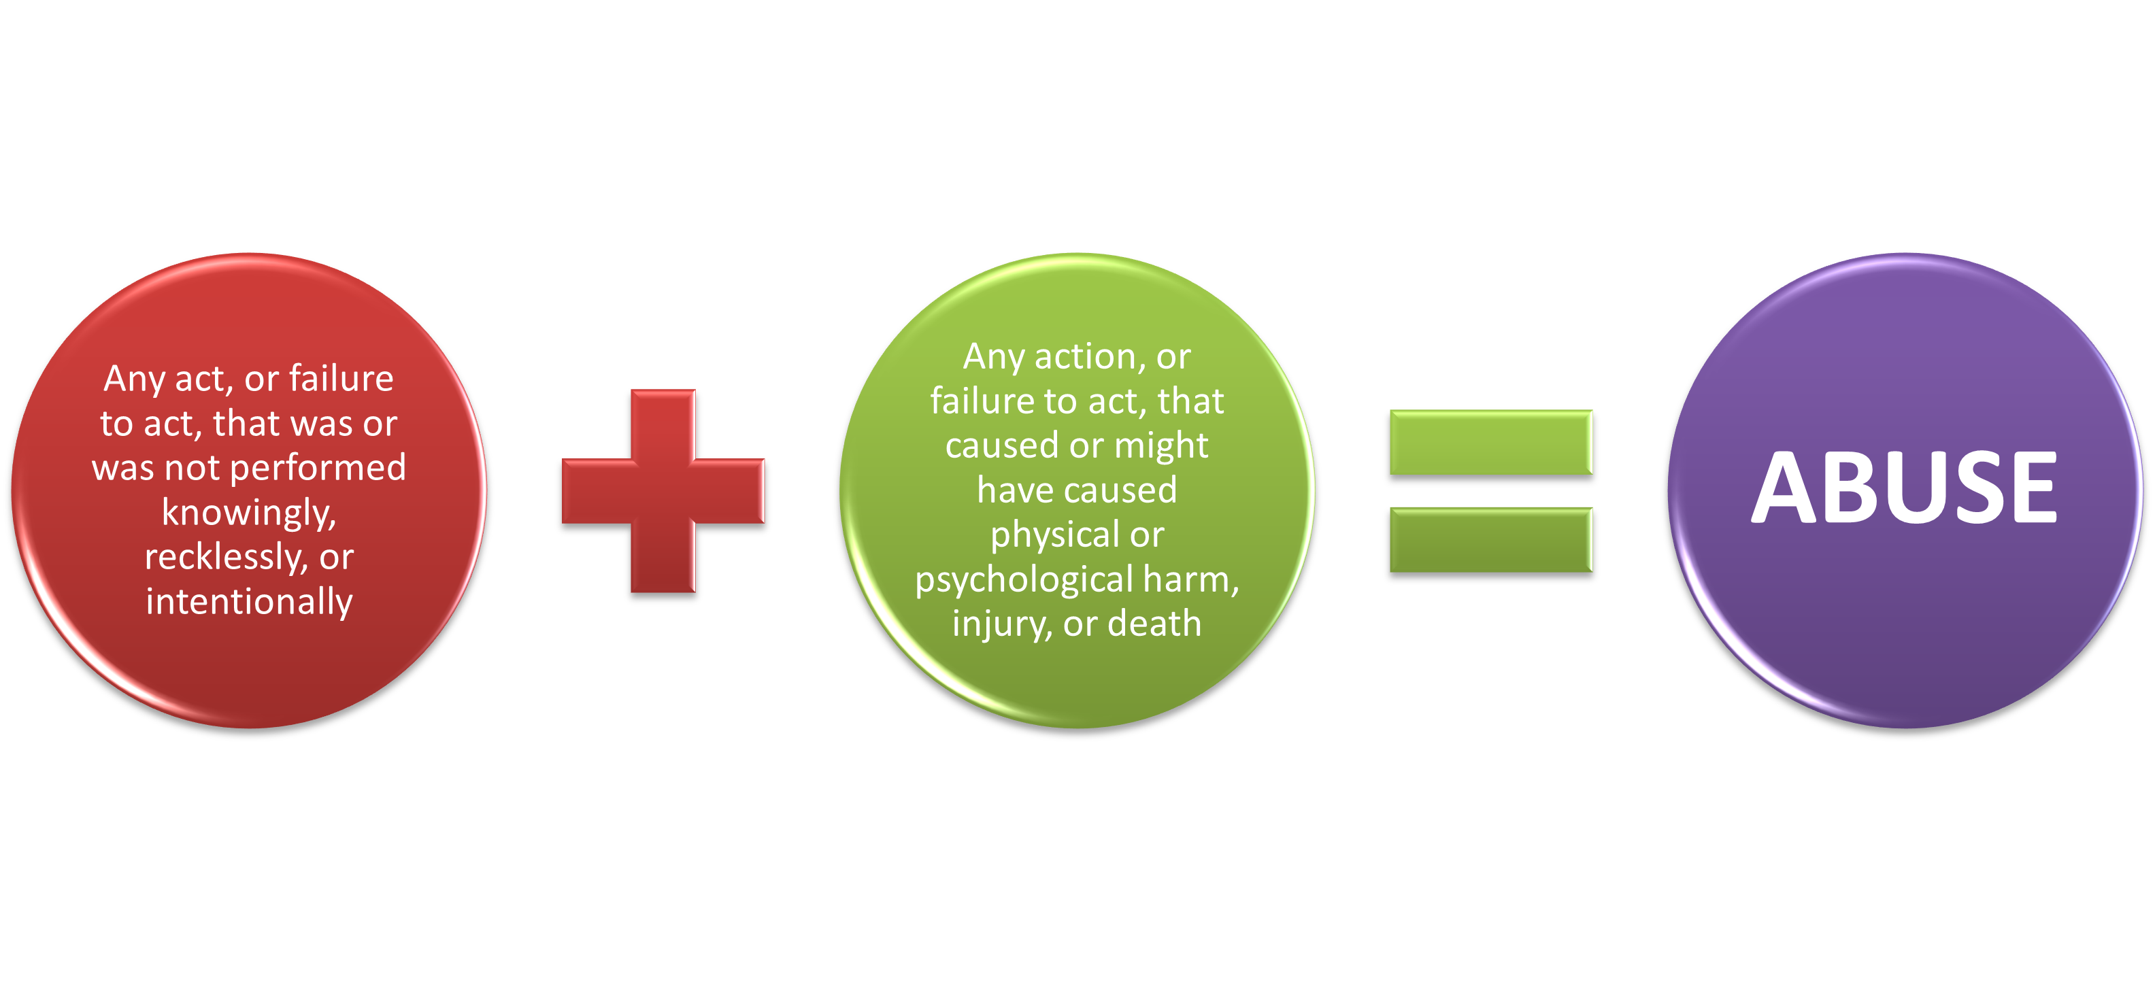
Abuse Defined
Notes:
The definition of abuse is complex in that two parts must be satisfied in order for abuse to have occurred. In considering whether abuse occurred:
First, it has to be determined whether the act, or failure to act by the employee was done knowingly, recklessly, or intentionally:
knowingly, meaning with a sense of consciousness or awareness;
recklessly, meaning with a sense of carelessness, inattention, or deviation from policy and procedure; or,
intentionally, meaning done deliberately or willfully.
Secondly, the act, or failure to act by an employee, must have either caused, or might have caused physical or psychological harm, injury, or death.
Another way to look at abuse is to separate them into five categories – physical, sexual, verbal, exploitation and excessive force (seclusion/restraint).

Slide 33
Exploitation Defined
Defined
Type of abuse
Misue, misappropriation of assets, goods, property
Use of authority to extract personal gain
Examples
Withholding an individual's belongings to ensure compliance with a request
Accepting gifts
Stealing or using an individual's belongings for personal gain
Offering an individual extra medication for favors
Notes:
Exploitation is a type of abuse. Examples include
using an individual’s belongings without permission
withholding an individual’s belongings to ensure compliance with a request
encouraging an individual to make a purchase with their money for something the provider/staff wants
accepting inappropriate gifts – DBHDS has a policy on this
stealing money or possessions
stealing an individual’s medications
offering an individual additional medication in exchange for sexual favors (this would also be considered sexual abuse)
financial misconducts include:
using an individual’s EBT card or other funds to make personal purchases
situations where individual funds were irreconcilable following an outing or purchase
theft (e.g., stealing an individual’s inheritance or non-allocated social security funds)
staff opening and/or using credit cards in an individual’s name

Slide 34
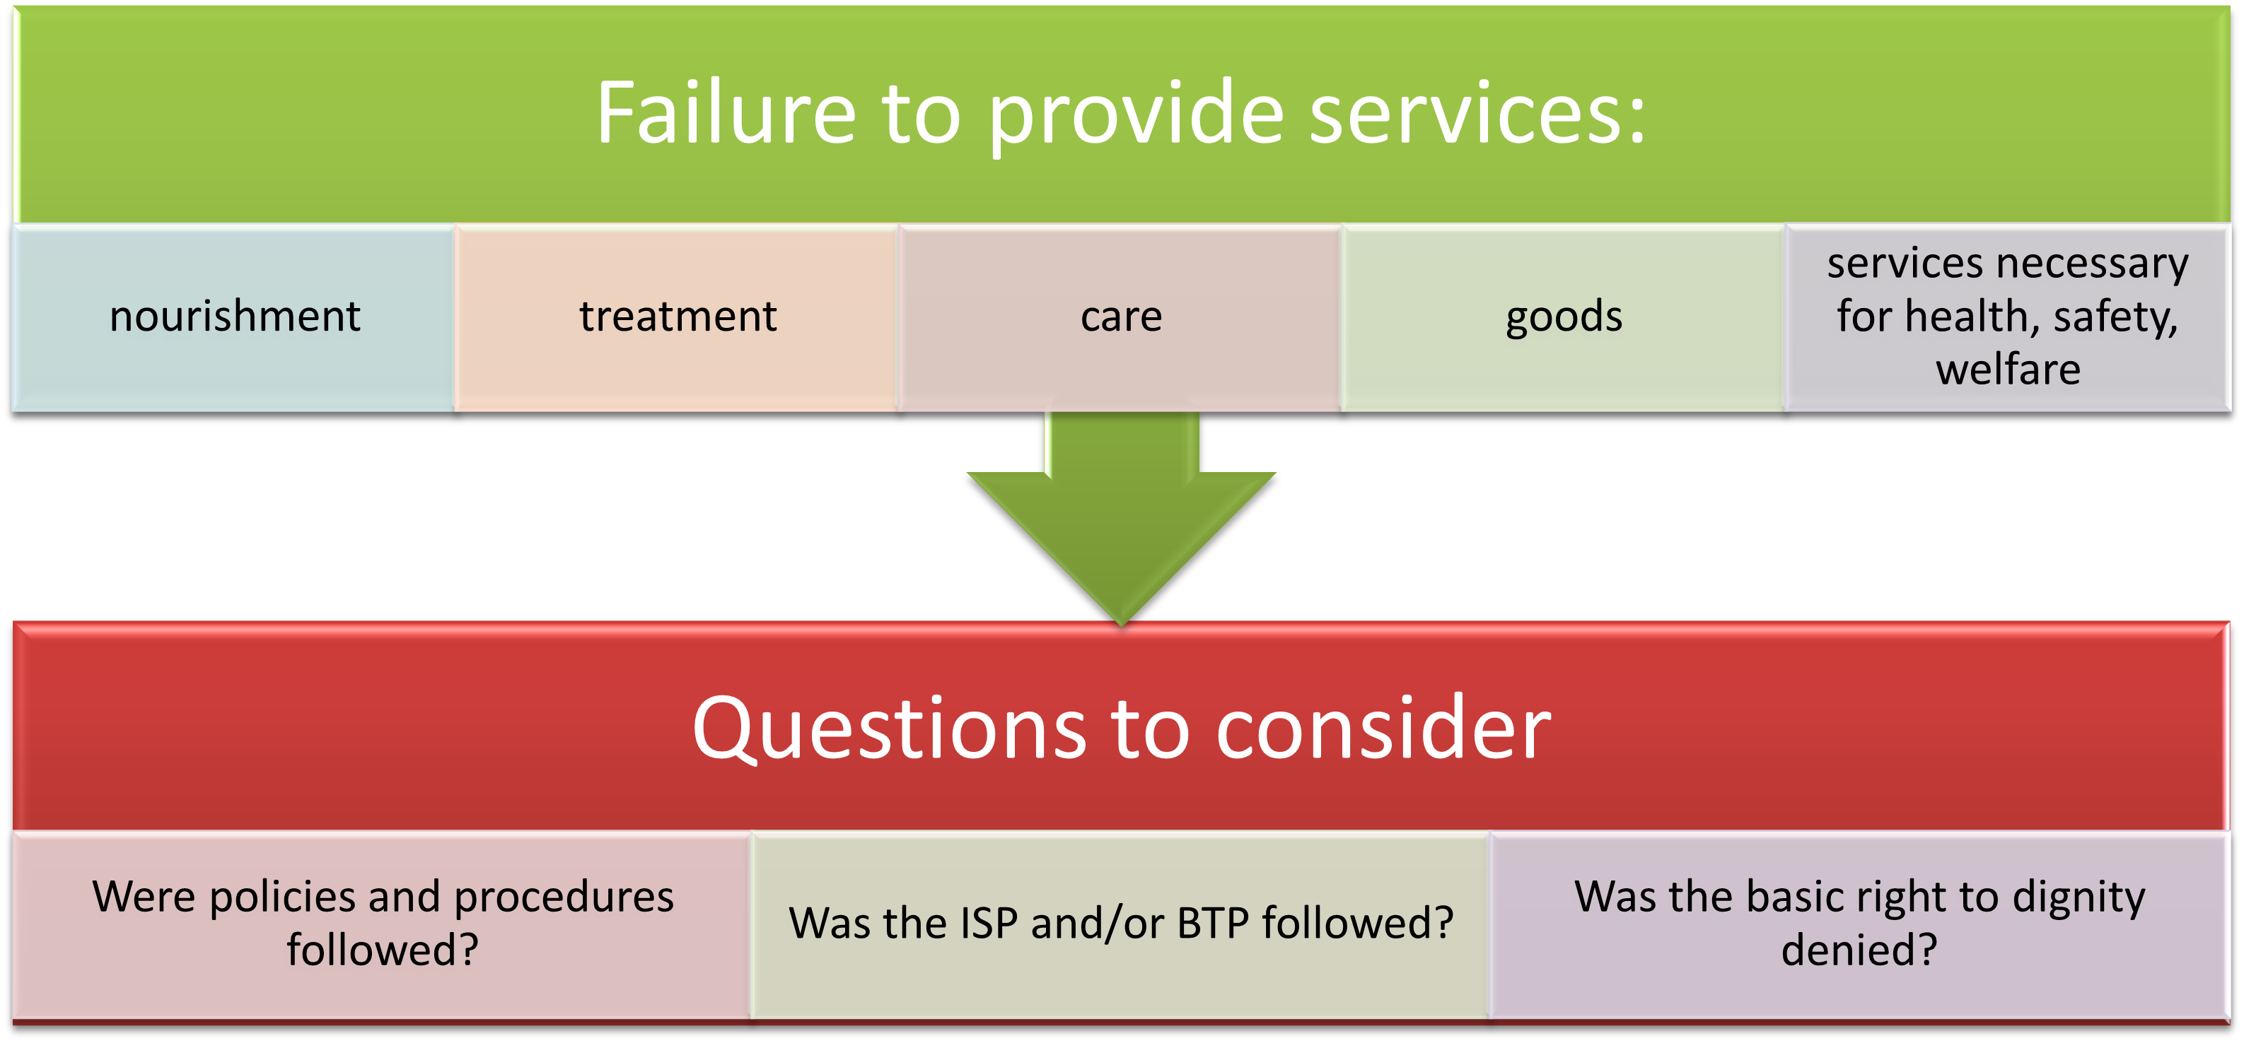
Neglect Defined
Notes:
What is important to understand about neglect, is that it is a failure to abide by policy and procedure, the treatment or behavioral plan, or a denial of an individual’s basic right to dignity that places the individual at risk of being unhealthy or unsafe.
Whether neglect occurred may seem somewhat of a sticky situation, however, it is rather simple. Did staff do what was supposed to be done in the manner it should have been done? What do the internal policies and procedures mandate?
Option: ask for specific examples about what these may look or sound like. Responses may include:
leaving an assigned individual for any period of time who is on a one-to-one observation
sleeping for any period of time when assigned to an individual on a one-to-one observation
letting an individual remain unwashed
not addressing pain that an individual has or knowingly leaving them in pain
allowing malnourishment of an individual
failure of staff to achieve objective standards of care
failure to provide appropriate clothing
failure to provide emotional support
observing neglect and not reporting it

Slide 35
DBHDS has no tolerance for acts of abuse, neglect, or exploitation.
Abuse and Neglect Continued
Notes:
When an allegation of abuse, neglect, or exploitation is made, the Facility Director will take immediate steps to protect the safety and welfare of the individuals we serve, take any action necessary to prevent future occurrences of abuse and neglect and initiate an investigation.
An allegation of abuse or neglect may not result in termination. The DI201 process would need to be followed.

Slide 36
Reporting
Abuse and Neglect
Report it immediately to the Facility Director
Insert Contact Information for your facility here
If the Facility Director is away, report it to their designee
Notes:
It is important to report anything you think is abuse and neglect, immediately to steps can be put into place to stop it from further happening. Even if you aren’t sure, report it immediately and let the process happen to determine if it is any of these.
The Facility Director must be made aware of ALL suspicions and allegations of abuse and neglect immediately.
Presenter: this is a good time to talk about the specifics to the reporting process at your facility. For example, who can the person report it to on the weekends or after business hours.

Slide 37
When to Make a Report
Direct observation of abuse, neglect, or exploitation
An allegation made by an individual
An allegation made by another workforce member
An allegation made by a family member or visitor
Any indicators of abuse, neglect or exploitation
Notes:
These are circumstances that should result in an allegation report by the person hearing or knowing the information.

Slide 38
Investigations of Abuse, Neglect and Exploitation
Be aware of certain cautions when involved in an investigation.
  Trained Investigators
Confidentiality
Interviews
Notes:
Each facility has specially trained investigators who have attended training conducted by the Office of Human Rights and who will conduct a thorough investigation of the allegation. Until there is a founding of abuse and/or neglect, it is considered to be an allegation. The investigator will conduct interviews that will be documented. They interview anyone who may have any information about the events that occurred. This includes anyone named in the original allegation and anyone named as having additional information or involvement as the investigation progresses.
Any and all involvement in an investigation is confidential. If you are interviewed, you may not discuss anything with anyone else. This could compromise the investigation. Failure to keep the investigation confidential could result in disciplinary action. Also, remember at this point it is an allegation so spreading information about someone isn’t fair to them.
Workforce members are not permitted to:
Discuss any aspect of the investigation except with the investigator
Share documents, statements or other evidence relevant to the investigation
Conduct their own investigation by taking photos, soliciting statements or in any way intervening in the activities of the assigned investigation
Remove or destroy documents or evidence of any kind relevant to the case
Misstate facts

Slide 39
Workforce Protections
If an employee is the subject of an abuse or neglect allegation, they are then afforded certain workforce protections. The workforce member must:
  Be informed of the abuse or neglect allegation, including the nature of the allegation, and that a timely, thorough, and impartial investigation will be conducted.
  Have their rights explained to them as outlined by the DI 201
  Receive written notification of the findings of the investigation
  Have an opportunity to present evidence on their own behalf to the investigator.
It is important to keep in my mind that persons are presumed innocent until the Facility Director makes the final determination which is based on the facts of the investigation.

Slide 40
What happens when the investigation concludes?
At the conclusion of the investigation, the abuse, neglect and/or exploitation may be determined to be:
  Substantiated
  Unsubstantiated
  Administrative Findings
All parties, including involved staff will be notified of the findings
Notes:
The investigation must be concluded within 10 working days unless an extension is requested.
The investigator will provide the Facility Director and Advocate with a written report that includes their findings and evidence. The Facility Director will make the final decision about the outcome of the investigation. The Office of Human Rights will be included in investigatory information and Central Office Human Resources may be involved in any disciplinary actions taken in addition to the Facility Human Resources Office.
Substantiated - the preponderance of the evidence shows that it is more likely than not to have happened
Unsubstantiated - the preponderance of the evidence shows that it is not likely to have happened
Administrative findings which are not substantiated but with opportunities for improvement
Staff will be informed of the findings in writing.
When an individual disagrees with the facility’s finding, they can appeal to the Local Human Rights Committee (LHRC). The individual and the facility have access to a second and final level of appeal through the State Human Rights Committee should either be dissatisfied with the outcome at the local level.

Slide 41
REFERRING and REPORTING
Who is the Human Rights Advocate at this facility?
How do I contact the Human Rights Advocate?
What are some reasons to contact the Human Rights Advocate?
Insert YOUR FACILITY ANSWERS Here
Notes:
Let the class know who the Advocate is at your facility, where their office is, their email address and phone number. Talk about some of the reasons staff would contact the Advocate – be sure to include things other than making a report of abuse/neglect such as
-to ask a question about what the HRR say about a particular subject or situation
-to consult about a policy or process that impacts individuals’ human rights
- to brainstorm alternatives to a restriction

Slide 42

Questions?

Slide 43
APPENDIX
Notes:
Use these slides to supplement your knowledge and training

Slide 44
Key Terms
Key Terms
DBHDS – Department of Behavioral Health and Developmental Services
OHR – Office of Human Rights
HRR – Human Rights and Regulations
ID/DD – Intellectual Disability/Developmental Disability
LHRC – Local Human Rights Committee
SHRC – State Human Rights Committee
AR – Authorized Representative
OSIG – Office of the State Inspector General
dLCV – disability Law Center of Virginia
LG – Legal Guardian
Notes:
This is a short list of key terms and their abbreviations that you will hear in the human rights presentation. There are many more acronyms used at this facility so be sure to ask if you hear one and you aren’t sure you know what it is.

Slide 45
Definitions
Attorney-in-fact: a person authorized, through a power of attorney document, to act on behalf of another person.
Authorized Representative: a person that is authorized by another person to act on their behalf.
Emergency/risk: a situation that requires a person to take immediate action to avoid harm, injury or death to an individual receiving services or others, including violent and self-destructive behavior that jeopardizes the immediate physical safety of the individual to staff member or others.
Developmental disability: any of various that usually become apparent during infancy or childhood and are marked by delayed development or functional limitations especially in learning, language, communication, cognition, behavior, socialization, or mobility
Health care agent: a person appointed by a declarant to act for and on behalf of the declarant to make decisions related to consent, refusal, or withdrawal of any type of health care

Slide 46
Definitions
Intellectual disability: mild to severe impairment in intellectual ability equivalent to an IQ of 70 to 75 or below that is accompanied by significant limitations in social, practical, and conceptual skills (as in interpersonal communication, reasoning, or self-care) necessary for independent daily functioning and that has an onset before age 18
Investigator: a person who has successfully completed investigative training and has received a certificate of completion by DBHDS.
Investigation: It is a systematic collection of facts, performed by a trained investigator, for the purpose of describing and explaining an allegation of abuse and/or neglect.
OSIG: investigates complaints alleging fraud, waste, abuse or corruption by an executive branch state agency, non-state agency or officers, employees or contractors of those agencies

Slide 47
Definitions
Restriction: the intentional limitation of resources.
Restraint: approved physical intervention to prevent an individual from moving their body to engage in behavior that places them or others at risk of harm.
Seclusion: involuntary placement of an individual alone in an area secured by door that is held or locked shut by a staff person, by physically blocking the door, or by other physical or verbal means, so the individual cannot leave it.
Time out: temporary separation from a rewarding environment, as part of a planned and recorded therapeutic program to modify behavior.

Slide 48
References
OHR web page
  Human Rights - Virginia Department of Behavioral Health and Developmental Services
Human Rights Regulations
  Virginia Administrative Code - Title 12. Health - Agency 35. Department of Behavioral Health And Developmental Services - Chapter 115. Regulations to Assure the Rights of Individuals Receiving Services from Providers Licensed, Funded, or Operated by the Department of Behavioral Health and Developmental Services

Slide 49
References Continued
DI 104 Behavior Interaction Management Techniques Training
DI 201 Reporting And Investigating Abuse And Neglect Of Individuals Receiving Services In Department Facilities
DI 206 Personal Private Fund Accounts
DI 208 Human Research Review And Approval
DI 209 Language Access Services For Individuals With Limited English Proficiency Or Other Communication Or Language Barriers
DI 214 Use of Seclusion And Restraint In State Facilities

Slide 50
References Continued
DI 215 Use of Restraint For Secure Transport
DI 218 Use of Personal Communication, Entertainment, and Computing Devices By Individuals Receiving Services in State Hospitals
DI 604 Physical Requirements For State Hospital Seclusion Rooms
DI 904 Implementing Privileges For Individuals Under Forensic Status
DI 905 Review Of Medical Records By Forensic Patients
DI 906 Community Medical Appointments And Special Hospitalization For Individuals Who Are Under Forensic Status
DI1001 Privacy and Use And Disclosure Of PHI

Slide 51
Supplemental slides

Slide 52
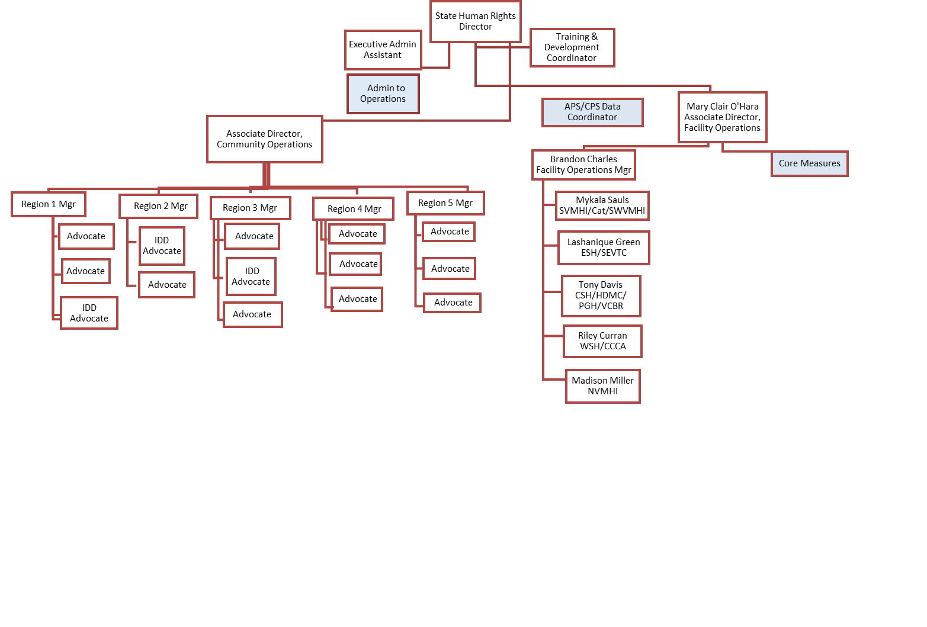
Office of Human Rights – Facility Team
Notes:
The Office of Human Rights (OHR) is a division in DBHDS Central Office. OHR has a statewide team of about 30 FT and 3 PT staff responsible for ensuring the rights of individuals receiving services from providers that are licensed, funded or operated by DBHDS. Advocate also fulfill other code mandated responsibilities that we will talk about later. You can see here that the Office of Human Rights is divided into two operation centers: one for state operated facilities and the other for licensed and funded providers of service in the community.
Advocates in the community and facility are responsible for:
representing individuals making a human rights complaint,
trying to prevent or correct alleged rights violations
providing training to individuals, family members and providers on the HRR and
examining all conditions or practices that may interfere with the free exercise of an individual’s assured rights.

Slide 53
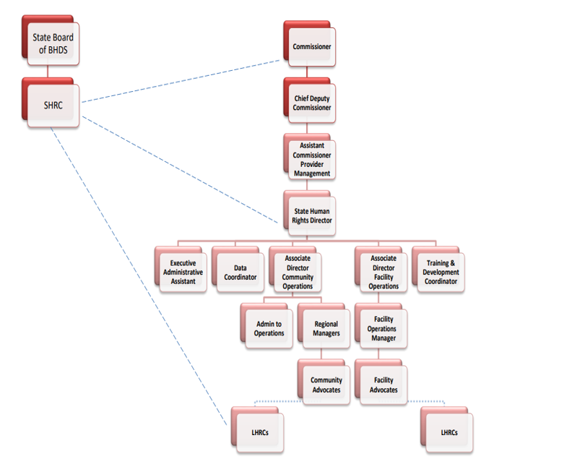
OHR is internal to DBHDS but external to state facilities

Slide 54
Behavior Treatment Plan Restrictions
Training for staff who will be implementing the plan
Address maladaptive behaviors that pose immediate danger
Have been developed after a systematic assessment by a licensed professional or licensed behavior analyst
Be reviewed by an independent review committee before implementing
Be mindful to consider the behavior management program
Notes:
If there is a behavioral treatment plan put into place for the use of restrictions or time out, the plan must include the items on this slide.
If the behavioral treatment plan involves the use of restraint or time out, there are additional review requirements:
Intermediate care facilities for ID individuals (SEVTC) require specially constituted committee approval prior to implementation
All other facilities must submit the plan and independent review committee approval to the LHRC prior to implementation
Plans must be reviewed quarterly by the independent review committee and LHRC or specially constituted committee
4. The use of seclusion is never permitted in a plan

Slide 55
Every individual is entitled to be completely free from any unnecessary use of seclusion, restraint or time out. This right is guaranteed under state and federal law as well as the policies of DBHDS and the Human Rights Regulations.
Use of Seclusion, Restraint and Time-Out

Slide 56
Exercises and videos

Slide 57

Human Rights at the Heart of
Mental Health Care
Notes:
This video is 3:34 minutes long.
Link: https://www.youtube.com/watch?v=KGoBgcHTmwA

Slide 58

Human Rights and Mental Health
Notes:
This video is 2:13 minutes long
Link: https://www.youtube.com/watch?v=A4xbXb9L4SA

Slide 59
Mental Health is a Human Right
Notes:
Ask the class what this means to them. Answers may include:
Health is a state of complete physical mental and social well-being
Holistic approach
Right to a standard of living adequate to health and well-being
Person centered
Education
Community supports
Independent living
No stigmatism
No discrimination

Slide 60
What types of complaints
do you think
are more commonly seen?
“A complaint is a unique opportunity to strengthen the relationship with the client.” -- Kevin Kelly
Notes:
The human rights complaint process is perhaps one of the most important sections of the Regulations. It not only documents individual’s rights concerning complaints against their rights but provides specific procedures for provider compliance in assuring individual’s right to complain and their protections.
Each facility has their own complaint resolution policies and procedures.
Examples of different types of complaints may include:
meals not meeting dietary needs
roommate stealing items
shower temperature too hot/cold
groups don’t meet needs
visiting hours at wrong time, not long enough
request for a medical specialty appointment taking too long
staff member using inappropriate language
**Presenters: you can come up with some examples that are more common to your facility

Slide 61
Abuse or Neglect
Notes:
Read each example and have the class identify if it abuse or neglect. Explain that abuse and neglect allegations can be very complex and an investigation can result in a finding or no finding based on information that is discovered during the course of it. The examples below are very basic. Presenters: you can create your own scenarios that you’ve seen at your facility or are more specific to your facility.
Individual A’s friend visits and gives them several $10 Amazon gift cards to use while they are hospitalized. They are very excited and show the cards to staff member B who asks if they can have one since there are several. Staff member B further explains to Individual A that their child’s birthday is coming up and they have the perfect gift in mind. Individual A gives one of the cards to staff member B. (Abuse)
Staff member B is assisting individual A in dressing and notices bruises on their arm. B asks the individual how they got there, and they say that staff member D grabbed them when they tried to leave the unit. B reports it in accordance with DI 201 and facility policy and after an investigation, there is a finding. (Abuse)
Individual A is getting discharged in a few days after being hospitalized for 14 months. Staff member B has been an integral part of their recovery and discharge planning. Their family comes with a box of nice chocolates and gives them to staff member B for all their work supporting their loved one while hospitalized. Staff member B accepts the chocolates. (A box of chocolates is an inexpensive gift. Staff member B should thank the family and explain that many staff participated in A’s recovery and discharge planning so they will put it in the break room for all to enjoy).
Staff member B is assigned to a one-to-one with Individual A from 3am-4am while they are sleeping. Staff member D is doing checks and sees Staff member B with their chin on their chest. They speak to them and B becomes alert immediately. B reports it in accordance with DE 201 and facility policy and after an investigation, there is a finding. (Neglect)
Individual A returns from a weekend pass and has multiple bruises and scratches on their arm. Staff member B asks how they got the bruises and scratches, and the individual says that a family member got mad at them and it happened in the process of shoving them into the bedroom. They further say that they don’t want anyone to worry about it since it was just this one time. DI 201 and facility policies don’t apply to family members however the facility can report this to CPS/APS.

