Slide 1

Reporting in CHRIS
Abuse, Neglect, Exploitation & Human Rights Complaints
Office of Human Rights
2024

Slide 2
Learning Goals and Objectives:
Develop an understanding of entering a complaint in CHRIS.
01
Identify and distinguish different types of complaints and reporting requirements.
02
Review reportable and non-reportable human rights complaints.
03

Slide 3
Agenda
Peer to Peer (P2P) Guidance
CHRIS Demo (Abuse Report)
CHRIS Demo (Complaint Report)
Considerations in Reporting
Regulatory “Handout”
Notes:
Abuse Report = Allegation
Complaint Report = Compliant w/o ANE

Slide 4
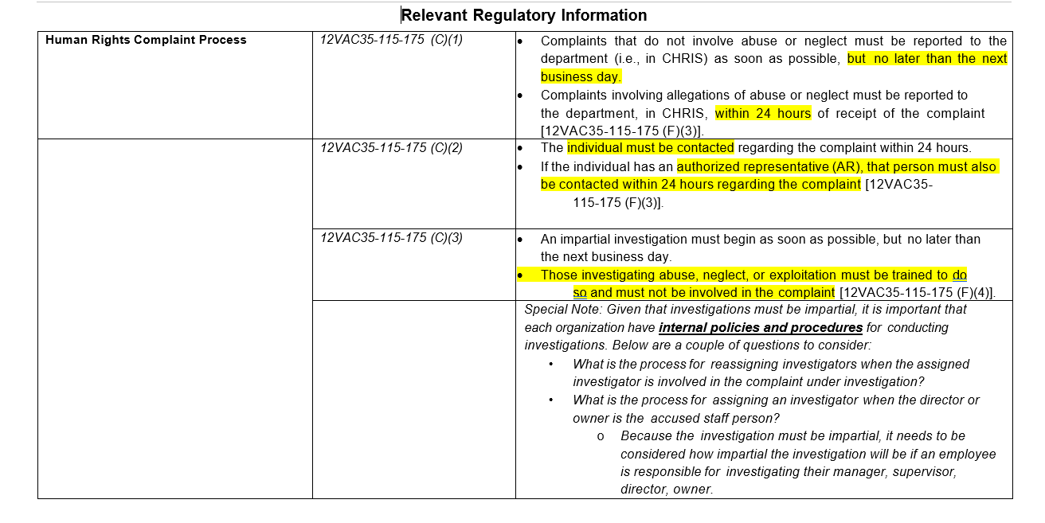
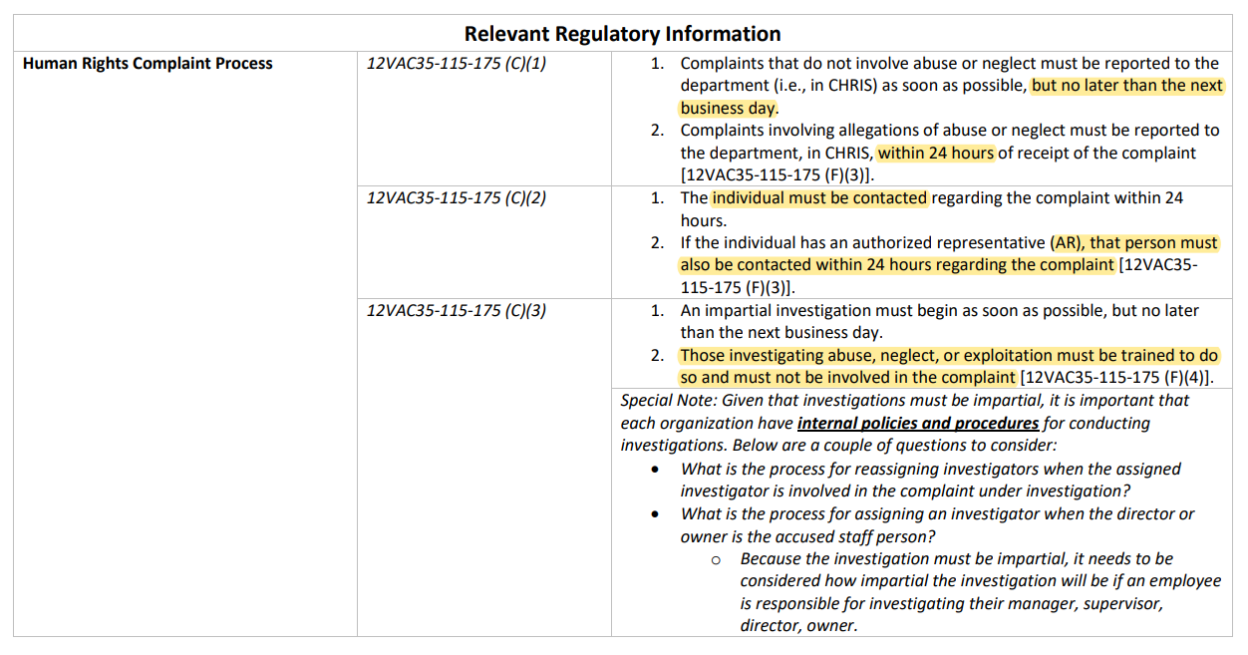
Reporting in CHRIS Training Handout

Slide 5
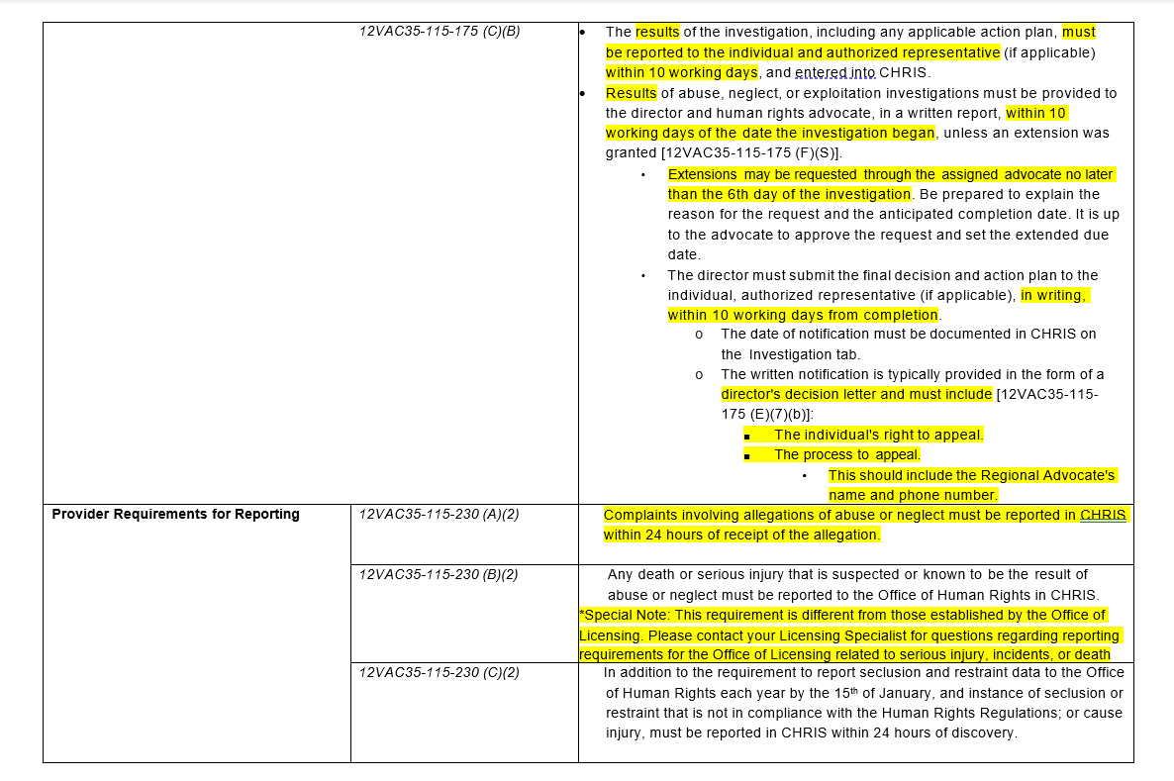
Reporting in CHRIS Training Handout

Slide 6
Determining Abuse
Any act, or failure to act, that was or was not performed knowingly, recklessly, or intentionally
Any action, or failure to act, that caused or might have caused physical or psychological harm, injury, or death
ABUSE

Slide 7
Determining Abuse
Coercion
Exploitation
Neglect
Coercion is not officially defined in the regulations; however, it is important to understand how it is related to abuse.
The use of expressed or implied threats of violence or reprisal or other intimidating behavior that puts a person in immediate fear of the consequences in order to compel that person to act against his or her will, or subtle language or actions intended to persuade or otherwise influence someone to do something that they might typically be unwilling to do, using tactics such as emotions, psychology, imagination, or indoctrination.
This is a type of abuse. Exploitation is the misuse or misappropriation of the individual's assets, goods, or property. Exploitation also includes the use of a position of authority to extract personal gain from an individual.
Using an individual’s belongings without permission • Withholding an individual’s belongings to ensure compliance • Accepting gifts • Financial misconducts • Stealing or borrowing an individual’s medications • Offering an individual additional medication in exchange for sexual favors (this would also be coded as sexual abuse)
Failure by an employee or program responsible for providing services to do so, including: nourishment, treatment, care, goods or services necessary to the health, safety and welfare of an individual receiving services.
Failure to take actions that would have prevented an injury • Failure to stop or try to stop an individual from an activity that could lead to harm • Allowing two individuals to fight without intervening (e.g., peer on peer aggression) • Failure to provide adequate supervision • Certain medication errors • Elopement (based on the provider’s internal policies & procedures)

Slide 8
Determining Abuse
First - determine whether the act, or failure to act by the employee was done knowingly, recklessly, or intentionally.
Knowingly: with a sense of consciousness or awareness.
Recklessly: with a sense of carelessness, inattention, or deviation from policy and procedure.
Intentionally: done deliberately or willfully.
Second - determine whether the act, or failure to act by an employee either caused, or may have caused:
Physical or psychological harm
Injury
Death

Slide 9
Licensed Community Providers Peer-to-Peer (P2P) Guidance
P2P Technical Assistance Memo Link
Peer on Peer (P2P) Aggression
Reporting P2P
Coding P2P in CHRIS
“Peer-on-peer aggression,” for purposes of this guidance, means a physical act, verbal threat, or demeaning expression by an individual against or to another individual that causes physical or emotional harm to that individual. Examples include hitting, kicking, scratching, and other threatening behavior
Providers must report to the OHR all incidents of peer-on-peer aggression that are alleged to have resulted in or from a human rights violation, whether the alleged violation is discovered by the provider or through a complaint. These incidents of peer-on-peer aggression shall be entered in CHRIS within 24 hours of discovery of the incident or receipt of the complaint, in accordance with 12VAC35-115-230.
These incidents should be coded under the category “Neglect Peer-on-Peer Aggression.”

Slide 10
Licensed Community Providers Peer-to-Peer (P2P) as Neglect Guidance
Reporting Peer-on-Peer Aggression as Neglect
Incidents involving peer-on-peer aggression [also] may constitute potential neglect when:
Provider staff fail to follow internal policies and procedures
Provider staff do not deliver supervision consistent with an individual’s individualized services plan (ISP) or occurred because staff were not engaged in appropriate supervision
Provider staff do not act to prevent an individual from being harmed during the incident, including:
  Physical harm resulting from peer-on-peer aggression may be evidenced by open wounds, bruises, black eyes, lacerations, or broken bones.
  Emotional harm resulting from peer-on-peer aggression may be evidenced by an individual stating that they are feeling unsafe or afraid of certain peers, or documented changes in the individual’s behavior (i.e., becoming more withdrawn, avoidance of peer(s), or clinical documentation from a qualified professional).
The following must always be reported as Neglect P2P:
A pattern of three (3) or more incidents of peer-on-peer aggression involving the same peers within a seven (7) day timeframe
Incidents between peers involving sexual assault, which is a form of violence that includes:
    Forced groping and rape;
    Involving unwanted sexual activity between minors (e.g., intercourse, kissing, touching of private areas);
    Involving sexual intercourse or other sexual activity, physical assault, or exploitation between adult peers in which at least one individual is deemed to lack capacity based on an existing assessment that indicated the individual was at risk of exploitation.

Slide 11
Licensed Community Providers Peer-to-Peer (P2P) Guidance
All incidents that meet the definition of “Peer-on-Peer Aggression” in the Human Rights Regulations are to be reviewed by the provider, in accordance with the providers policies and procedures, and undergo an “internal review.”
  “Internal review” is not a defined term in the Human Rights Regulations; however, when used in this guidance, it refers to the provider’s standard processes to review incidents to determine any further actions needed to identify and address potential harms to an individual and to reduce the likelihood of reoccurrence. Providers should have policies to address internal review procedures that include a reasonable timeframe for the review of incidents, the methodology used for the review, and a structure for documenting the outcome of the review.
    Please note that the “internal review” is separate from the investigation that would occur if the review raised suspicion of abuse or neglect, or if the provider received a complaint.
Upon completion of this internal review, providers are expected to implement any identified proactive measures that may reduce the number of peer-on-peer aggressions and lessen the possibility of neglect, resulting in a safer treatment environment overall.
  (See also 12VAC35-105-160 and 12VAC35-105-520 of the Rules and Regulations for Licensing Providers by the Department of Behavioral Health and Developmental Services [“Licensing Regulations”] that specify various review and reporting requirements.)
The OHR may request to review provider information specific to their review of incidents involving peer-on-peer aggression because of identified trends, the possibility of neglect, complaints discovered by the OHR that were known to the provider but not reported, or in any situation that the OHR deems necessary to protect the rights of individuals receiving services from providers of mental health, developmental, or substance abuse services in Virginia. (See 12VAC35-115-260.)
Notes:
The following must always be reported from the previous slide:
*When those things happen or are discovered they must be reported, and the provider should not wait until the internal review has been concluded. to decide.

Slide 12
Guidance: Reporting Peer-on-Peer Aggressions (P2P) as Potential Neglect - FAQs
Q-Now that we don’t have to enter every single P2P for OHR, what new documentation is expected for our tracking, specifically for OHR?
  All incidents that meet the definition of “peer-on-peer aggression” (P2P) in the Human Rights Regulations are to be reviewed by the provider. This review is expected to consider, at a minimum, whether provider staff followed internal policies and procedures, delivered supervision consistent with individual(s) needs and the ISP(s) and acted to prevent individuals from being harmed while receiving services.
  During the internal review process, the provider is responsible for determining whether something is reportable to OHR in CHRIS.
  P2P is an incident. Providers are required to track and trend incidents per Licensing Regulations. (See 12VAC35-105-160 and 12VAC35-105-520).
Q-What is the differences between an "internal review" and “investigation“?
  Internal Review refers to the provider’s standard processes to review incidents to determine any further actions needed to identify and address potential harm to an individual and to reduce the likelihood of reoccurrence. This is separate from the human rights investigation, that would occur if the review raised suspicion of abuse or neglect, or the provider received a complaint.
Q-Is a provider required to submit documentation from internal reviews of P2P incidents to OHR, like they do for Annual Seclusion/Restraint?
  No. OHR may request to review provider information specific to their review of incidents involving P2P because of identified trends, the possibility of neglect, complaints discovered by the OHR that were known to the provider but not reported, or in any situation that the OHR deems necessary to protect the rights of individuals receiving services (See 12VAC35-115-260.)
Q-How long does the provider have to complete their internal review of P2P incidents?
  Providers should have policies to address internal review procedures that include a reasonable timeframe for the review of incidents, the methodology used for the review, and a structure for documenting the outcome of the review.
Q-What if a provider makes an incorrect determination and does not report in CHRIS? Will there be a late reporting citation?
  When the provider is doing an internal review and identifies a potential rights violation, the provider would use the date of the internal review as the date of discovery and report the incident within 24 hours.
  Late reporting is when the provider is made aware of a reportable incident by OHR, and the provider does not enter the report into CHRIS within the 24-hours or when a provider is aware of a reportable P2P incident and only enters it on the OL side of CHRIS.
  If OHR discovers that a provider should have but did not report a P2P incident to OHR in CHRIS, this would be considered a failure to report.
Notes:
NEW Guidance became effective February 1, 2024 and supersedes guidance dated June 15, 2017, entitled “Office of Human Rights Peer-to-Peer Reportable Incidents.”
New Guidance is based on a comprehensive review of neglect data entered by providers in CHRIS, and collaborative conversations with key stakeholders.
NEW Guidance is intended to clarify provider reporting requirements for peer-on-peer aggressions that occur in licensed community provider settings.
NEW Guidance document is accessible on the OHR webpage and Town Hall
Q-What if a provider makes an incorrect determination and does not report in CHRIS? How do we enforce appropriate determinations? Late reporting citations?
A-If a provider is doing an internal review of incidents and identifies a potential rights violation, the provider will be encouraged to enter that incident into CHRIS using the date of the internal review as the date of discovery. In an instance, for example, where the provider did a review a month later, OHR may highlight the circumstances of the current incident and provide guidance as to why the provider’s internal review should occur more frequently (to identify and possibly prevent similar incidents) and prompt that as a possible corrective action.
Q-What if a provider makes an incorrect determination and does not report in CHRIS? Will there be a late reporting citation?
A-When the provider is doing an internal review of incidents and identifies a potential rights violation, the provider should report that incident to OHR in CHRIS using the date of the internal review as the date of discovery.
If OHR identifies a P2P incident, either by external referral (IMU, APS, individual complaint) and the provider was unaware of the incident, the provider will be notified by OHR and have up to 24 hours to report the incident in CHRIS and initiate an investigation.
If OHR discovers that a provider should have but did not report a P2P incident to OHR in CHRIS, this would be considered a failure to report. For example, if OHR received an APS report where it is clear that APS contacted the provider during the APS investigation and the provider never reported the incident. Late reporting is when there is a CHRIS entry already, but OHR has identified that it was not entered within 24 hours of the date of discovery. Late reporting is when the provider is made aware of a reportable incident by OHR, and the provider does not enter the report into CHRIS within the 24-hours

Slide 13
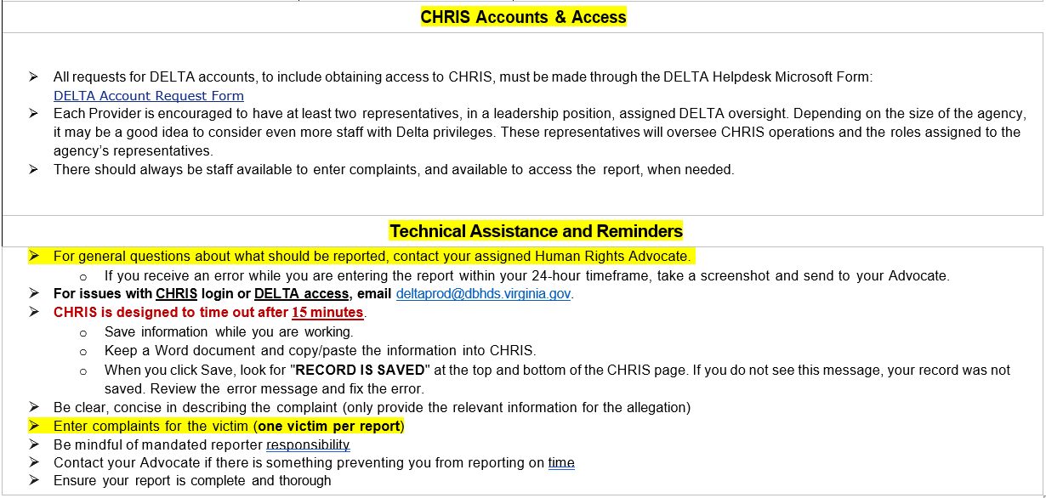

CHRIS Technical Assistance
DELTA Account Request Form

Slide 14
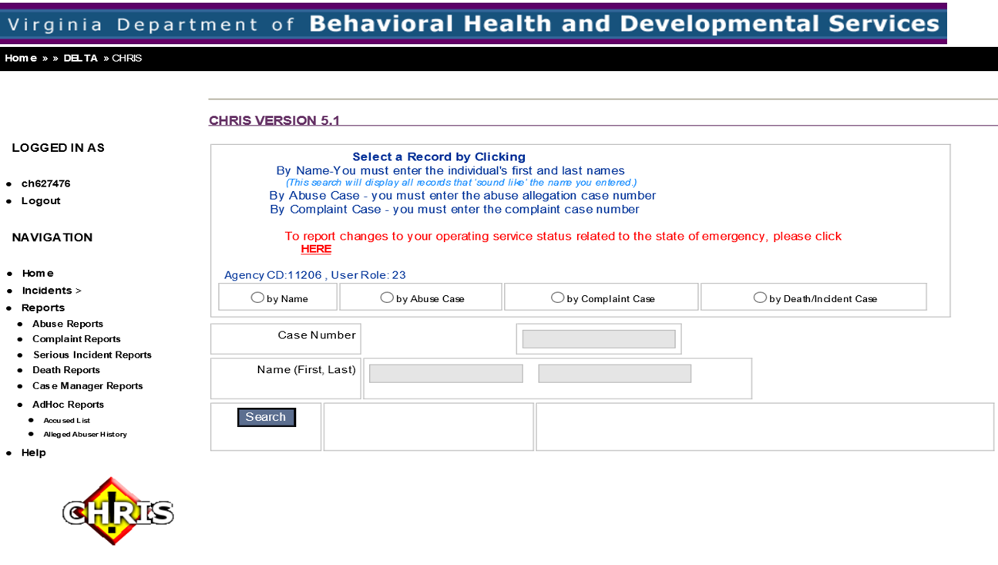
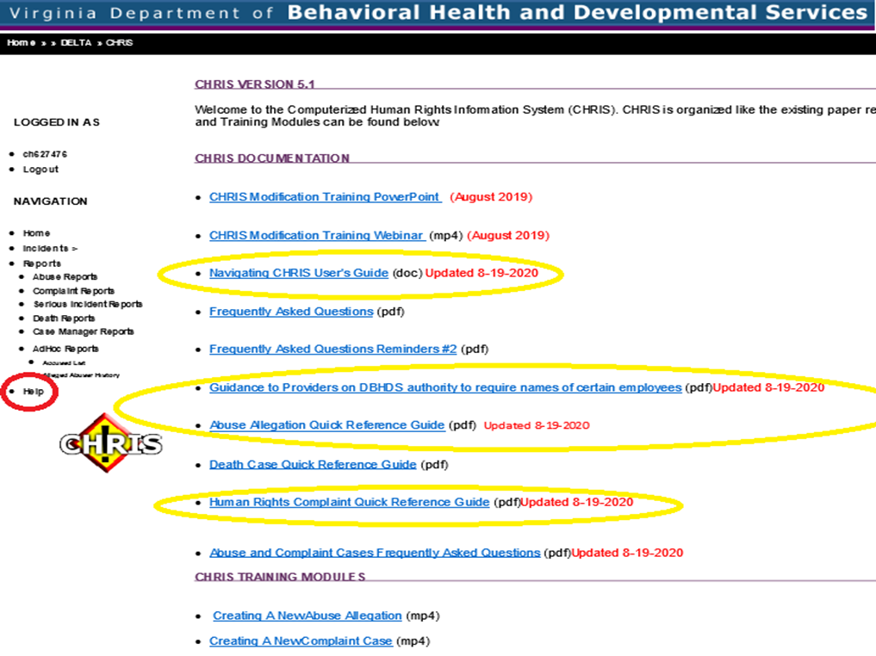
CHRIS Resources
12VAC35-115-175 & 230
CHRIS log in or Delta Access
DELTAprod@DBHDS.Virginia.gov
Notes:
Highlight the resources found internally in CHRIS before reaching out to your advocate on help entering a CHRIS rpt.
Can be found in left navigation pane under Help. – PDFs, video files available for your use – download and create your own CHRIS trng manual.
OHR cannot assist with login credential problems – only DELTA can assign new logins and temporary passwords.
Refer to the DELTA email address for those issues.
Ensure you keep your login credentials active – they will expire if you are not active in CHRIS and you will need to request a new password to get back in. This is not a valid excuse to be locked out when you need to report.
Login credentials will also expire after approx. 3 months and you will be prompted to create a new password – don’t ignore the prompts otherwise you’ll be locked out.

Slide 15
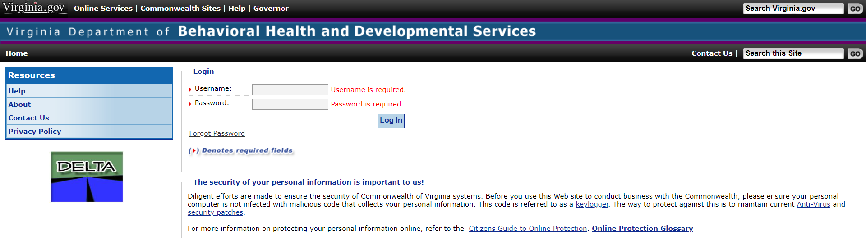
Entering ALLEGATIONS
Notes:
Icon is a live link

Slide 16
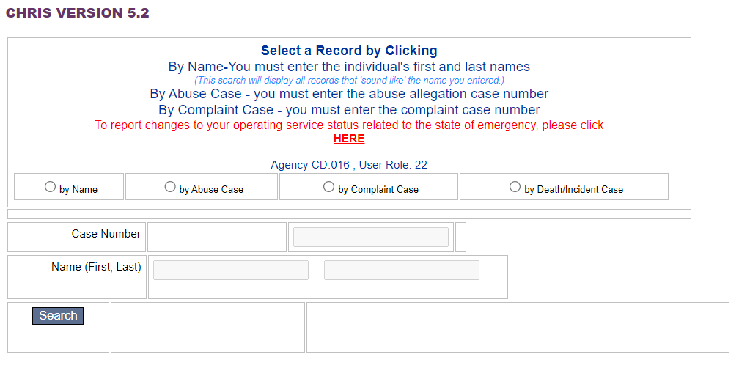



Entering ALLEGATIONS
Select one
*You must select a record search type to access ability to enter existing case numbers or name

Slide 17
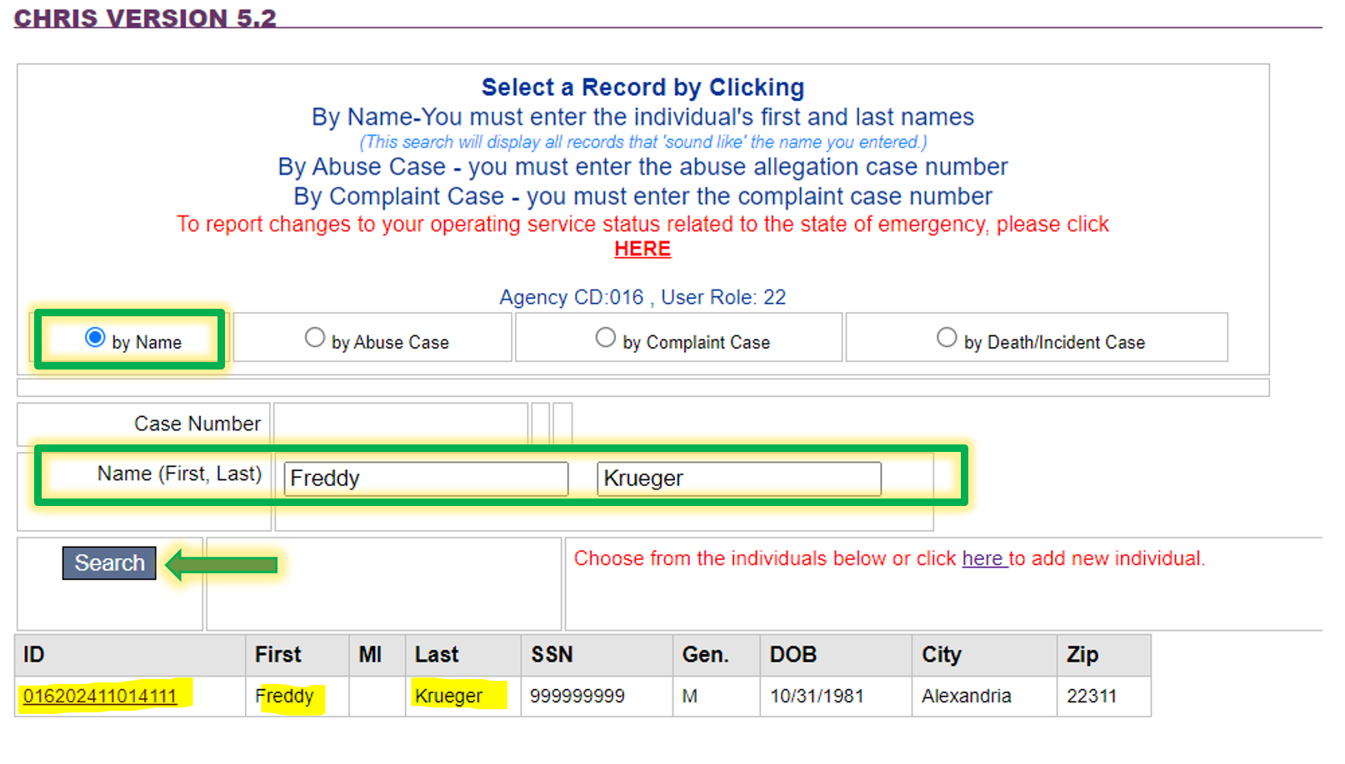
Entering ALLEGATIONS
Example:
Search:
“by Name”
Enter name:
(FIRST, then last)
Click “Search”
Individual is found
Click “ID” link
Note:
If this is a newly entered individual, you may use the hyperlink in CHRIS to begin entering in demographics to create new case
Thor
Odinson
Thor
Odinson

Slide 18
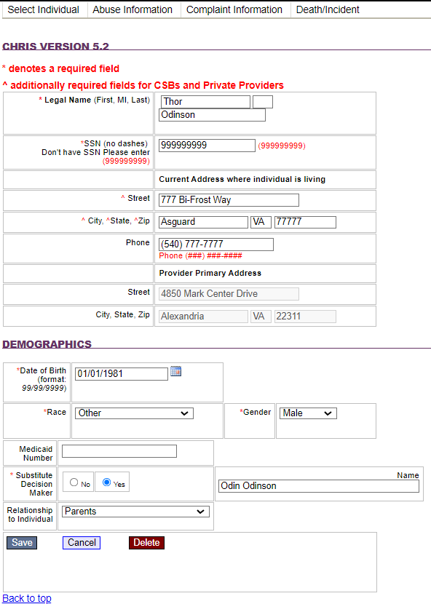
Entering ALLEGATIONS
Select Individual tab:
Verify correct individual
Provider address will auto populate from location selected previously
In the “Demographics” section of this tab, the Substitute Decision Maker field is now required. When “Yes” is selected, the “Name” and “Relationship to Individual” fields must be completed.
Save record - This completes the Select Individual Tab

Slide 19

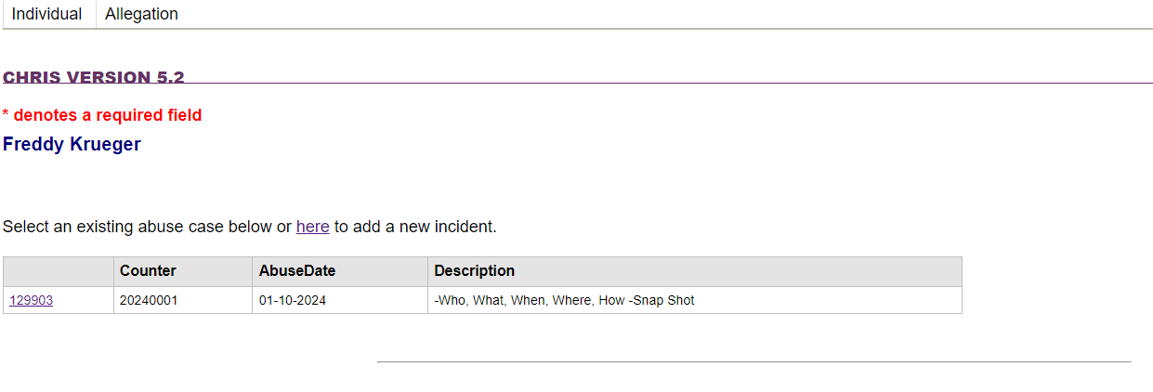
Allegation Tab
Next: Click the “Abuse Information” Tab:
Next: Click the “Allegation” Tab:
Thor Odinson
On the “Allegation” tab, any existing cases for the individual will be shown
Add updates by clicking the hyperlink to the case in CHRIS (i.e. 129903 in this example)
New incidents can also be added at this time by clicking the hyperlink stating “here” to add new incidents

Slide 20
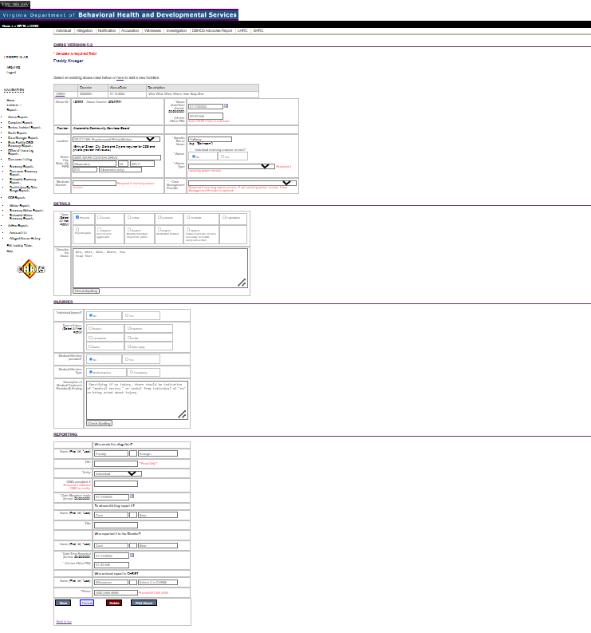
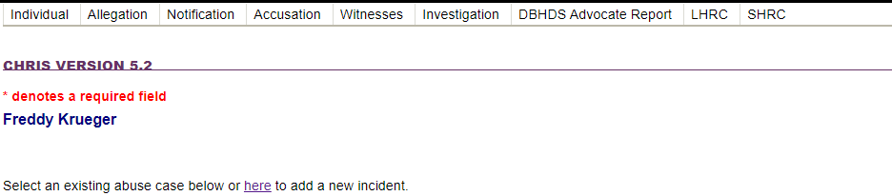
Allegation Tab
1
Overview: Time/Date, Service type/location, etc.
2
Details: Who, What, Where, When, How – Snapshot
3
Injuries: Specific Injury/injuries reported or observed
4
Reporting: Persons reporting /Report “Trail”

Slide 21
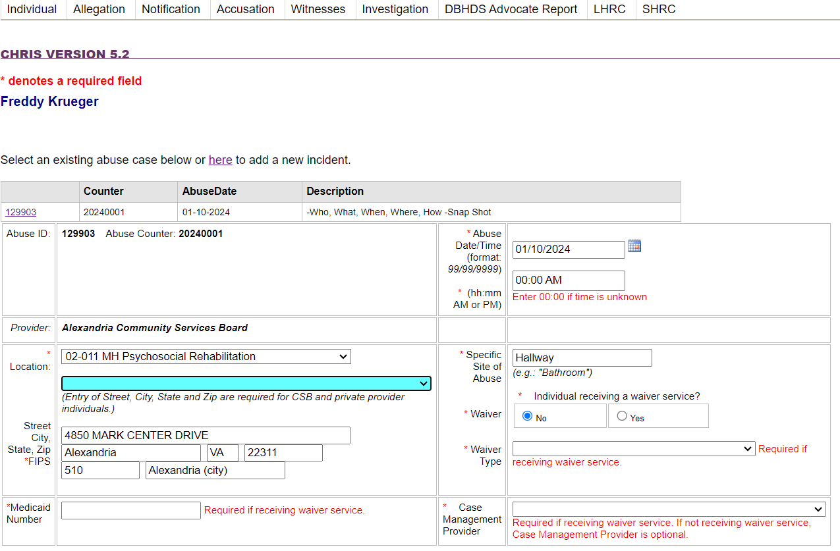
Allegation Tab: Overview section
1
Overview
”Abuse Counter” = Case Number
  i.e. 202400001 seen here
Enter the following information:
Abuse Date/Time Reported
Provider will be auto-populated
Select Service Type/Location
Specific area where alleged abuse occurred during the service
Indicate “Yes” or “No” to Individual receiving a wavier service.
“Yes” will require additional information such as:
Type of Wavier
Medicaid Number
Support Coordination CSB
Thor Odinson

Slide 22

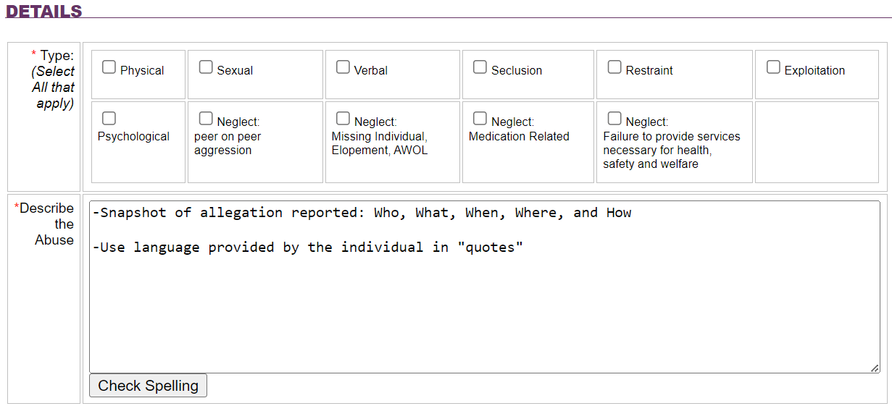
Allegation Tab: Details section
Details
Select type(s) of abuse alleged. More than one selection can be chosen.
Describe:
“Who” is the alleged assaulter /victim
“What” type of alleged abuse is reported/denied, and by whom
“When” did the alleged abuse occur
“Where” specifically in the service area did the alleged abuse occur
“How” was the alleged abuse perpetrated or happened.

Slide 23

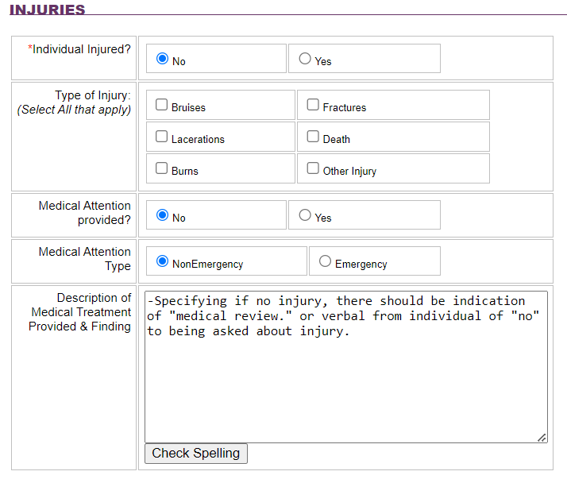
Allegation Tab: Injuries section
Injuries: Specific Injury/injuries reported or observed
Indicate injuries that are observed, that meet the definition of serious injury (section 30) - by selecting yes or no
Specify the type of injury - more than one type of injury can be selected
Select yes or no if the individual receive medical attention, and the type of care provided
  *Emergency (i.e., ambulance or taken out of the facility) / Non-emergency (i.e., appointment made)
Lastly describe the treatment provided and findings. *If taken out of the facility use hospital records to report the treatment received / diagnosis or cause.
If specifying “NO” to injury, a notation of a “medical review” and/or verbal denial of injury noted from individual.

Slide 24

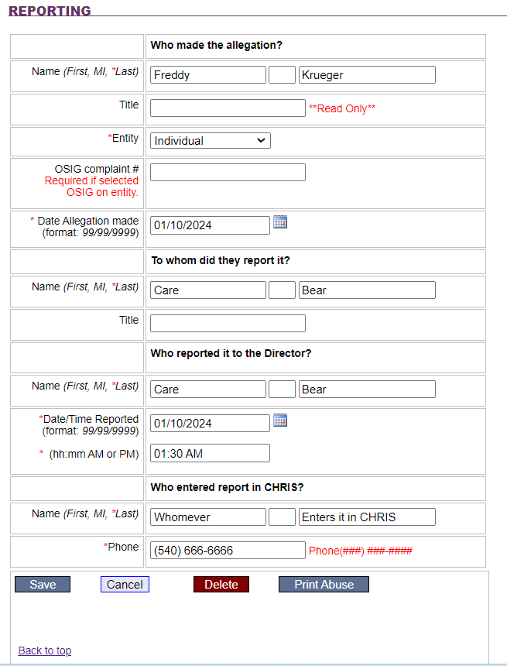
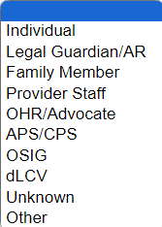
Allegation Tab: Reporting section
Reporting: Persons reporting /Report “Trail”
Begin by noting the person making the allegation, followed by their title (if applicable) and “Entity” (i.e. is the person reporting the individual, the parent or the AR, staff, etc.)
Allegations from the Office of the State Inspector General (OSIG) will have a ‘complaint number” associated with the allegation, which must be listed next.
The person to whom and when the allegation was reported is noted next, as well as their title.
Next is noting whom reported the allegation to the Facility Director (FD) and date/time when the FD was notified.
Lastly, enter the name and the telephone number for the person entering the information into CHRIS *allegations of ANE must be entered in CHRIS as soon as possible, but no later than *24 hrs.
SAVE record – This completes the Allegation Tab
Thor Odinson
(540) 857-6309

Slide 25
After clicking “Save” for the individual on the Allegation tab, a series of additional tabs will become visible (*or will already be visible if accessing a previously entered case.)
Allegation
Notification
Accusation
Witness
Investigation
The remaining tabs are for the Advocate to complete. However, Providers may observe entries on these tabs.
DBHDS Advocate Report: progress of the Advocate review of information entered by the provider.
LHRC: Will be completed when appeals to the director decision are made/requested.
SHRC: Will be completed when appeals of the LHRC are made/requested.

Slide 26
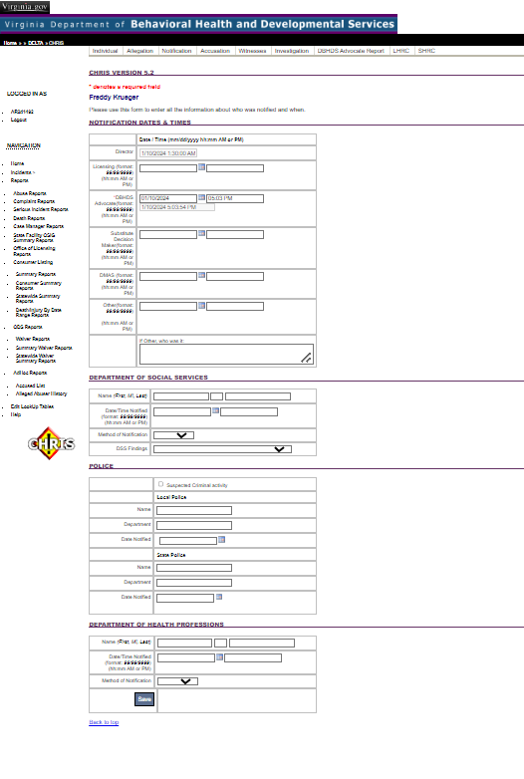
Notification Tab
1
Notification: Time/Date /Persons notified of allegation
2
Department of Social Services (DSS) Notification
3
Police Notification
4
Department of Health Professionals

Slide 27
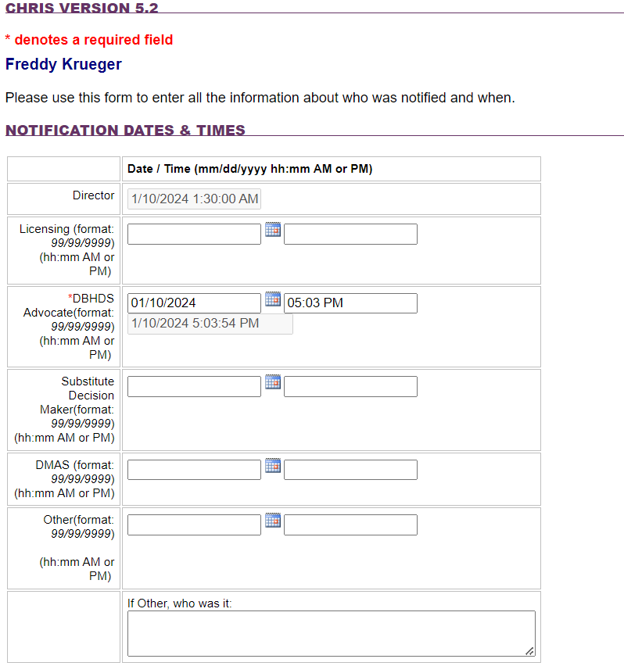
Notification Tab: Notification Dates & Times section
1
Notification:
Time/Date/Persons notified of allegation
Thor Odinson
Director notification date and time auto-populates from previous entry on allegation tab.
Note the date and times of additional notification to appropriate additional parties:
  Licensing
  Advocate
  Substitute Decision Maker:
    Authorized Repetitive (AR)
    Legal Guardian (LG)
    Power of Attorney (POA)
Other: Any other person notified. Use the text field to note who was notified.

Slide 28
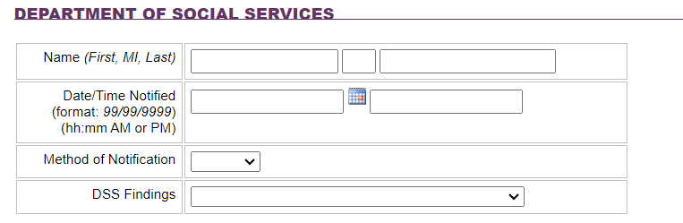
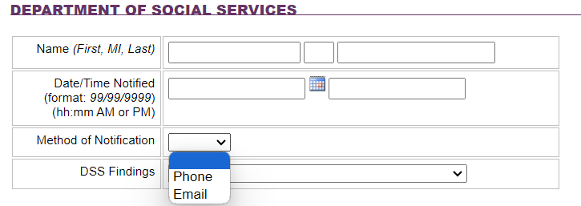
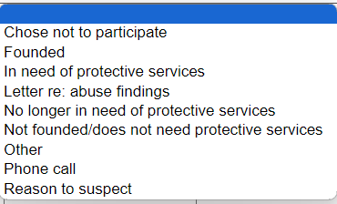
Notification Tab: DSS Notification section
2
Department of Social Services (DSS) Notification
Note any communications with DSS in this section:
Name, Date, and Time of person notified
Method of Communication via drop down Menu: Phone or Email
Any participation, communication, or findings by DSS can be identified/updated via drop down menu

Slide 29
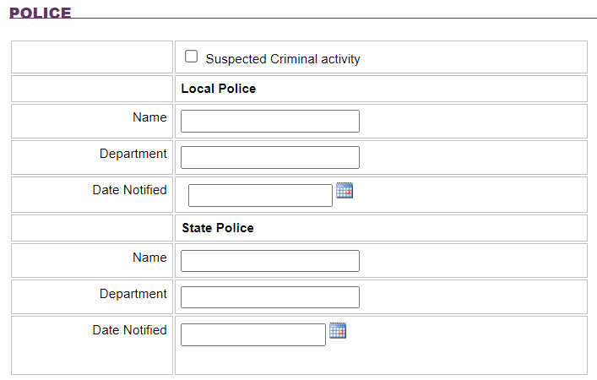
Notification Tab: DSS Notification section
3
Police Notification
When there is known or suspected criminal activity, note this by checking the box indicating this concern.
Identify the police organization contacted (Local or State):
  Name of person contacted
  Department
  Date

Slide 30
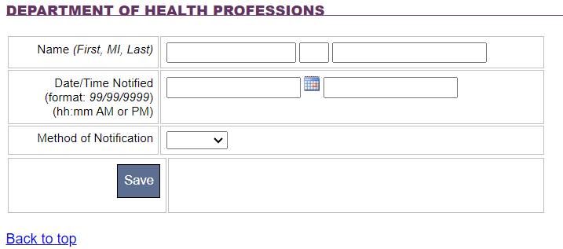
Notification tab: DHP Notification section
4
Department of Health Professionals (DHP)
Complete the section only when an alleged assaulter who is licensed by the DHP has been determined in the investigation findings and Director's decision as having conducted abuse.
Name, Date, and Time of person notified
Identify the method of Communication via drop down Menu: (Phone or Email)
  *if faxed, use email as notification type
“Save” record - This completes the Notification Tab

Slide 31
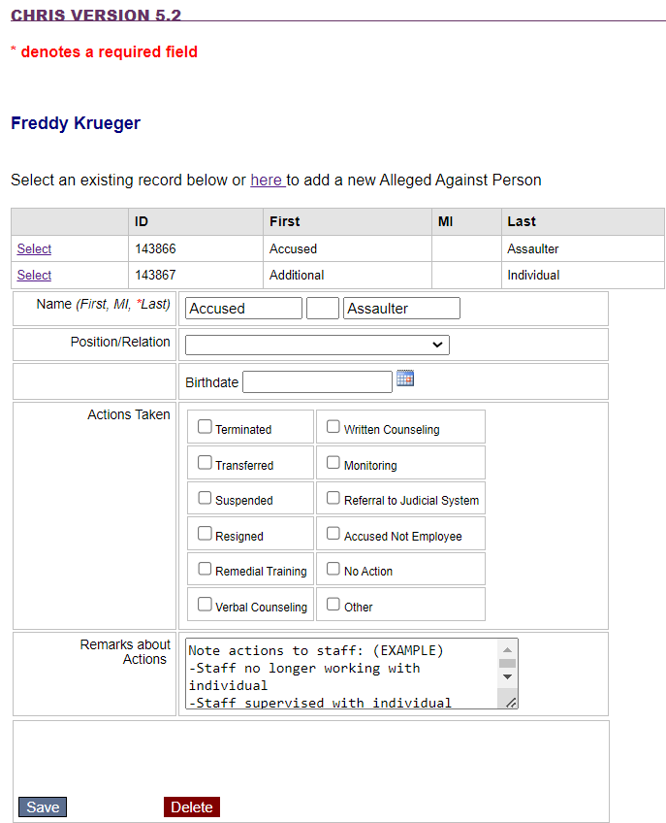
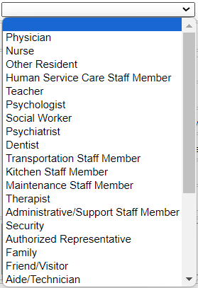
Accusation Tab
Thor Odinson
Note the alleged employee(s) accused of abuse; and additional individuals involved or accused.
  Name: List the employee’s/individuals name(s). (if name us unknown – list “staff” until discovered.
  Position/Relation: Note the title or relationship to the accused - if known (*will appear in drop down menu).
  Action Taken: indicate what steps are taken regarding the accused employee
  Remarks: describe what the “actions taken” (from above) included
“SAVE” record – This completes the Accusation tab

Slide 32
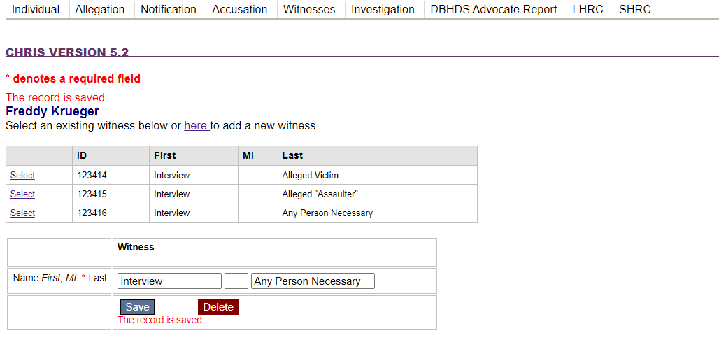
Witness Tab
Note the individuals who were interviewed as part of the investigation.
Include the alleged victim on this tab, as they should also be interviewed as part of the investigative process.
Save record -
This completes the Witness tab
Thor Odinson

Slide 33
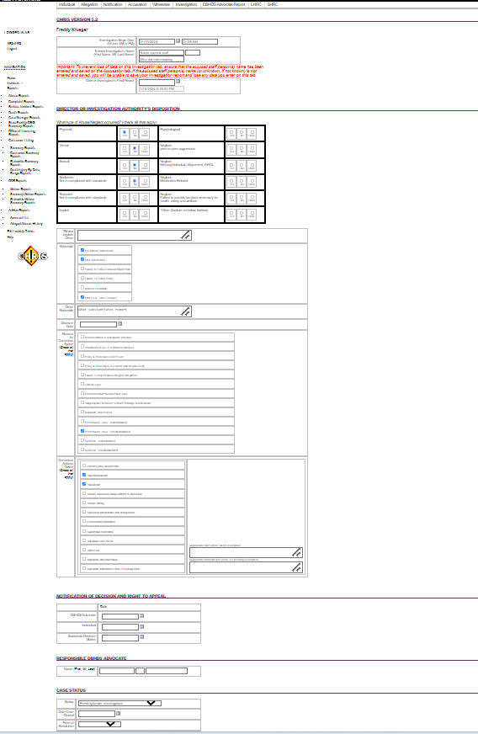
Investigation Tab
1
Investigation Begin date, Trained Investigator, Final Date of Investigation
Director or Investigator Authority Disposition
Notification of Decision and Right to Appeal
Responsible DBHDS Advocate
Case Status
2
3
4
5

Slide 34
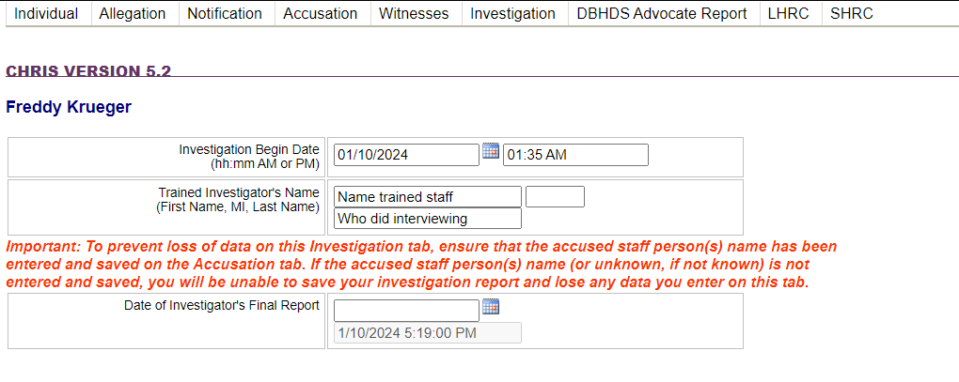
Investigation Tab : Section 1
1
Notification:
Time/Date /Persons notified of allegation
Note when the investigation began – Date and Time
Note the trained investigator assigned to the case
Note the date of the close of the investigation.
  10 days, unless an extension has been granted
Thor Odinson
  Extensions must be requested ASAP but no later than the 6th working day of the investigation
Notes:
Extensions are granted by the advocate for good cause and typically do not extend beyond a few days. This is because the resolution process is intended to be timely with a focus on mitigation and prevention of future/additional harms.
Extensions are granted by the advocate for good cause and typically do not extend beyond a few days.

Slide 35
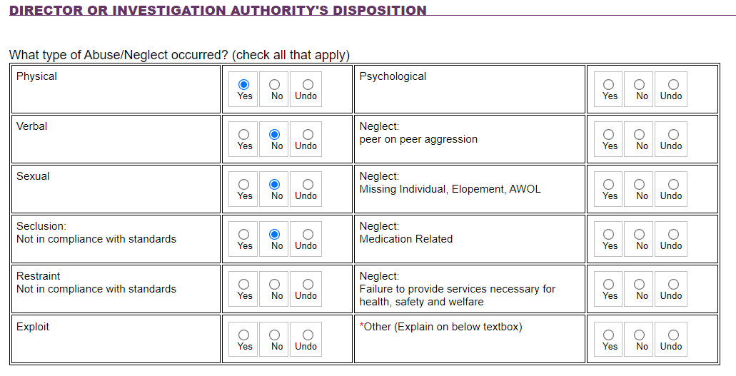
Investigation Tab : Section 2
2
Director or Investigator Authority Disposition
Use this section to identify the type of ANE determined via the investigation findings – you may select as many that may apply.
If *Other is anticipated as an appropriate abuse type selection, please reach out to your advocate for technical guidance.
Notes:
*Other: Usually we see this when there is not a preponderance of the evidence that Abuse occurred for example, it is clear that a staff person said or did something inappropriate or unprofessional, but it does not rise to the level of abuse and the provider intends to re-train the staff and/or clarify something in their Policy as a result. Another example is the med error situation where it was alleged that an individual did not receive their medication, but the investigation determined the medication was received by the individual but not accurately documented.

Slide 36
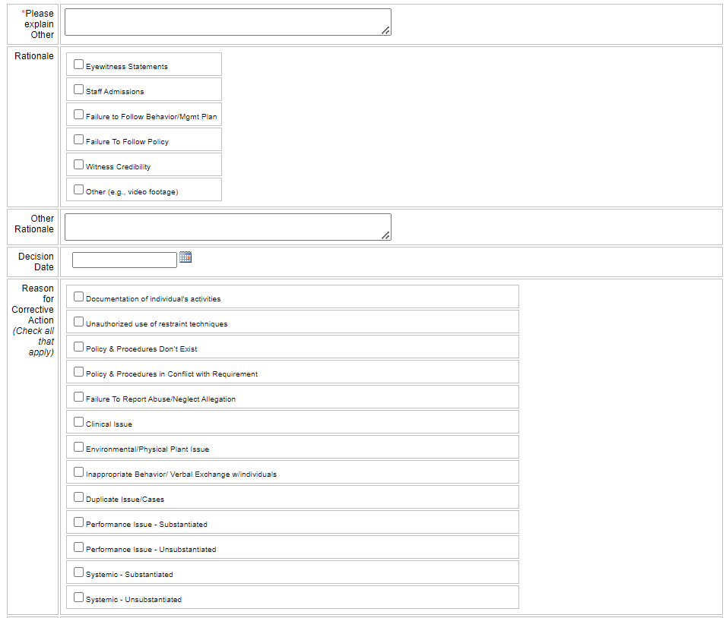
Investigation Tab : Section 2 – continued
2
Director or Investigator Authority Disposition – cont.
Rationale: identify how information in the investigation finds were obtained.
  other rationale pertains to video footage: Note time, date, and actions observed on the footage in the text field
Decision Date: Note the date the determination of ANE was made.
Reason for Corrective Actions: In the investigation findings, select what was the identified concern/why corrective action is necessary (*select all that are found to apply).

Slide 37
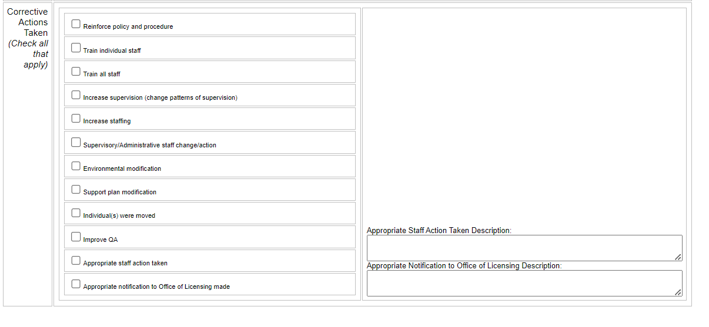
Investigation Tab : Section 2 – continued
2
Director or Investigator Authority Disposition - cont.
Identify all actions taken as result of the findings of the investigation (*select all that apply)
Should “Appropriate staff action taken” or “Appropriate notification to Office of Licensing” be selected, use the text fields on the right to specify what the actions taken included and/or what was reported to licensing (the method and to whom.)
Appropriate staff action taken signifies corrective actions taken against staff appropriately; not if accused staff acted appropriately

Slide 38
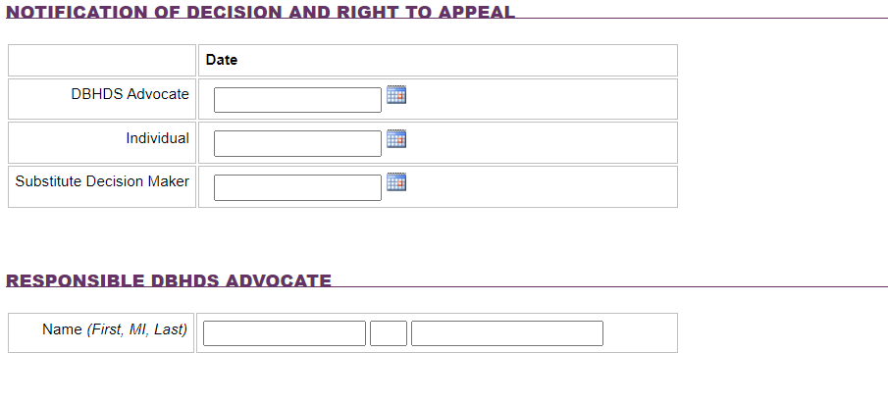
Investigation Tab : Section 3 & 4
3
Notification of Decision & Right to Appeal
Note the date the Advocate, individual, and Substitute Decision Maker (if applicable) were notified of the Director’s decision and appeals information provided
  Date Investigation Tab is completed.
  Date decision letter provided
4
Responsible DBHDS Advocate
Note the name of the assigned Advocate

Slide 39
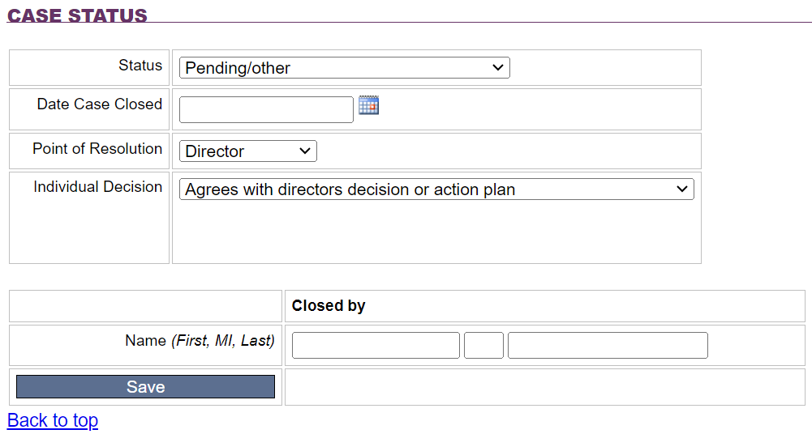
Investigation tab : Section 5
5
Case Status
Complete this section as shown:
  From the drop-down menu(s), only select the following:
  “Pending Other” as Status
  “Director” as Point of Resolution
  “Agrees with…” as Individual Decision
  The Advocate completes the remainder of the fields; and closes the case or updates case statuses drop-down menus.
Closed by: Should always be completed by the Advocate only
Save record – This completes the Investigations Tab

Slide 40
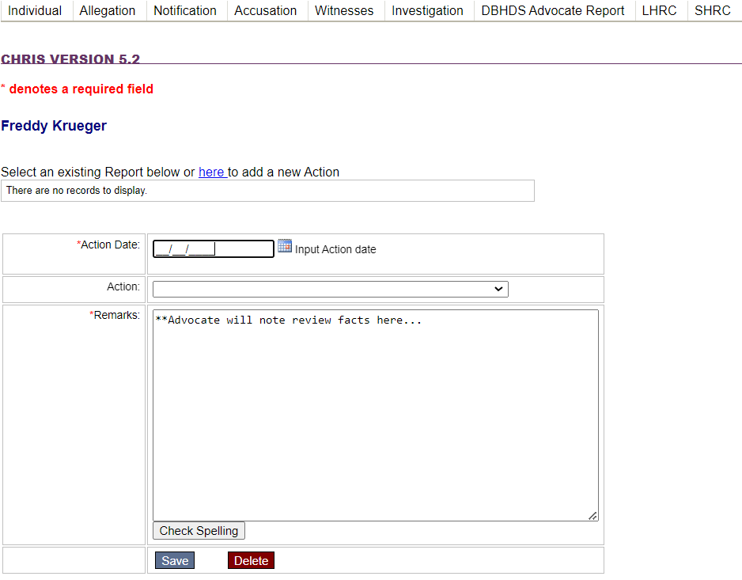
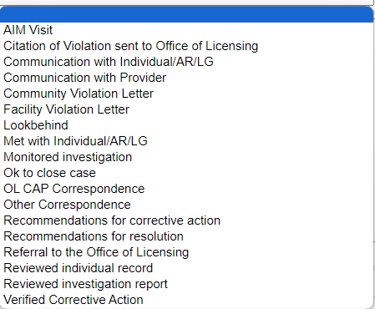
DBHDS Advocate Report Tab
This tab is only completed by the assigned Advocate; however, may be observed by the provider.
Thor Odinson
The Advocate will Date and select Actions or participation taken during the investigation; and describe the actions and participation in the Remarks field.

Slide 41
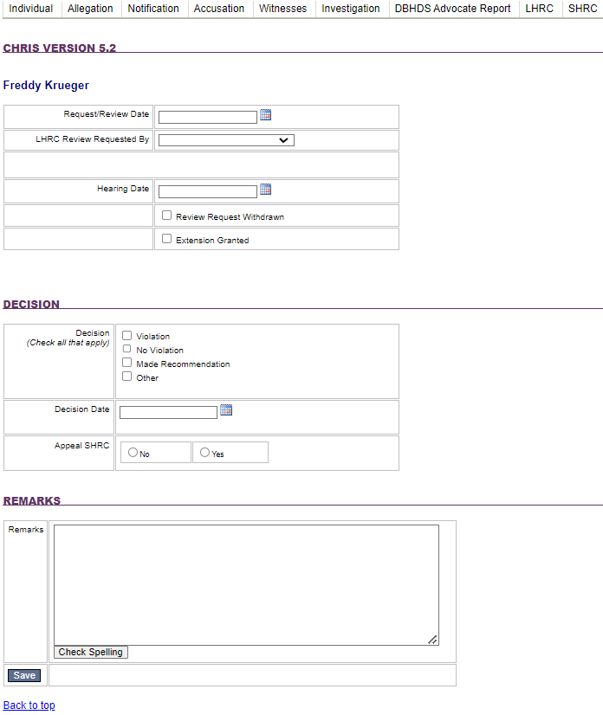
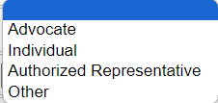
Local Human Rights Committee (LHRC) Tab
Thor Odinson
The Advocate completes this tab when a LHRC Hearing is needed or requested, noting the following:
Date LHRC hearing was requested or reviewed
Whom requested the LHRC Hearing
Date of the hearing
  (or indicating if the hearing request was withdrawn; or an extension for the investigation was granted)
Decision: The decision of the LHRC will noted, the date the decision was made by the LHRC, and if there is an appeal of the LHRC decision
Remarks: The Advocate will note remark pertaining to the hearing/Recommendations from the hearing

Slide 42
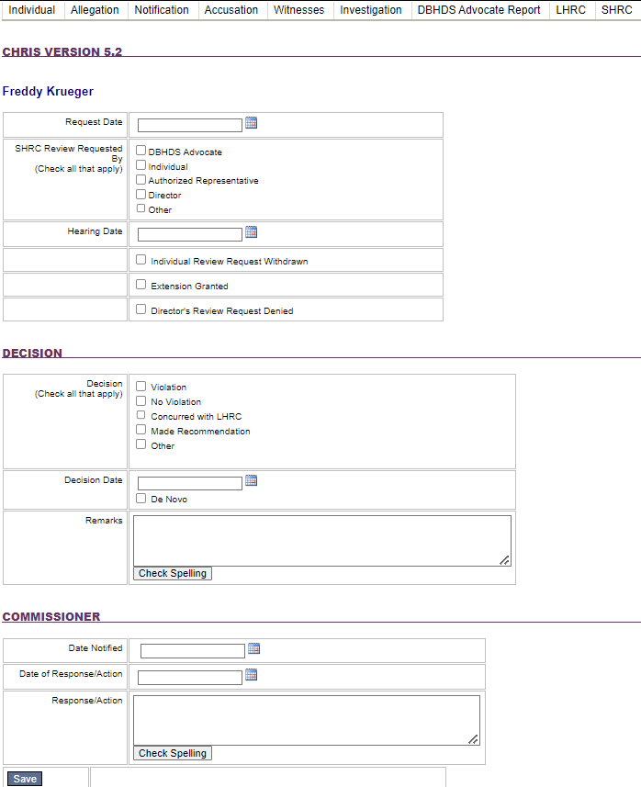
State Human Rights Committee (SHRC) Tab
Thor Odinson
The Advocate completes this tab when an SHRC request/review is requested (via appeal of LHRC decision), noting the following:
Date the SHRC review/hearing was made
Whom made the SRCH review/hearing request
The date of the hearing
  *Or if the review/hearing request was withdrawn, denied, or an extension granted it will be selected
Decision: The SHRC decision, the decision date, and remarks from the hearing will be noted here.
Commissioner: notification, date of response, or actions/remarks will be noted here.

Slide 43
Entering Complaints

Slide 44

Entering Complaints
Select one
*You must select a record search type to access ability to enter existing case numbers or name

Slide 45
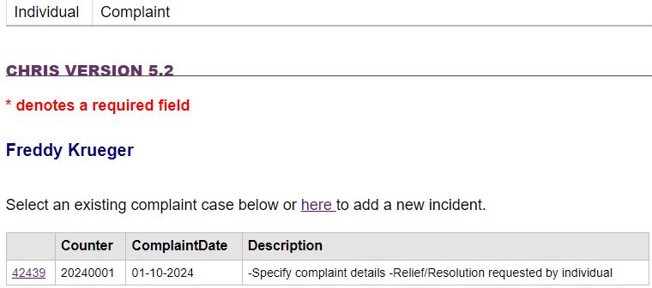
Complaint tab
Next: Click the “Complaint Information” Tab:
Next: Click the “Complaint” Tab:
Thor Odinson
On the “Complaint” tab, any existing cases for the individual will be shown
  Add updates by clicking the hyperlink to an existing case in CHRIS
  New incidents can also be added by clicking the hyperlink stating “here to add new incident”

Slide 46
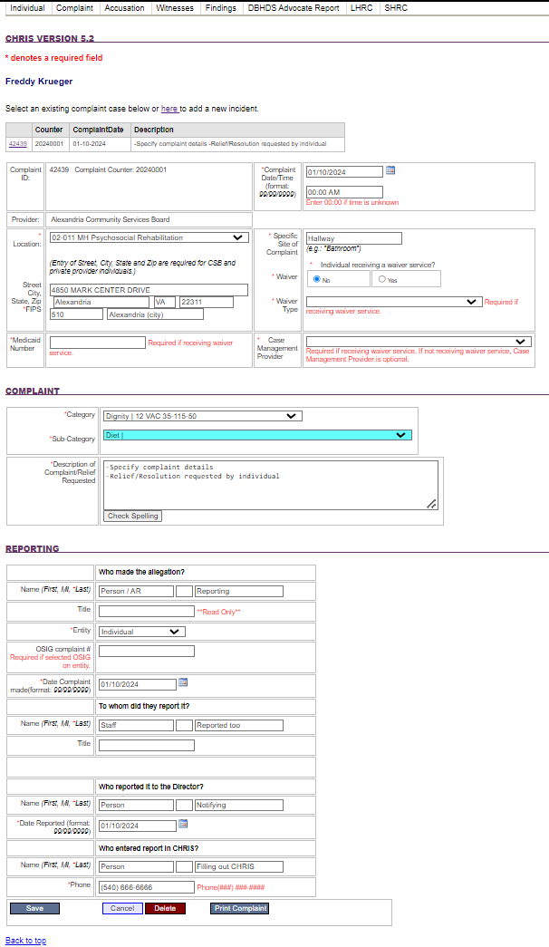
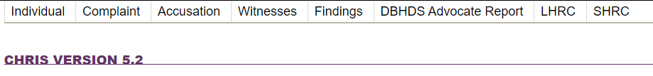
Complaint tab
1
Complaint overview
2
Complaint type
3
Persons Reporting / Reporting “trail”

Slide 47
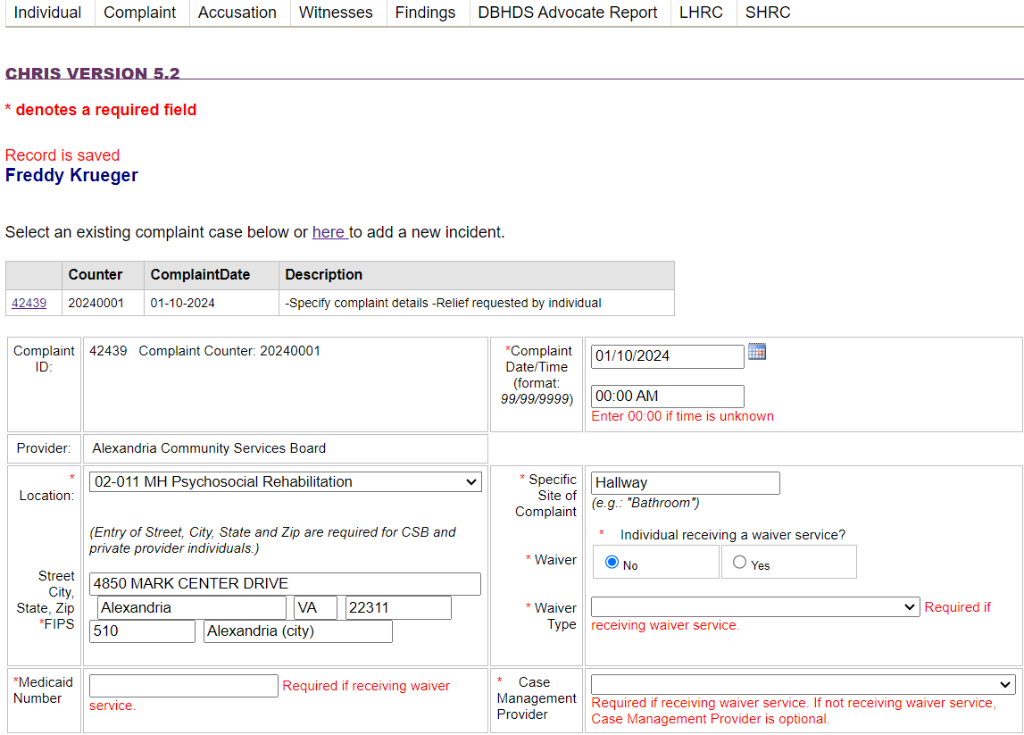
Complaint tab
1
Complaint overview
Cases previously entered will appear at the top along with the ability to enter a new complaint
To access a previously entered case click the complaint ID hyper link
  Enter the complaint Date/Time
    If time is unknown enter “00:00”
The Provider will auto populate from location selected previously.
  Specify the setting where the complaint was alleged to occur.
DD waivered individuals will require additional information: Wavier type, Medicaid #, and Support Coordinator Provider CSB name
Thor Odinson

Slide 48
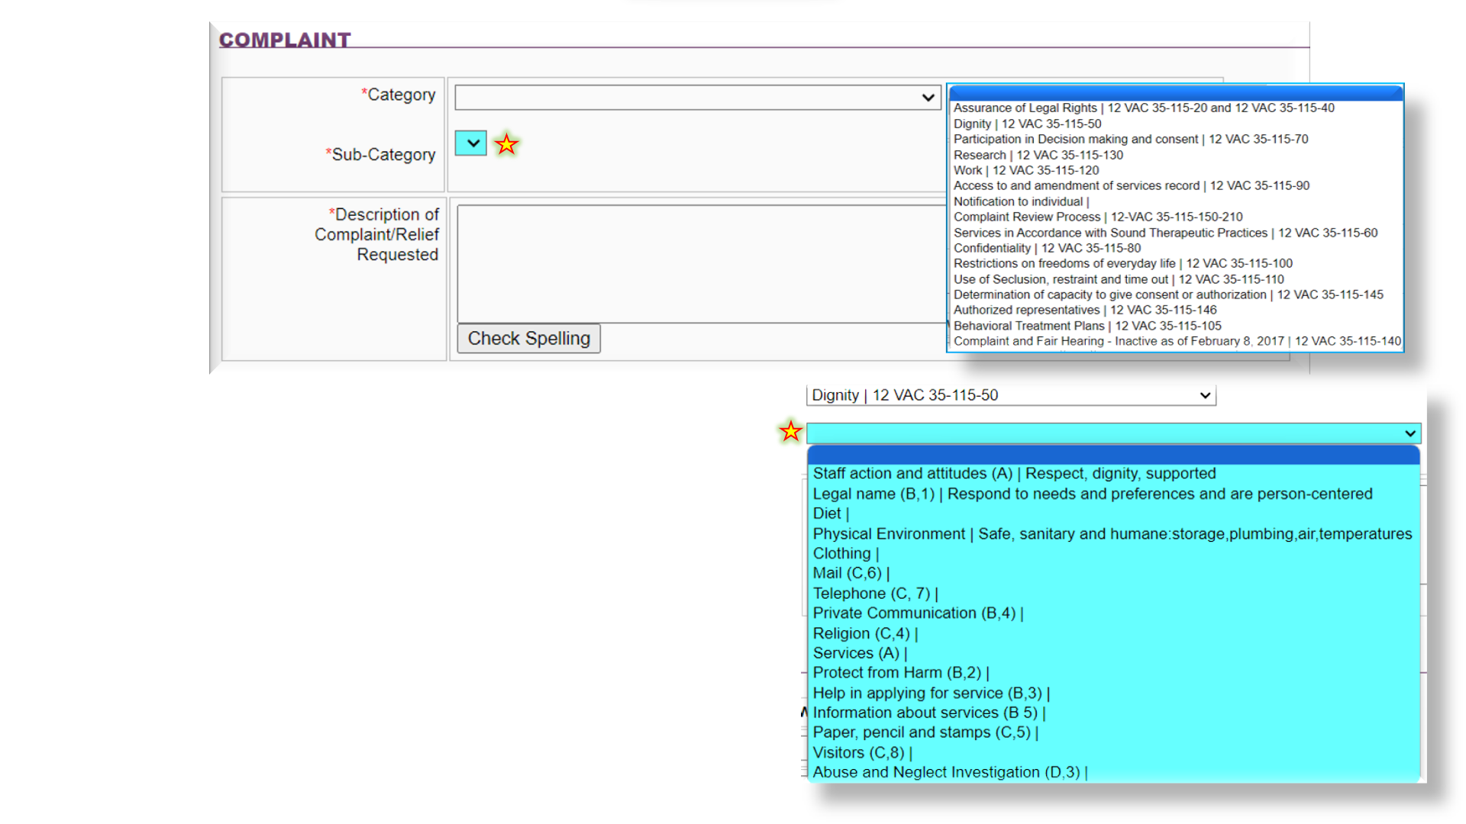
Complaint tab: Complaint Section
2
Complaint type
Category: Select the complaint type. The corresponding regulation accompanies the complaint category.
Sub-Category: access to the sub-categories will only become available based on the category above. The selections will be specified to the category selected.
Description:
  Specify complaint details
  Note relief/resolution requested by individual
    (i.e. what is the individual asking to be done to resolve the concern.)

Slide 49
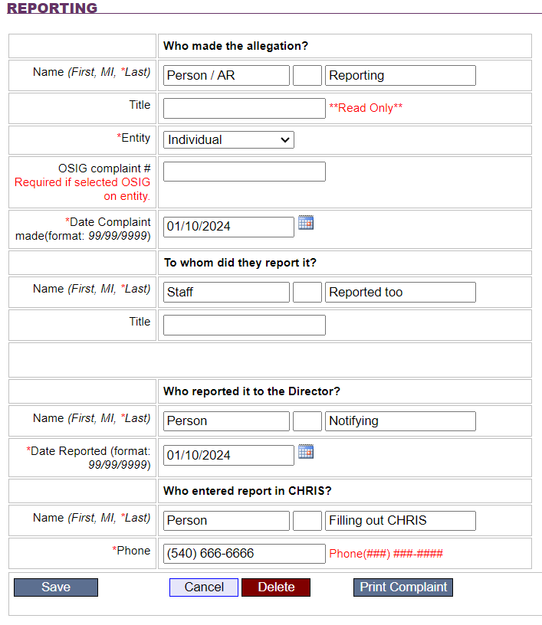
Complaint Tab: Reporting section
3
Reporting: Persons reporting /Report “Trail”
Begin by noting the person making the allegation, followed by their title (if applicable) and “Entity” (i.e. is the person reporting the individual, the parent or the AR, staff, etc.)
Complaints from the Office of the State Inspector General (OSIG) will have a ‘complaint number” associated with the complaint, which must be listed next.
The person to whom and when the allegation was reported is noted next, as well as their title.
Next is noting whom reported the allegation to the Director and date/time when the Director was notified.
Lastly, enter the name and the telephone number for the person entering the information into CHRIS *allegations of ANE discovered in a complaint must be entered in CHRIS as soon as possible, but no later than *24 hrs.
SAVE record – This completes the Accusation Tab

Slide 50
After clicking “Save” for the individual on the Complaint tab, a series of additional tabs will become visible
  *or will already be visible if accessing a previously entered case.
Complaint
Accusation
Witness
Findings
The remaining tabs are for the Advocate to complete. However, Providers may observe entries on these tabs.
DBHDS Advocate Report: progress of the Advocate review of information entered by the provider.
LHRC: Will be completed when appeals to the director decision are made/requested.
SHRC: Will be completed when appeals of the LHRC are made/requested.

Slide 51
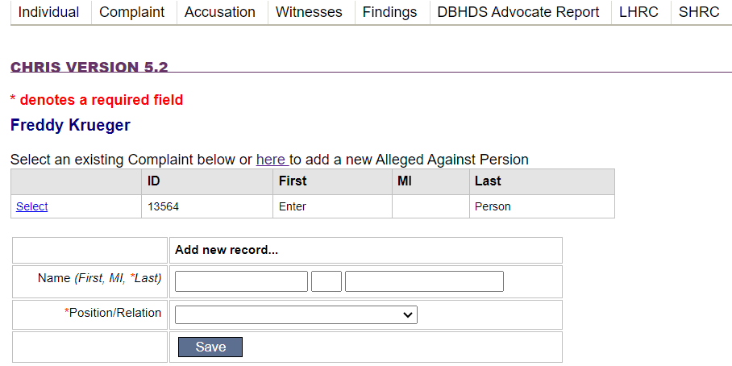
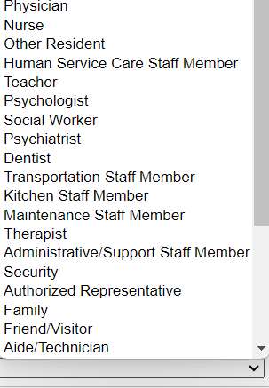
Accusation tab
Enter the name of the person(s) accused and their title/relation to the individual
Select the title/relation from the drop-down menu.
You may enter multiple “alleged against” individuals. Save after each entry.
  Please note that a separate report is required for multiple alleged victims.
This completes the Accusation tab
Thor Odinson

Slide 52
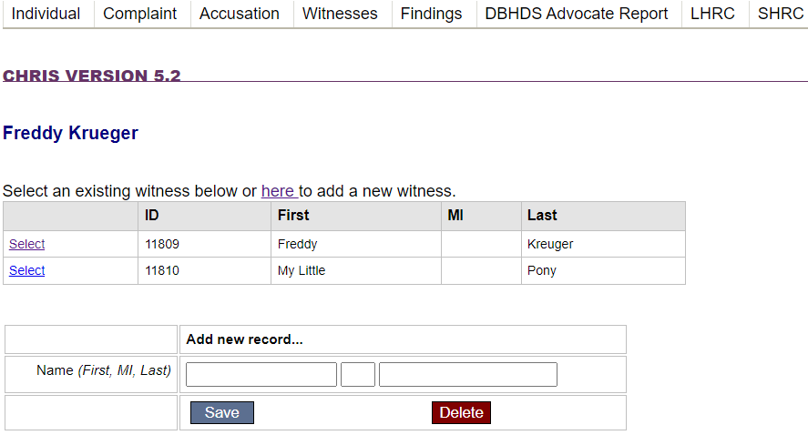
Witness tab
Note any person who was interviewed as part of the investigation here.
Include the alleged victim and the alleged assaulter. on this tab, as they should also be interviewed as part of the investigative process.
Save record - This completes the Witness tab
Thor Odinson
Thor Odinson

Slide 53
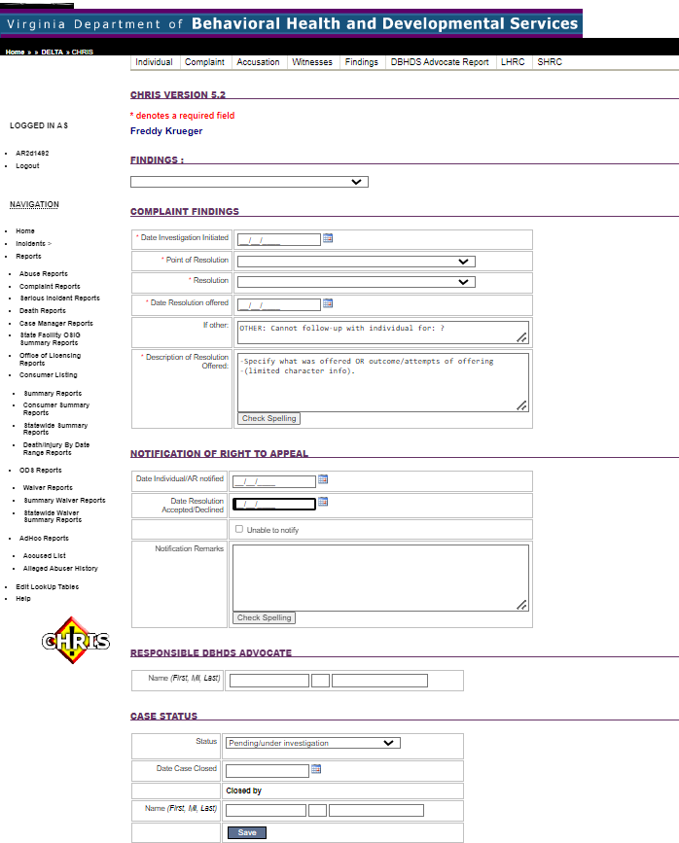
Findings Tab
1
Finding
Complaint Findings
Notification of Right to Appeal
Responsible DBHDS Advocate
2
3
4
5
Case Status

Slide 54

Findings tab: Section 1
1
Findings
Using the drop-down menu, select:
Violation –
  Facts support a violation
No Violation –
  Facts do not support a violation
Other –
  Talk with Advocate if “Other” is felt to need to be chosen
Thor Odinson
Even when the complaint is able to be resolved, that doesn’t mean that there isn’t still a violation initially.

Slide 55


Findings tab: Section 2
2
Complaint Findings
Note the date the investigation was initiated.
Point of Resolution: from the drop-down menu, select “Director” as level complaint was offered (*as shown).
Resolution: from the drop-down menu, select either:
  No Action required (for unsubstantiated complaints)
  Individual accepts resolution.
Use the text field as indicated. The field has limited text capacity – be concise.
**Use the individual’s language where able/appropriate
Discharge from a service does not mean that a complaint cannot still be made or require being entered.

Slide 56


Findings tab: Sections 3, 4, & 5
3
Notification of Right to Appeal
Identify the date the individual or AR (if applicable) was notified of their right to appeal
Identify the date that the resolution offered was accepted
If the individual or AR were unable to be notified select the field to indicate this.
Use the “Notification Remarks” field to indicate how the notification occurred or efforts toward notification if unable to do so.
4
Responsible DBHDS Advocate
Enter the assigned Advocates name, consulted on the investigation.
5
Case Status
From drop-down, Select:
  Pending/Under investigation
Only the Advocate will identify if LHRC/SHRC review is needed in the drop-down menu, or close the case
Save record –Findings tab is complete

Slide 57


DBHDS Advocate Report tab
This tab is only to completed by the assigned Advocate; however, may be observed by the provider.
Thor Odinson
The Advocate will date and select actions or participation taken during the investigation; and describe the actions and participation in the remarks field.

Slide 58

LHRC tab
The Advocate will complete this tab when a LHRC Hearing is needed or requested, noting the following:
  Date LHRC hearing was requested or reviewed
  Select whom requested the LHRC Hearing from the drop-down menu
  Date of the hearing
    (or indicating if the hearing request was withdrawn; or an extension for the investigation was granted)
Decision: The decision of the LHRC will be noted, the date the decision was made by the LHRC, and if there is an appeal of the LHRC decision
Remarks: The Advocate will note remarks pertaining to the hearing or recommendations from the hearing
Thor Odinson

Slide 59

SHRC tab
Thor Odinson
The Advocate will complete this tab when an SHRC request/review is requested (via appeal of LHRC decision), noting the following:
Date the SHRC review/hearing was made
Whom made the SRCH review/hearing request
The date of the hearing
  *Or if the review/hearing request was withdrawn, denied, or an extension granted it will be selected
Decision: The SHRC decision, the decision date, and remarks from the hearing will be noted here.
Commissioner: notification, date of response, or actions/remarks will be noted here.

Slide 60

Considerations in Reporting
DO report the following: | DO NOT report the following:
Only report incidents in CHRIS that are alleged to have resulted in a human rights violation 12VAC35-115, when that complaint is made by an individual receiving services, their surrogate decision maker, or their chosen representative. Individuals can file complaints with or without ANE post discharge from a service. There is no statue of limitations on reporting. Allegations of Abuse, Neglect, and/or Exploitation (ANE) Three (3) or more incidents of peer-on-peer aggression involving the same peers within a seven (7) day timeframe Incidents between peers involving sexual assault Falls that are a result of alleged ANE Injuries that are a result of alleged ANE Improper use of restraints Injury sustained during restraints Deaths which are a result of known (or suspected) ANE Deaths that occur unexpectedly Deaths with “suspicious” circumstances | A review of an incident where there is no complaint, identified pattern, or determination that a human rights violation may have occurred is not reportable to the Office of Human Rights (OHR) in CHRIS. However, these may still be reportable to the Office of Licensing if they meet the definition of a serious incident. Complaints with or without ANE that does not occur during the provision of the provider's service and the alleged abuser is not an employee, contractor or volunteer of the provider is not reportable to the OHR. . Falls that are not result of ANE Injuries that are not a result of ANE Deaths that do not involve ANE or are “suspicious” in nature Expected Deaths Terminal Illnesses Individuals on hospice care

Slide 61

Should a provider require reporting to both OL and OHR, they should enter the OHR report first. The OL Serious Incident Report will have a space to enter the OHR CHRIS Abuse or Complaint Report number(s) in relation to the case.
Reporting to Office of Licensing (OL) and Office of Human Rights (OHR)
OHR
Thor Odinson
Thor Odinson
OL
20240001
20240001

Slide 62

Office of Human Rights Regional Advocate Manager Contacts

Slide 63
Resources and Additional Contacts
OHR Web Page
Resources for
  Individuals
  Licensed Providers
  State-Operated Facilities
Memos, Correspondence & Training
Data & Statistics
OHR Contact information
---
Human Rights Regulations
---
Alonzo Riggins, Training & Development Coordinator
Alonzo.riggins@dbhds.virginia.gov
Jennifer Kovack, Associate Director Community Providers
Jennifer.kovack@dbhds.virginia.gov
Taneika Goldman, State Human Rights Director
Taneika.goldman@dbhds.virginia.gov
Notes:
This last slide provides information about opportunities for you to stay connected with the OHR.
The OHR webpage where we have resources for providers as well as individuals receiving services. In the middle of the slide there is a link to the HRR directly on the LIS website.
Thank you again so much for the invitation and for your attention; in helping us to protect all of our family and friends and neighbors from abuse, neglect and exploitation.

